Slide 1
Year Six Curriculum Information for Parents

Slide 2
Introductions
Mr McCormick – 6M
Mrs. Gyles – 6N
Miss. Newman – 6M & 6N
Ms. Madden – TA
Mr. Heneghan – Monday
Mr. Fuiava - Friday

Slide 3
Aims
Provide clarity for class splits
Give you a better understanding of your child’s learning this term
Share expectations
Help parents/carers to feel empowered to support their children
Give you the opportunity to ask questions

Slide 4
Expectations
In Year 6, we are preparing students for secondary school by expecting them to show: independence, organisation, time management, strong work ethic, respectful of themselves and others.
Smaller class sizes and a 3rd teacher to maximise learning and progress for all children. Therefore children are expected to make the most of this valuable opportunity by showing the Christian values at all times.
The groups will change throughout the year in order to maximise learning potential and meet individual needs.

Slide 5
Behaviour
Our school Christian values and 4 school rules are to show love, service, respect and courage.
We are using a restorative justice approach - behaviour management focuses on the offender accepting responsibility for their behaviour and critiquing it; recognising the impact on others and actions that can be taken to restore relationships
Home school agreement

Slide 6
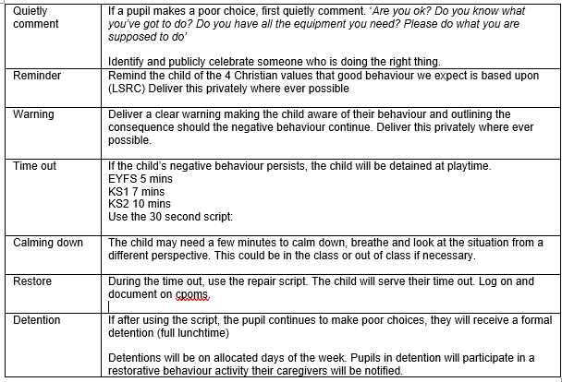
Behaviour
Restorative justice process

Slide 7
Phase 3 Behaviour
If your child has 3 time outs in one day, they will earn a formal detention - you will receive a slip home notifying you in writing.
3 time outs in 1 half term, you will receive a slip notifying you in writing.
6 time outs in 1 half term, you will receive a phone call from class teacher.
9 time outs in 1 half term, you will be invited to meet with class teacher to discuss behaviour plan.

Slide 8
Phase 3 Rewards
House points for house championships
Phase Achievement Assembly:
- Arc awards
- certificates
Values record:
- new to Phase 3
- to earn a ‘half termly treat’
- reward for individuals showing exceptional behaviour and showing 4 house values

Slide 9
Homework - Reading
At least 20 minutes daily
Signed reading record - Date, title and pages read, written by your child
Discussion about the text
Discuss new vocabulary
Reading around the word to provide context/meaning
Checking for understanding
Predicting
Inference and deduction
Intonation and expression

Slide 10
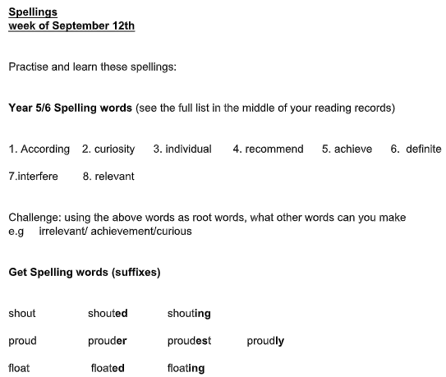
Homework - spellings
High frequency words
Spelling rules
Test on Friday
Now set on Friday

Slide 11
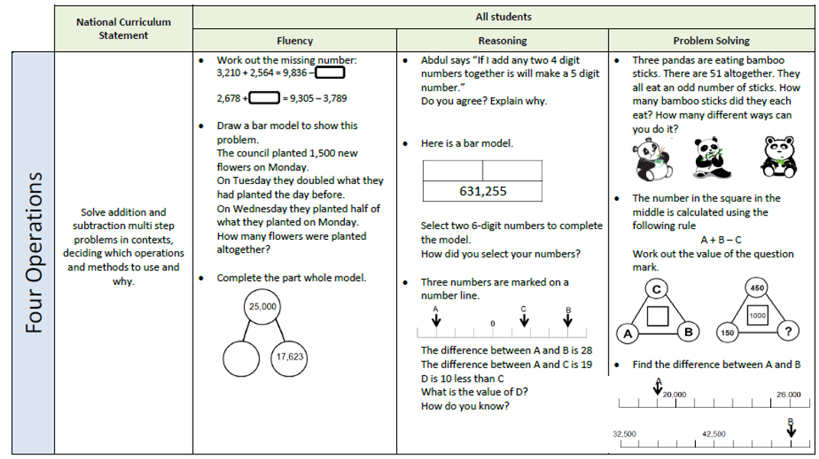
Homework - Maths
Maths questions progressively get harder from fluency to problem solving.
Reviewed on Friday

Slide 12
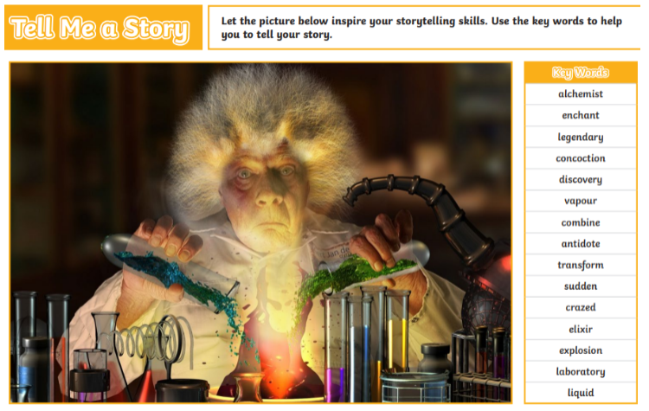
Homework - writing
10 minute writing activity at school set on Friday
Children to extend, edit and up-level with an adult (where possible)
To share/celebrate in class on Friday

Slide 13
Weekly Timetable

Slide 14
The Core Subjects- Mathematics
Progression shown year-by-year – revisiting key areas.
This term: Place Value, Number Operations, Fractions.
All pupils will participate in additional 15 minute maths fluency throughout the week.
Children will complete weekly arithmetic practise.
Pupils across all year groups will complete end of unit/termly reasoning and arithmetic papers from the White Rose scheme (providers of our maths curriculum planning).
Skills are developed, working towards mastery: fluency – reasoning – problem solving as mirrored with weekly homework.

Slide 15
Maths Overview – White Rose

Slide 16
The Core Subjects- English
Revision of skills to consolidate previous learning. For example in writing: use a wide range of punctuation, precise vocabulary choice for the intended piece, used verb tenses correctly and to write effectively for a ranges of purposes and audiences.
For example in reading: refer to text to support opinions /predictions, give a view about a choice of
vocabulary, structure, appreciate how a set of sentences has been arranged
to create maximum effect, explain how a writer has used sentences to
create particular effects.
This term we have been studying: Picture Book, Personal Narrative

Slide 17
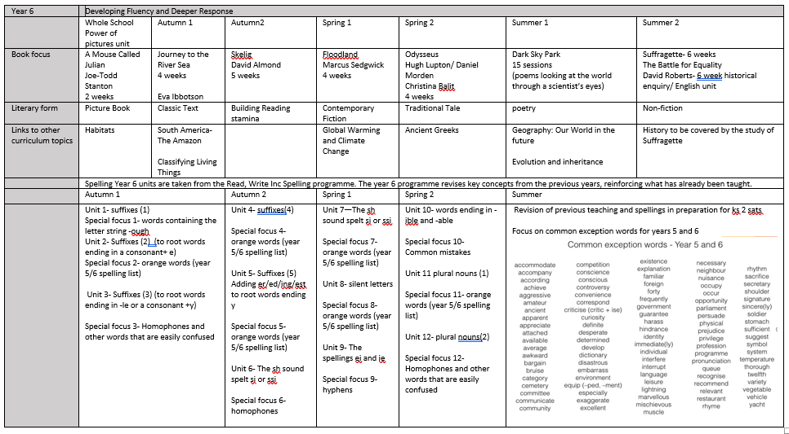
English Overview

Slide 18
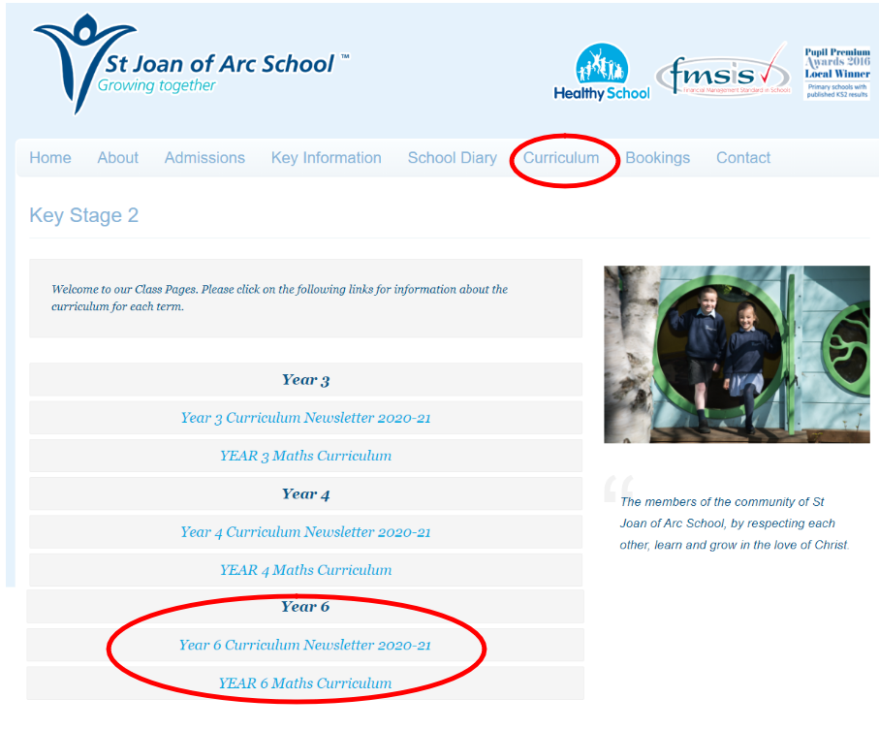
Curriculum Overview

Slide 19
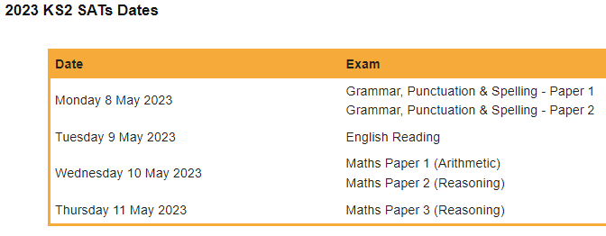
KS2 SATS
Reading: 60 minutes SPAG: spellings and grammar Maths: 3 papers (1 arithmetic, 2 reasoning)
Writing: teacher assessed

Slide 20
Activity Week
We are pleased to announce that Activity Week can take place this year. The children will be offsite for 4 days, taking part in teambuilding challenges.
We are hoping this will take place on the penultimate week of the summer term (10th July) however we are awaiting confirmation. More information to follow.

Slide 21
Date for your Diaries
Parent Conferences – 18th-19th October (Tues & Wed)
Year 6 Assembly – 3rd November (Thursday)
Christmas Performance – 14th December (Wed)

