Slide 1
Year Four Curriculum Information for Parents
Notes:
Jess

Slide 2
Contents
Introduce the staff
Daily routines
Behaviour expectations
Homework
Curriculum:
Core subjects
Foundation subjects
Notes:
Jess

Slide 3
Year 4 Staff
4I - Miss Thomas (Mon-Weds) & Mrs Rawlings (Weds-Fri)
4J – Miss Williams
Mrs Convey & Miss Astronomo
Notes:
All introduce

Slide 4
Daily Routines
Soft start from 8:15 am
School day begins at 8:30 am
Pupils complete maths activities, handwriting, times tables tasks or 1:1 reading
Emphasis on personal organisation:
Changing reading books independently
Belongings: all to be labelled
Personal responsibility for record books and homework book
Notes:
Jess

Slide 5
PE
Children will have PE twice a week, on a Wednesday and a Thursday
Please come dressed in your PE kits
Please make sure PE uniform is in line with the school uniform guidance
Notes:
Jess

Slide 6
Behaviour Policy – Restorative Justice
Quietly comment
Reminder
Warning
Time out
Calming down
Restore
Detention
Notes:
Jess

Slide 7
Christian Values
Notes:
Jess

Slide 8
Behaviour Expectations
The Standards are:
• For pupils to show a respectful attitude to prayer
• To always try their best
• To respect everyone, their rights, belongings and feelings.
• To listen to teachers and follow their instructions
• To do their homework as well as they can, and on time
• To wear the school uniform appropriately and neatly
In year four:
House points
Arc Awards
Marble jar (whole class reward)
Weekly certificates at phase assembly each Thursday
Values chart for half-termly phase treat/trip (special privilege)
Notes:
Jess

Slide 9
Homework - Reading
At least 15 minutes daily, aloud to an adult or silently
Signed reading record daily, child can write comment and parent can sign off (comments are really helpful)
Discussion about the text
Sounding out
Reading around the word
Checking for understanding
Predicting
Inference and deduction
Intonation and expression
Notes:
Brenda

Slide 10
Reading Records
National Curriculum statements at front
Signed off by teacher/teaching assistant during guided reading
When necessary, next steps may be highlighted
Ideas for home reading and spelling are in the middle of the reading record
Notes:
Brenda

Slide 11
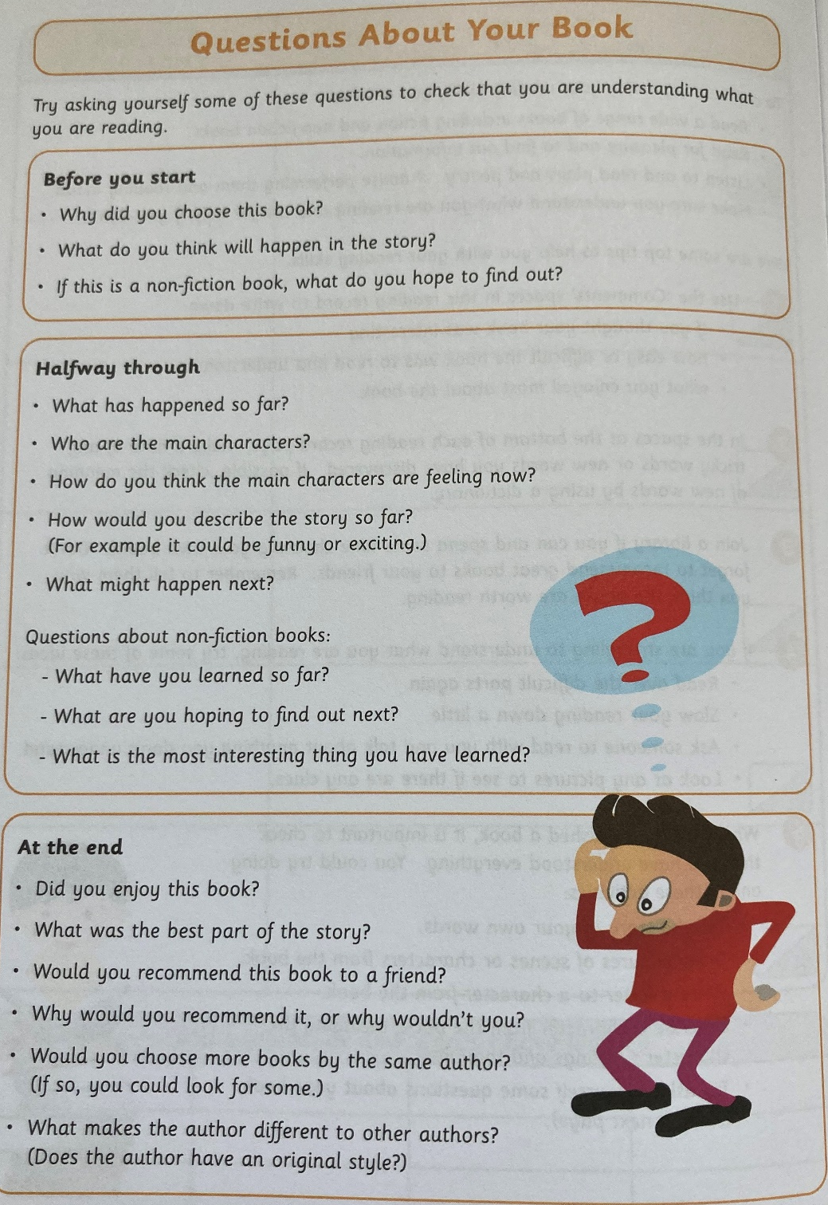
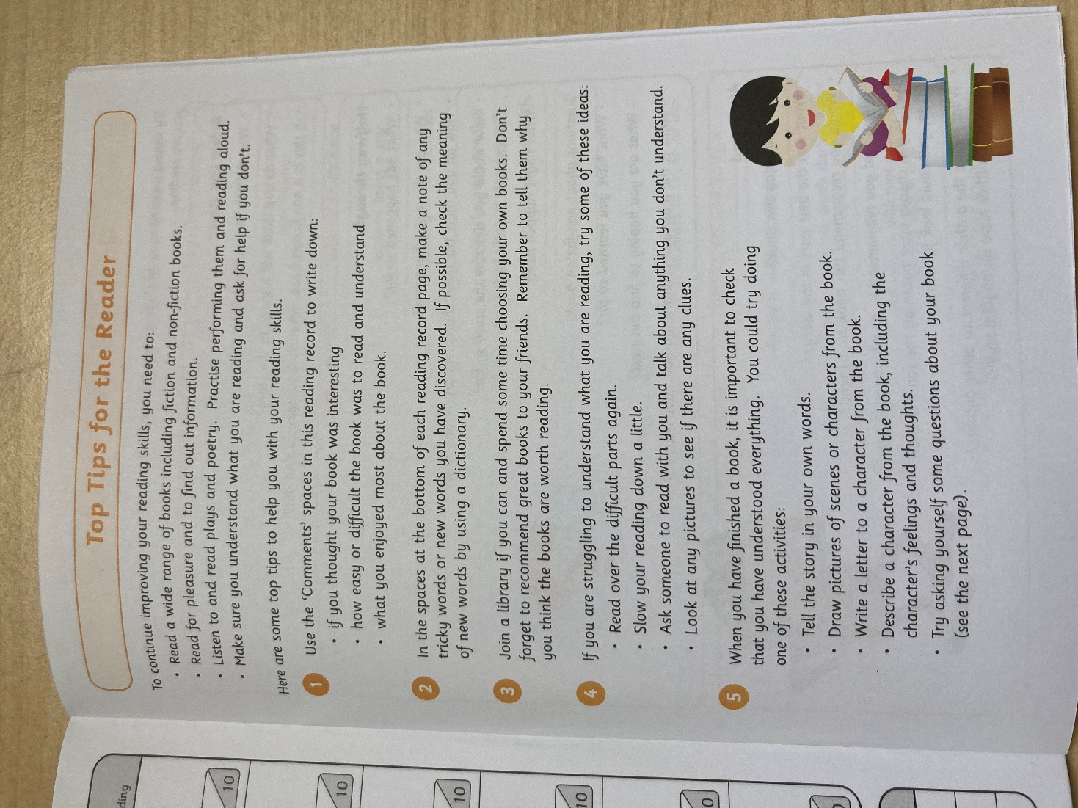
Notes:
Brenda

Slide 12
Homework - Spellings
Common exception rules: everyday words that break the phonic rules
Spelling rules
Examples given
Research other words that follow the rule
Notes:
Brenda

Slide 13
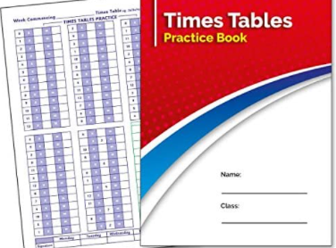
Homework - Maths
Maths homework can be viewed online on GC and answers can be written out in pink books
This will be reviewed in Friday’s lesson. (Not to be submitted on GC)
Times Table Log Book (daily) and Times Table Rockstars
Notes:
Brenda

Slide 14
Year 4 Curriculum
The National Curriculum gives sets out the statutory requirements of the Year 4, 5 and 6 curriculum. Progress across all of Key Stage 2 is assessed in the end of Year 6 tests.
Year 4 pupils will sit an online, timed test of their times table knowledge - 25 questions, 12 x 12. This is a statutory requirement.
Notes:
Brenda

Slide 15
Mathematics
We use the White Rose for Maths
All pupils will participate in additional 15 minute maths fluency sessions in addition to the hour long daily maths lesson.
Children will complete weekly arithmetic practice.
Pupils across all year groups will complete termly reasoning and arithmetic papers from the White Rose scheme (providers of our maths curriculum planning).
Pupils across all year groups will complete termly reasoning and arithmetic papers from the White Rose scheme (providers of our maths curriculum planning).
Notes:
Brenda

Slide 16
Year 4 Maths Objectives
Core skills:
Recall all multiplication facts to 12 x 12, and solve problems involving multiplication.
Round numbers to the nearest 10, 100. 1000 & decimals with 1 decimal place to nearest whole number.
Count backwards through zero
Read Roman numerals to 100.
Add/subtract up to 4-decimal places using formal written methods of addition/Sub.
Divide a 1 or 2-digit number by 10/100 & multiply 2 & 3-digit by a 1-digit number.
Compare and classify geometrical shapes.
Know that angles are measured in degrees and can identify acute and obtuse angles.
Measure/calculate perimeter of reg. shape
Read, write and convert between analogue and digital 12 and 24 hour times.
Notes:
Brenda

Slide 17
English
For English, we draw on a variety of planning resources, we use the CLPE teaching units and Read Write Inc spelling resources.
Children will focus on creating, editing and continually reviewing and improving their writing
Opportunities for digital publishing
Whole class reader sets so that children can participate in whole class together. Children will revisit these at regular intervals across the week
Each child will participate in Guided Reading weekly
Handwriting three times a week in class – big focus on presentation in the curriculum
We will be using teacher judgements and Oxford Reading Buddy assessments to assess the children’s reading, we will no longer be benchmarking the children.
Notes:
Antonella

Slide 18
Year 4 English Objectives
The overarching aim for English in the national curriculum is to promote high standards of language and literacy by equipping pupils with a strong command of the spoken and written word, and to develop their love of literature through widespread reading for enjoyment. The national curriculum for English aims to ensure that all pupils:
read easily, fluently and with good understanding
develop the habit of reading widely and often, for both pleasure and information
acquire a wide vocabulary, an understanding of grammar and knowledge of linguistic conventions for reading, writing and spoken language
appreciate our rich and varied literary heritage
write clearly, accurately and coherently, adapting their language and style in and for a range of contexts, purposes and audiences
use discussion in order to learn; they should be able to elaborate and explain clearly their understanding and ideas
are competent in the arts of speaking and listening, making formal presentations, demonstrating to others and participating in debate.
Notes:
Antonella

Slide 19
English Curriculum
Year 4 | Developing Fluency and Deeper Response
 | Whole School Power of pictures unit | Autumn 1 | Autumn2 | Spring 1 |  | Spring 2 | Summer 1 | Summer 2
Book- focus | A Mouse Called Julian Joe-Todd Stanton 2 weeks | The Great Kapok Tree 3 weeks Lynne Cherry | The Rhythm of the Rain Grahame Baker-Smith 6 weeks | Werewolf Club Rules- Joseph Coelho- 3 weeks | Fly Eagle Fly- An African Tale Retold by C Gregorowski 3 weeks | Leon and The Place In Between Angela Mc Allister 4 weeks (or Arthur and the golden Rope 5 weeks) | The Wild Robot Peter Brown 6 weeks | African Tales 4 weeks Gcina Mhlophe
Literary form | Picture Book | Non-fiction | Picture Book | Poetry | Reflecting Realities | Contemporary fiction | Building Reading Stamina | Traditional Tales
Links to other curriculum topics | Habitats | Geography: The Americas Science: Living Things | History: The Ancient Egyptians (the Nile River) Science: Looking at States | Geography: Rivers and the River Cycle. Science: Brilliant Bubbles |  | History: Roman Britain Science: Teeth and Eating | Geography: Earthquakes and Volcanoes Science: What’s that sound? | Knowledge of Africa linked to earlier learning (Ancient Egypt/ Fly Eagle Fly)
Writing and performance outcomes | Writing and producing own picture book | Poetry Performance of a poem Explanation text Debate Report writing Writing in role Argument writing Making a visual text Note of advice Playscript Extension of a narrative | Plan writing by discussing writing similar to that which they are planning to write, learning from its structure, vocabulary and grammar. Draft and write by composing and rehearsing sentences orally; In narrative create settings, characters and plot; Develop creative and imaginative writing by adopting, creating and sustaining a range of roles. | Poetry performance, , Text marking Drafting, redrafting and writing poetry | Poetry, thought bubbles, Letters in role, Narrative from a character’s perspective. | Writing: (Transcription / Composition) Plan writing by discussing writing similar to that which they are planning to write, learning from its structure, vocabulary and grammar Draft and write by composing and rehearsing sentences orally In narrative create settings, characters and plot Develop creative and imaginative writing by adopting, creating and sustaining a range of roles | Writing: (Transcription/Composition) Plan writing by discussing writing similar to that which they are planning to write, Discuss words and phrases that capture readers’ interest and imagination Draw inferences about characters’ feelings, thoughts, emotions and actions learning from its structure, vocabulary and grammar Draft and write by composing and rehearsing sentences orally In narrative create settings, characters and plot Develop creative and imaginative writing by adopting, creating and sustaining a range of roles | Writing in role Diary writing Newspaper writing Persuasive writing Letter writing
Notes:
Antonella

Slide 20
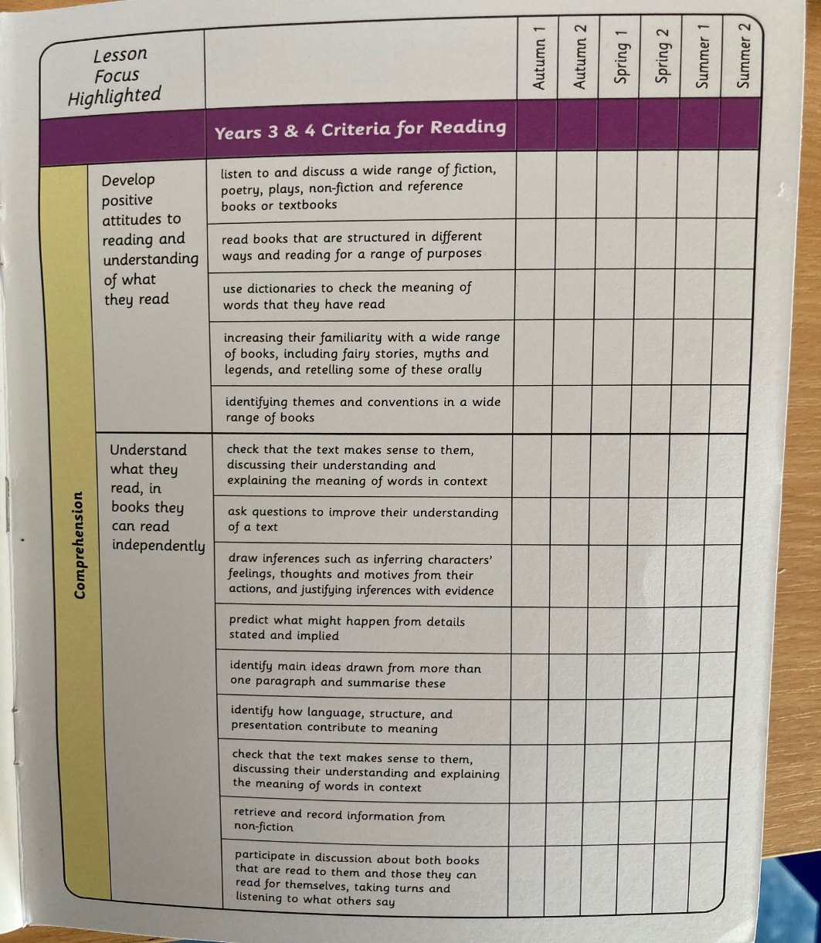
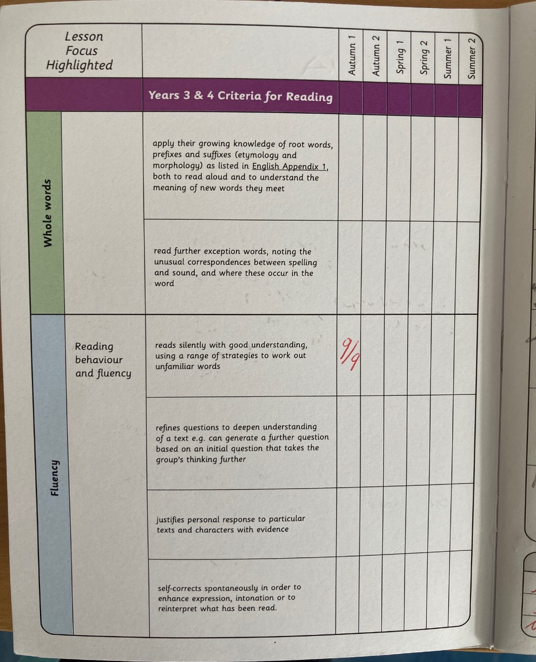
Reading
Notes:
Antonella

Slide 21
Oxford Reading Levels
Children will now have a numbered level rather than a colour band. This will mean the children will have a very specific text matched to their reading level and will have access to a range of online books and resources on Oxford
Reading Buddy.
Notes:
Antonella

Slide 22
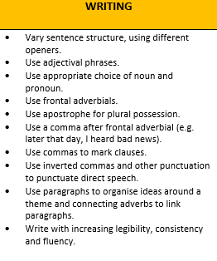
Writing
Notes:
Antonella

Slide 23
Punctuation and Grammar in Year 4
Notes:
Antonella

Slide 24
Other Subjects
Foundation subjects are taught in half termly blocks
Foundation subjects (Music/Spanish, Computing, Art and History) will be taught across Year 3/4 subject specialist teachers. To be reviewed half-termly
Singing assembly takes place on a Friday afternoon
All children have a weekly half- hour music lesson with Mr Owen
A topic related trip will take place offsite and we will provide more details on this at a later date
Notes:
Antonella

Slide 25
Humanities
Notes:
Antonella

Slide 26
Religious Education
Whole school assembly on Mondays
Year 4/5/6 Assembly on Thursdays celebrating achievements
Masses – Check school diary
Year 4 Mass- Class J – Ash Wednesday (22nd February 2023)
- Class I - St Patrick’s day (17th March 2023
Notes:
Jess

Slide 27
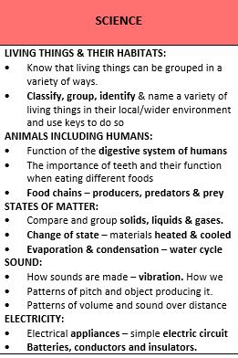
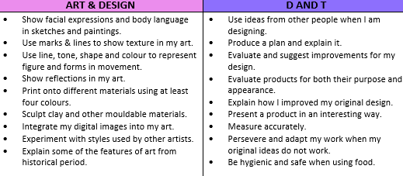
Science, Art and DT
Notes:
Jess

Slide 28
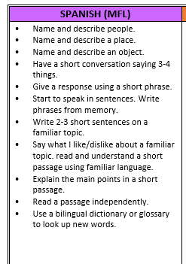
Music, PE and Spanish
Perform a simple part rhythmically. Sing songs from memory with accurate pitch. Improvise using repeated patterns. Use notation to record and interpret sequences of pitches. Use notation to record compositions in a small group or on my own. Explain why silence is often needed in music and explain what effect it has. Identify the character in a piece of music. Identify and describe the different purposes of music.
Notes:
Jess

Slide 29
Computing and Online Safety
Notes:
Jess

Slide 30
Relationships and Health Education
Similarities and differences between people as they grow.
Creating community
Self-confidence comes from being loved not status
Respecting our bodies through what we wear, eat and physically do.
How emotions (include hormonal effects) change our feelings but are not always a good guide for actions
Who are our trusted people?
Looking after our emotional well-being- thankfulness builds resilience
How media images do not always reflect reality
Life cycles- handmade by God with the help of their parents- how a baby grows in the womb
Humans experience life on a physical, psychological and spiritual level
Ways to develop good, trusting relationships where friend s what is truly best for each other
Bullying, cyber-bullying, harassment and exploitation. Why these are harmful behaviours and how to respond to them
How to stay safe online and recognise that too much use of technology can affect us negatively
How to report and get help I they encounter inappropriate materials or messages
To know what physical contact is acceptable and unacceptable
Changing Bodies; the changes that take place in the male and female bodies during puberty
The correct names of body parts, including genitalia
To know that medicines are drugs and that alcohol and tobacco are harmful substances
First aid- basic knowledge / remaining calm and taking quick action
Notes:
Jess

Slide 31
Google Classroom
The children’s homework will be posted each week onto the classroom feed (Friday to Friday)
Maths/ Times tables tasks will be posted too
We will also use the GC for computing sessions and interactive Geo/History lessons
Log- ins for GC, Oxford Reading Buddy and Times tables rock stars are all the same
For GC, add @g.st-joanofarc.islington.sch.uk after the 206
Notes:
Brenda

Slide 32
Dates for your diaries
Year 4 Special Assembly Thursday, December 1st
14th December Year 4, 5 and 6 Carol service
Notes:
Brenda

Slide 33
Thank you for taking the time to read this information.
We look forward to working with you!
Notes:
Brenda

