Slide 1
Year 1 Curriculum Information for Parents
Welcome
Class C:
Miss Nicou
Ms Francis
Class D:
Miss O’Connor
Ms Nel
Ms. Squire is shared across the year group.

Slide 2
Aims
Give you a better understanding of your child’s learning this year.
The school day and classroom routines.
Curriculum coverage.
Help parents/carers to feel empowered to support their children at home.
Give you the opportunity to ask questions.

Slide 3
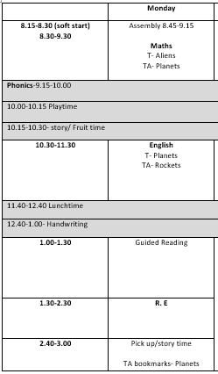
The school day
Here is an example of what a day looks like as a year 1 child.
On a Monday the children come in and independently change their guided reading books, book bag books and book corner books.
On a Friday the children will bring back their math's homework, we go through it as a class and then they are given the next week’s homework.

Slide 4
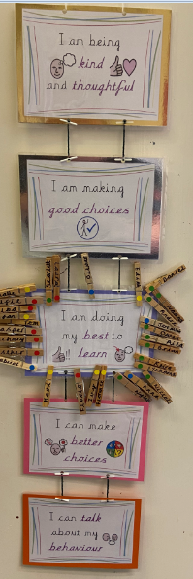
Behaviour
As you know we have reviewed the schools behaviour policy this year.
You have all received a copy and signed it.

Slide 5
Behaviour

Slide 6
Behaviour
Certificates are also awarded for demonstrating the school ethos and/or fantastic work during our Phase assembly (years 1,2 and 3) on a Wednesday afternoon.

Slide 7
Curriculum
For English we follow a scheme that promotes the power of reading. We will look at a number of lovely picture books in lots of detail throughout the year.
Daily phonics sessions RWI
Guided reading with T and TA
1:1 reading
Story time – promote a love for reading

Slide 8
Phonics: what is RWI?
A reading and writing programme, which is based on the teaching of synthetic phonics
Aims to get children reading fast, by having a secure phonic knowledge and being able to read and spell words
Links phonics, reading, spelling, handwriting and writing
The children are securing their phonics knowledge of speed sound set 1 and 2 learnt in reception before we move onto set 3.
In Year 1: we have 4 sessions a week which are led by either a teacher or teaching assistant, which rotates fortnightly.
Phonics screen check - June

Slide 9
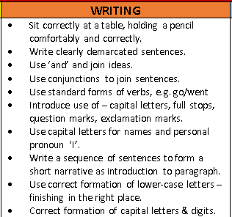
Curriculum
Shared writing
Adult directed writing tasks
Phonic sessions
Encouraging phonetic sounding out of words
Letter formation
High frequency words - bookmarks
Handwriting – three times a week

Slide 10
Handwriting formation
Form lower-case letters correctly
Know and form capital letters
SJA website: handwriting, school script and rhymes

Slide 11
Handwriting formation

Slide 12
Curriculum
Whole-School Mastery approach – Focusing on secure understanding of key concepts.
Adult led investigations moving towards more independent
Everyday fluency
Using a wide-range of manipulatives (Numicon, bead strings…)
Develop reasoning: “How do you know that? Prove it”
Modelling vocabulary
Maths working wall.

Slide 13
Curriculum
The children pray together at the beginning of the day, lunch time and at the end of the day.
We attend church and celebrate mass at the beginning of each term and on Feast days that fall during the school week.

Slide 14
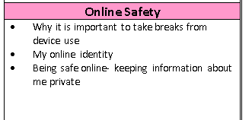
Curriculum
Organised into four Threshold Concepts
Code: This concept involves developing an understanding of instructions, logic and sequences
Connect: developing an understanding of how to safely connect with others
Communicate: involves using apps to communicate one’s ideas
Collect: developing an understanding of databases and their uses

Slide 15
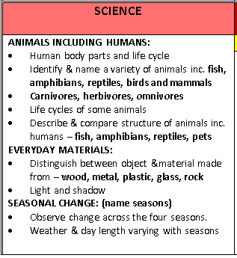
Curriculum
We cover these objectives throughout the year through the following topics-
Who am I – The human body.
Celebrations – light, shadows and materials
Polar adventures – classifying materials
Treasure Island – plants
On Safari – invertebrate animals
Holiday – classify animals

Slide 16
Curriculum

Slide 17
Curriculum
Our topics for geography are –
Our local area
People and their communities
Animals and their habitats
Our topics for history are –
My family history
The greatest explorers
Great inventions
Building on skills and knowledge learnt in reception and forms the foundations of learning to come.

Slide 18
Curriculum

Slide 19
Curriculum
Singing assembly lead by Ms Gallagher – we learn new hymns and other lovely songs.
Music / dance lesson introducing them to rhythm and movement.

Slide 20
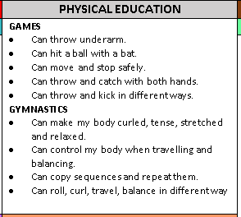
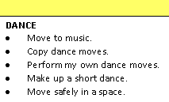
Curriculum

Slide 21
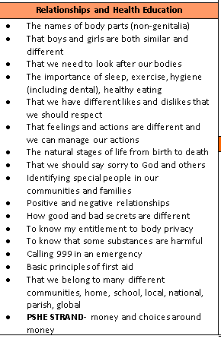
Curriculum

Slide 22
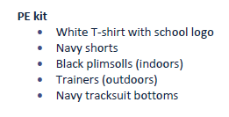
PE days
Please remember to send your child into school in their PE kits on a Tuesday and Friday so they can take part in the lesson.

Slide 23
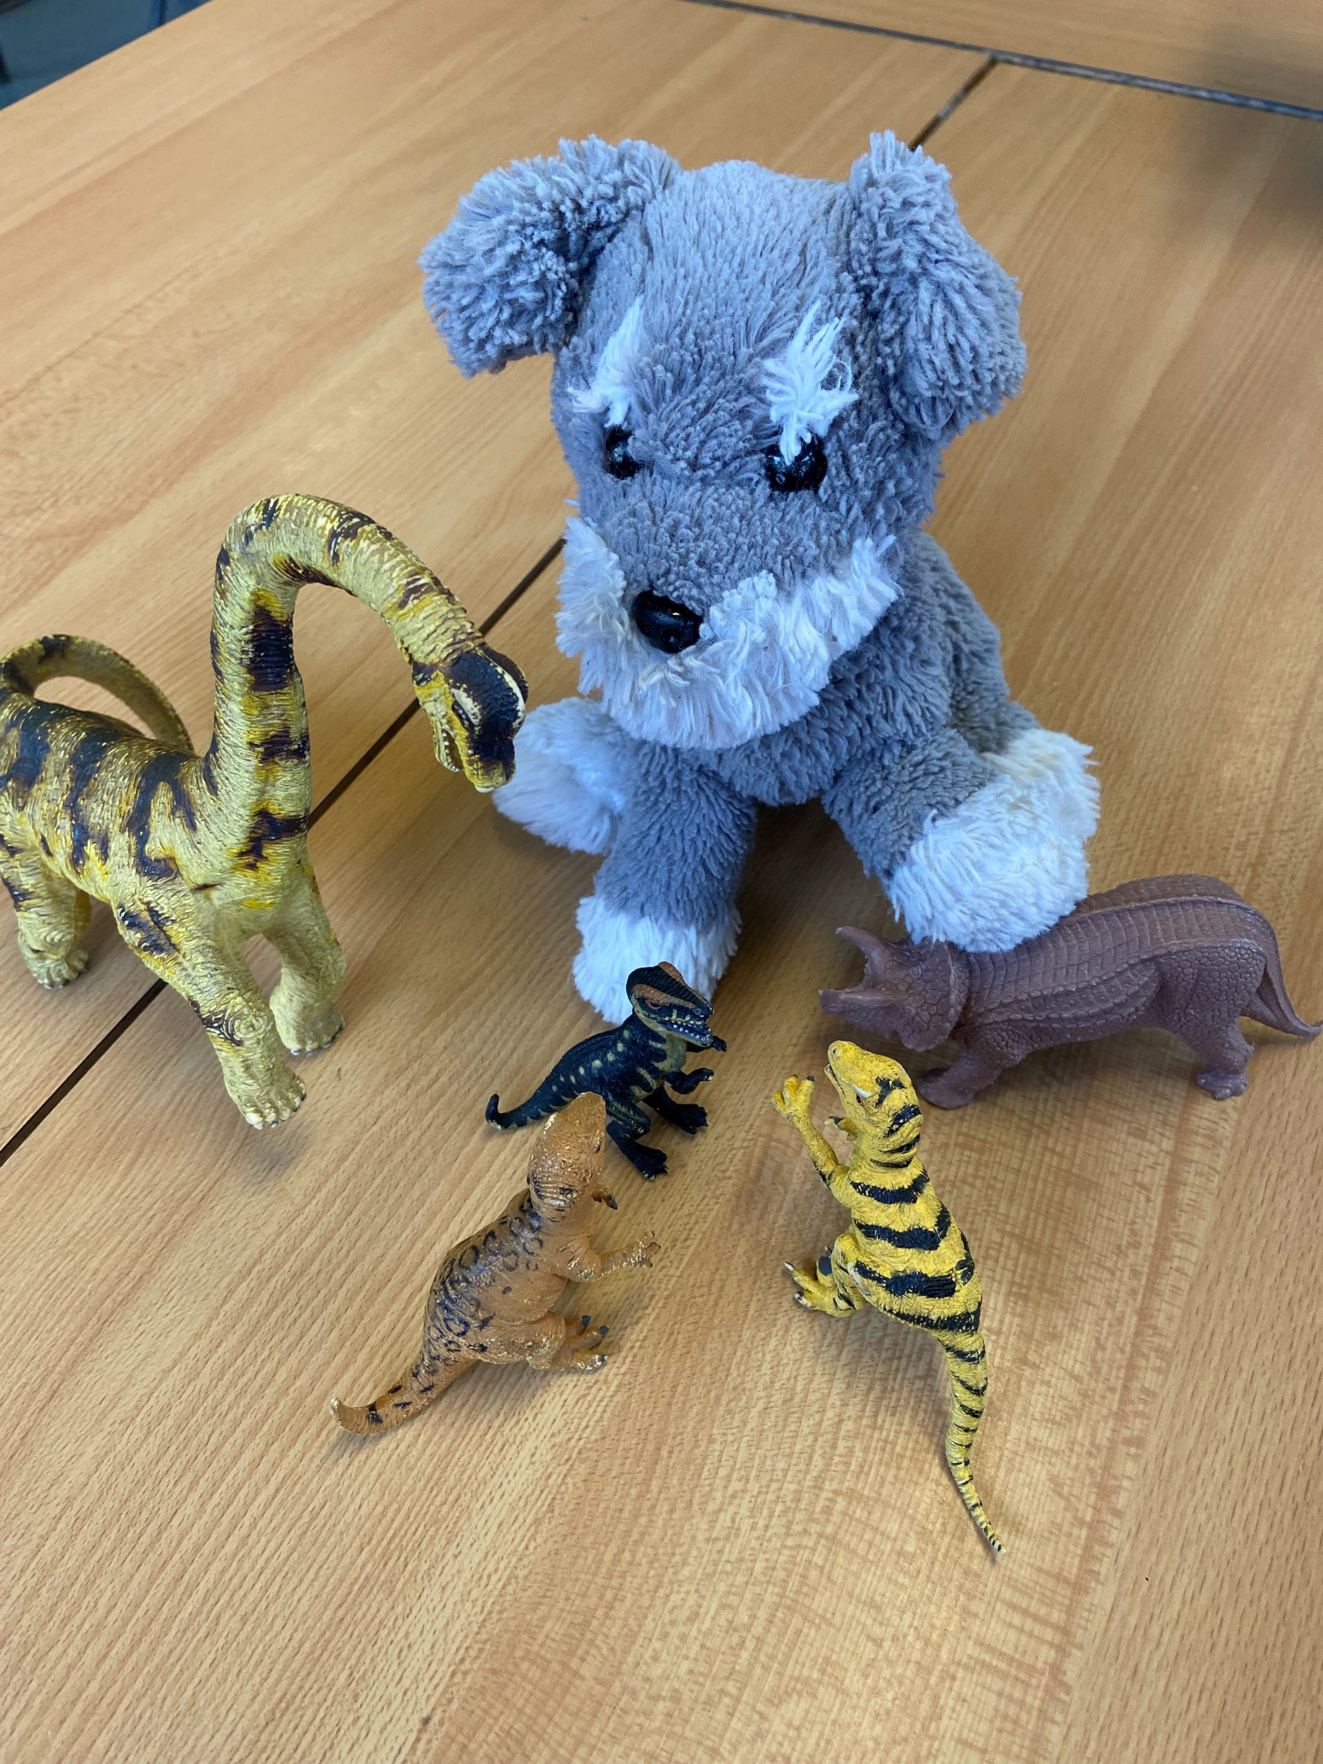
Maths homework
Math's homework will be handed out on a Friday in your child’s green homework folder. As a class we go through the homework the following Friday.
The homework is based on the learning done that week or the previous week in class.
Class pet
Please upload photos and a little caption onto your child’s Google Classroom page by the following Friday so they can enjoy showing their peers.
Danny Dog

Slide 24
Supporting your child at home
Reading at home makes such a difference
Ten / fifteen minutes reading with your child each day – their guided reading book / book bag book / book corner book
Ask questions as well as listening to your child read.
Comment in the Reading Record and ensure you sign it daily

Slide 25
Reading & spelling bookmarks
Year 1 pupil’s have a bookmark with high frequency words to learn to read and spell. This will have continued on from Reception. They will work through these at their own pace, please practise these regularly with your child.
Children should work through their current bookmark but also review previous bookmarks
They will be given five new words once they can confidently read/write their current ones. They will come off book marks when they have completed bookmark 29.
Each child will be checked on throughout the week

Slide 26
Learning resources at home
Your child’s LGfL log-in and google classroom log in are the same and are stuck in the back of your child’s reading record.
Access interactive resources across all areas of learning via free LGfL website

Slide 27
Other matters…
Children should attend school everyday, and there is an expectation that children have a minimum of 96% attendance
Please ensure all clothing and water bottles are labelled
Also ensure your child is wearing the correct school uniform (including jackets/coats – navy blue, grey or black and shoes not trainers)
Please help your child at home by encouraging them to dress and undress themselves, put on their own coats and zip them up
Notes:
Letter with highlighted missing/incorrect items

