Slide 1
Year Six Parents’ Meeting
Thursday 14th September

Slide 2
Introductions
Miss Newman – KS2 manager
Mr McCormick – Maths lead
Mr Heneghan (Mondays in 6N and daily maths)
Mrs Bowden and Mrs O’Donovan support across the cohort

Slide 3
Aims of the meeting
Give you a better understanding of your child’s learning this term
Share expectations
Help parents/carers to feel empowered to support their children
Give you the opportunity to ask questions The comment stream will be open and available for you to ask any questions throughout the presentation.

Slide 4
Expectations
In Year 6, we are preparing students for secondary school by expecting them to show: independence, organisation, time management, strong work ethic, respectful attitude of themselves and others.

Slide 5
Expectations
In Year 6, we are preparing students for secondary school by expecting them to show: independence, organisation, time management, strong work ethic, respectful attitude of themselves and others.
Behaviour policy – comms sent to all families
Restorative justice – the system we use
Home School Agreement – signed and returned

Slide 6
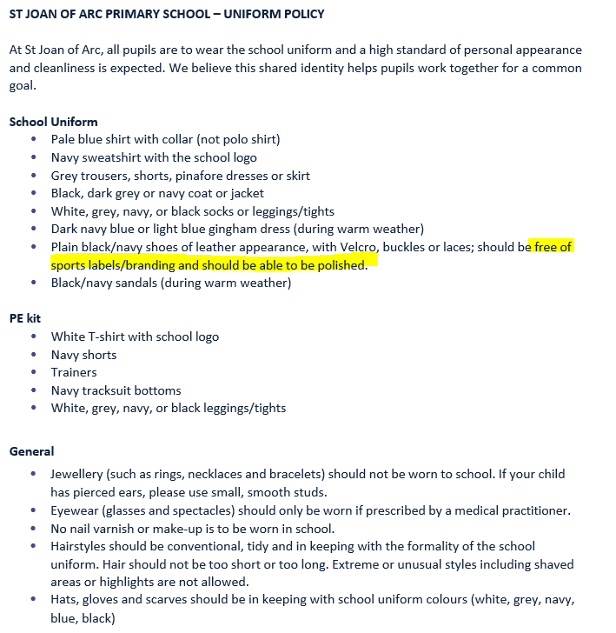
Expectations
Notes:
Uniform – PE kits to be accurate and no trainers with normal school uniforms – even black trainers – policy states that the black shoes should be polish-able

Slide 7
Expectations
If you would like your child to walk home alone, please send in a signed note of permission.

Slide 8
Homework - Reading
At least 20 minutes daily
Signed reading record - Date, title and comment written by your child
Discussion about the text
Discuss new vocabulary
Reading around the word to provide context/meaning
Checking for understanding
Predicting
Inference and deduction
Intonation and expression

Slide 9
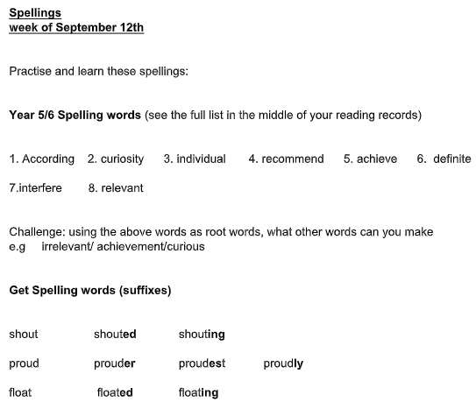
Homework - spellings
High frequency words
Spelling rules
Test on Friday
Now set on Friday

Slide 10
Homework - writing
10 minute writing activity at school set on Friday
Children to extend, edit and up-level with an adult where possible
To share in class on Friday

Slide 11
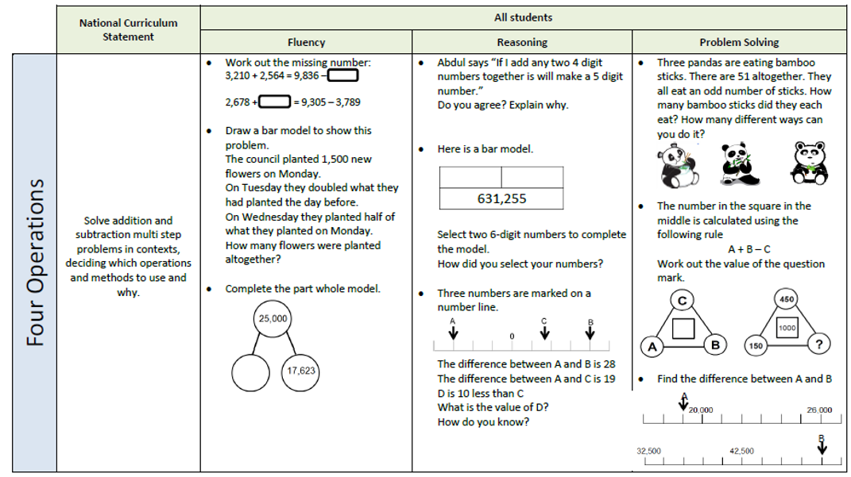
Homework - Maths
Maths questions progressively get harder from fluency to problem solving.
Set on Friday/Reviewed on Friday

Slide 12
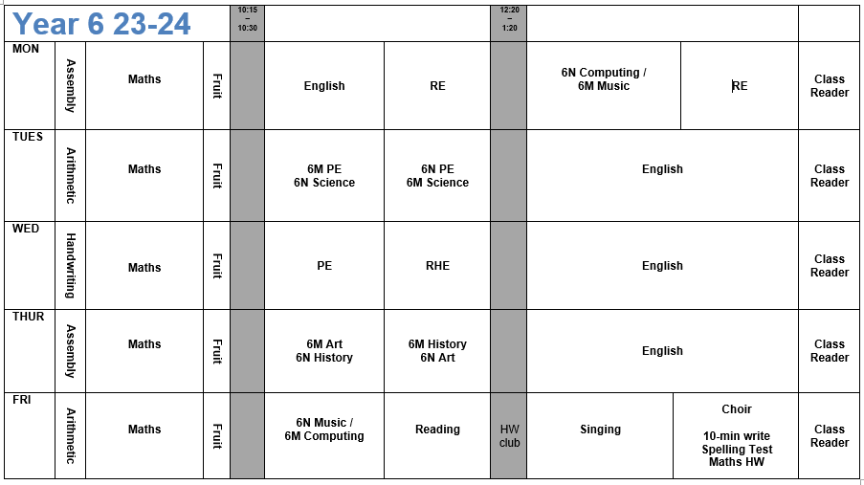
Weekly Timetable

Slide 13
The Core Subjects- Mathematics
Progression shown year-by-year – revisiting key areas.
This term: Place Value, Number Operations, Fractions.
All pupils will participate in additional 15 minute maths fluency throughout the week.
Children will complete weekly arithmetic practise – to be redone at home if extra support necessary.
Pupils across all year groups will complete end of unit/termly reasoning and arithmetic papers from the White Rose scheme (providers of our maths curriculum planning).
Skills are developed, working towards mastery: fluency – reasoning – problem solving as mirrored with weekly homework.

Slide 14
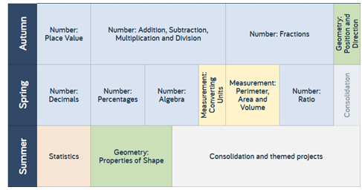
Maths Overview – White Rose

Slide 15
The Core Subjects- English
Revision of skills to consolidate previous learning. For example in writing: use a wide range of punctuation, precise vocabulary choice for the intended piece, used verb tenses correctly and to write effectively for a ranges of purposes and audiences.
For example in reading: refer to text to support opinions /predictions, give a view about a choice of
vocabulary, structure, appreciate how a set of sentences has been arranged
to create maximum effect, explain how a writer has used sentences to
create particular effects.
This term we will be studying: Narrative & Poetry

Slide 16
English Overview
Notes:
In daily English lessons, Year 6 pupils explore a range of texts selected from the Power of Reading units. These books will be studied in depth so that children can immerse themselves in the richness of the texts. These units provide many opportunities to develop children’s reading, writing, oracy, dramatic and artistic skills, as well as enhancing other areas of the curriculum. The units allow children to enjoy the full experience of the text while helping the children to work towards high quality writing production.
Most children in Year 6 will have a firm grasp of the decoding skills required to become increasingly fluent readers. For children not yet secure in this area, they are supported with regular targeted reading intervention. Children are also supported through the use of the Oxford reading buddy programme which ensures children have suitably decodable books to support their reading development.
Pupils learn about grammar and punctuation discreetly and through the analysis of texts. In addition to daily English lessons, pupils will have guided reading at least fortnightly which consolidates the reading objectives they work towards meeting in English lessons. From the spring term, the children will begin to take home weekly spellings to learn. Pupils will also explore several whole class readers across the year. The children are given weekly spellings to learn and have regular taught spelling practice using the Read, Write Inc Year 6 spelling programme.
Year 6 children cover the National Curriculum Programme of Study for English lower Key stage 2 (Years 5 and 6):
https://assets.publishing.service.gov.uk/government/uploads/system/uploads/attachment_data/file/335186/PRIMARY_national_curriculum_-_English_220714.pdf

Slide 17
KS2 SATS
SATS – Reading, Maths, SPAG
13th May 2024
Reading: 60 minutes SPAG: spellings and grammar Maths: 3 papers (1 arithmetic, 2 reasoning)
Writing: teacher assessed

Slide 18
Activity Week
We are pleased to announce that Activity Week will take place this year. The children will be offsite for 5 days, taking part in teambuilding challenges.
We are hoping this will take place at the end of the summer term (1st July) however we are awaiting confirmation. More information to follow.

Slide 19
Date for your Diaries
Wednesday 18th and Thursday 19th October – parents evening
Wednesday 1st November – 9:00 All Saints Day Mass led by 6N
Wednesday 20th December - Christmas carol concert

