Slide 1

Year Six Parents’
Zoom Meeting
Thursday 12th SEPTEMBER

Slide 2
Introductions
Mr. McCormick – 6M
Mr. Shreeves – 6N
Ms. Madden – T.A.
Miss. Mitchell – T.A.

Slide 3
Aims of the meeting
Give you a better understanding of your child’s learning this term
Share expectations
Help parents/carers to feel empowered to support their children
Give you the opportunity to ask questions
The comment stream will be open and available for you to ask any questions throughout the presentation.

Slide 4

Behaviour
Our school Christian values and 4 school rules are to show love, service, respect and courage.
We are using a restorative justice approach - behaviour management focuses on the offender accepting responsibility for their behaviour and critiquing it; recognising the impact on others and actions that can be taken to restore relationships
Home school agreement

Slide 5
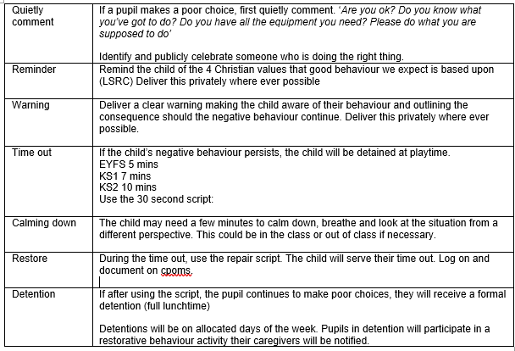
Behaviour
Restorative justice process

Slide 6
Behaviour
If your child has 3 time outs in one day, they will earn a formal detention - you will receive a slip home notifying you in writing.
3 time outs in 1 half term, you will receive a slip notifying you in writing.
6 time outs in 1 half term, you will receive a phone call from class teacher.
9 time outs in 1 half term, you will be invited to meet with class teacher to discuss behaviour plan.

Slide 7
Rewards Systems
House points for house championships
Phase Achievement Assembly:
- Arc awards
- certificates
Values record:
- to earn a ‘half termly treat’
- reward for individuals showing exceptional behaviour and showing 4 house values

Slide 8
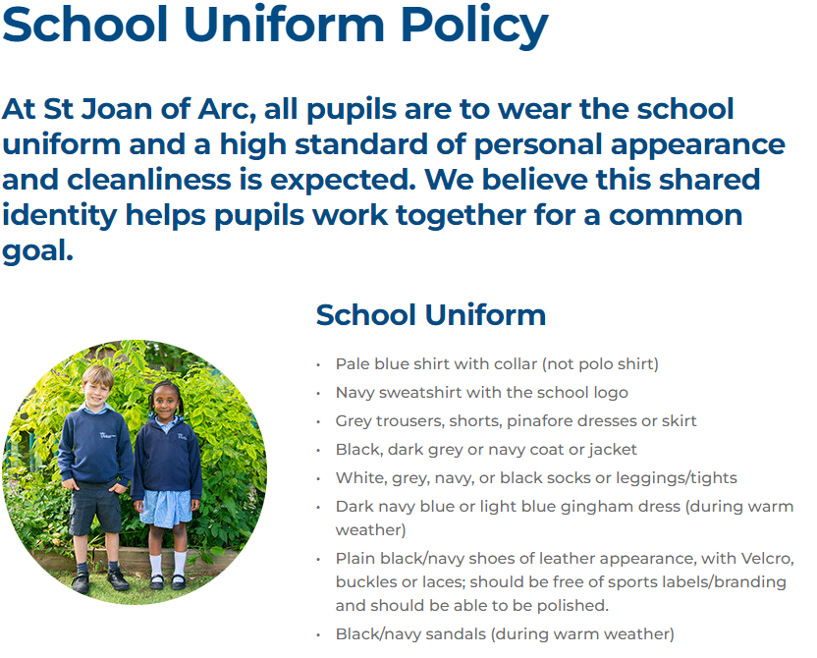
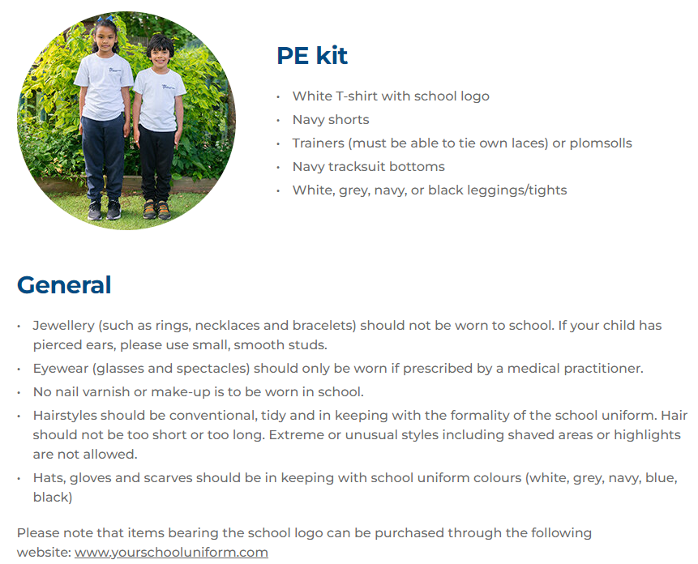
Uniform

Slide 9
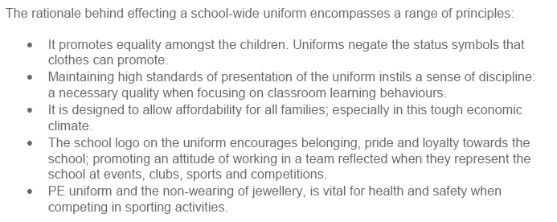
Why We Have a Uniform

Slide 10
Homework - Reading
At least 20 minutes daily
  reading level book,
  book corner book
  their own book
  Oxford Reading Buddy
Signed reading record
- Date, title and pages read, written by your child
Discussion about the text
  Discuss new vocabulary
  Reading around the word to provide context/meaning
  Checking for understanding
  Predicting and comparing
  Inference and deduction
  Intonation and expression

Slide 11
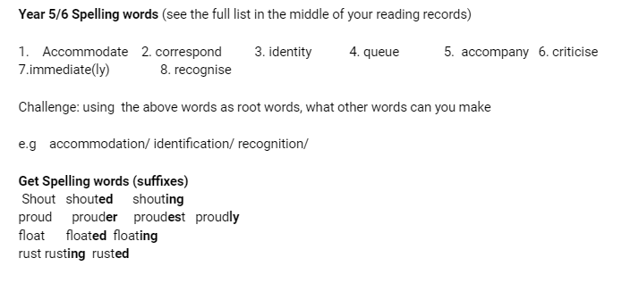
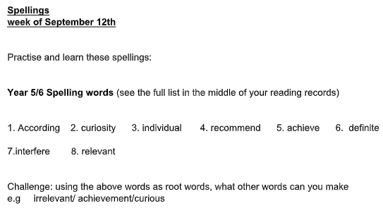
Homework - spellings
High frequency words
Spelling rules
Test on Friday (10 words)
Set on Friday, reviewed the following Friday

Slide 12
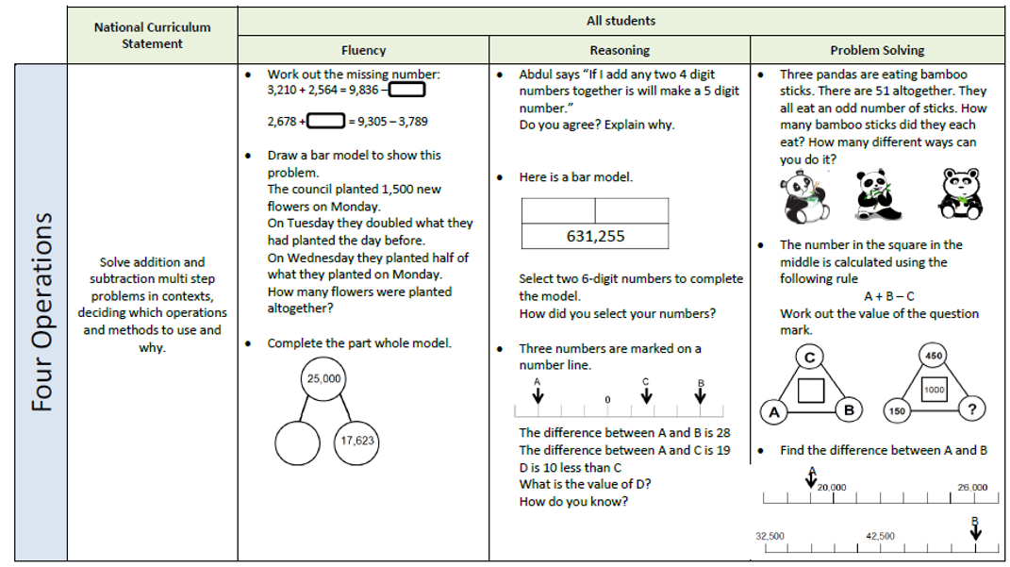
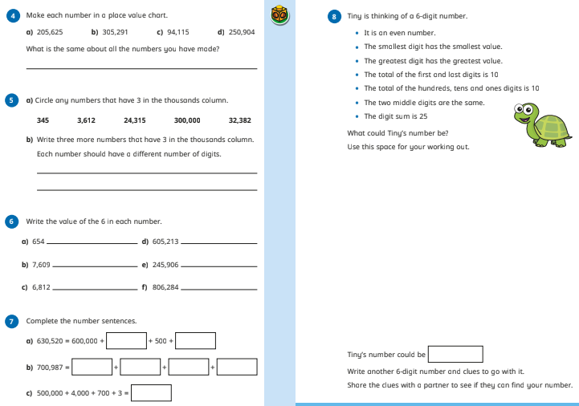
Homework - Maths
Maths questions progressively get harder from fluency to problem solving.
Set on Friday, reviewed the following Friday

Slide 13
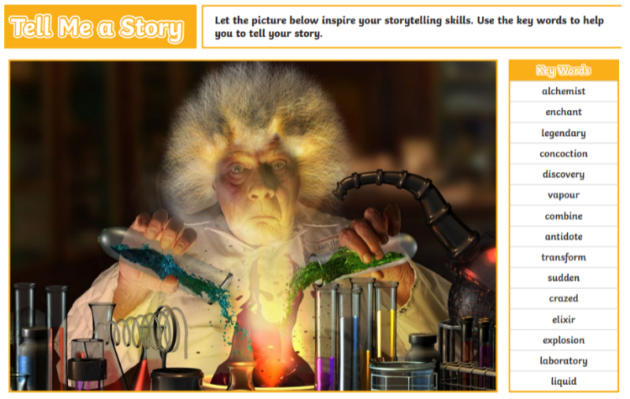
Homework - writing
10 minute writing activity at school set on Friday
Children to extend, edit and up-level with an adult (where possible)
Due back in school the following Friday

Slide 14
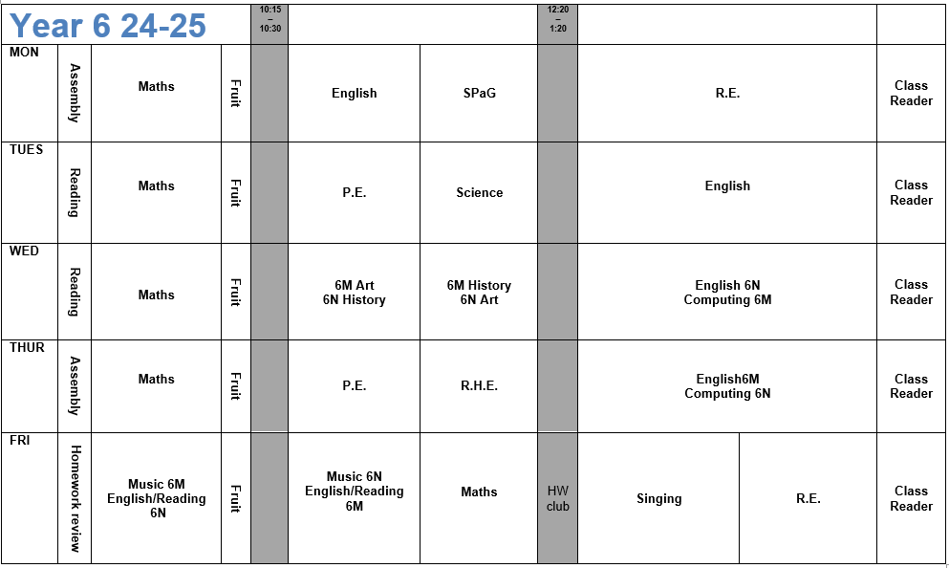
Weekly Timetable

Slide 15
The Core Subjects- Mathematics
Progression shown year-by-year – revisiting key areas.
This term: Place Value, Number Operations, Fractions.
Children will complete weekly arithmetic practise.
Pupils across all year groups will complete end of unit/termly reasoning and arithmetic papers from the White Rose scheme (providers of our maths curriculum planning).
Skills are developed, working towards mastery: fluency – reasoning – problem solving as mirrored with weekly homework.

Slide 16
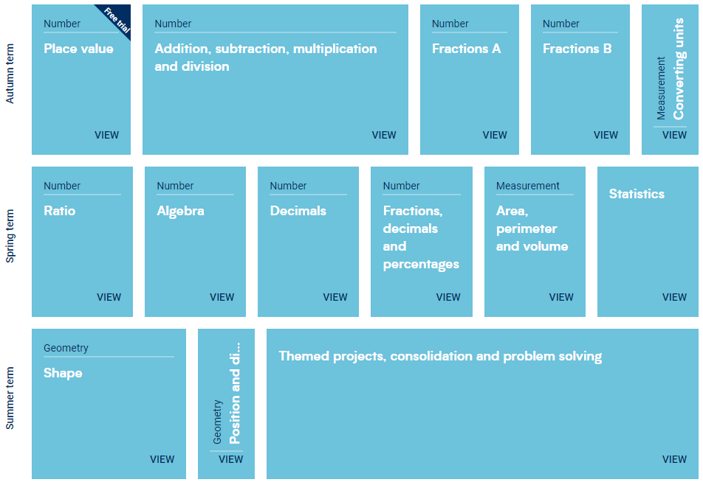
Maths Overview – White Rose

Slide 17
The Core Subjects- English
Revision of skills to consolidate previous learning.
For example in writing:
use a wide range of punctuation, precise vocabulary choice for the intended piece, used verb tenses correctly and to write effectively for a ranges of purposes and audiences.
For example in reading:
refer to text to support opinions /predictions, give a view about a choice of
vocabulary, structure, appreciate how a set of sentences has been arranged
to create maximum effect, explain how a writer has used sentences to
create particular effects.
This term we have been studying: Picture Book, Personal Narrative

Slide 18
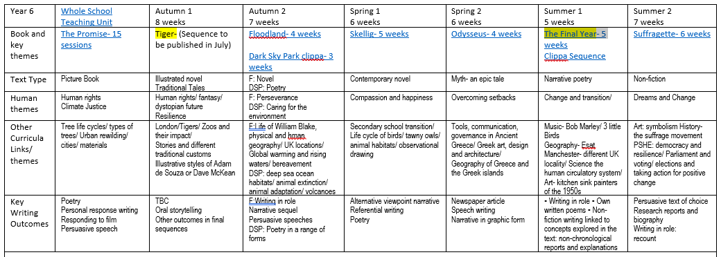
English Overview

Slide 19
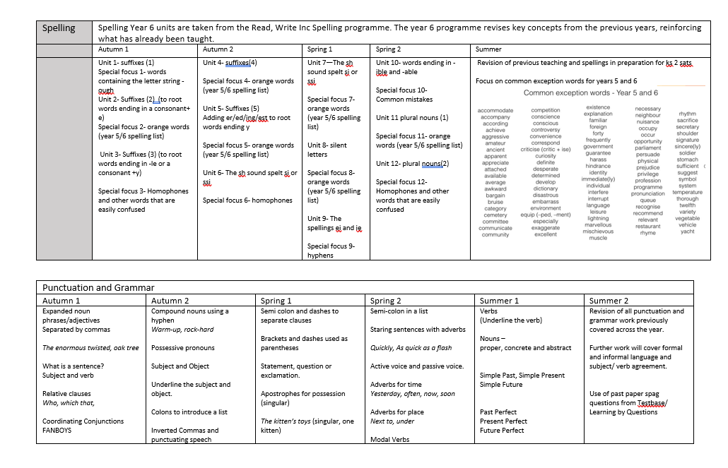
English Overview

Slide 20
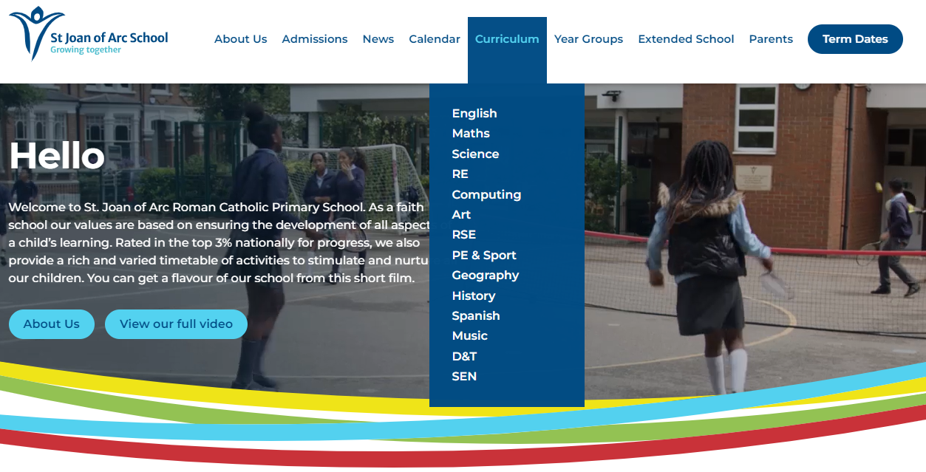
Curriculum Overview

Slide 21
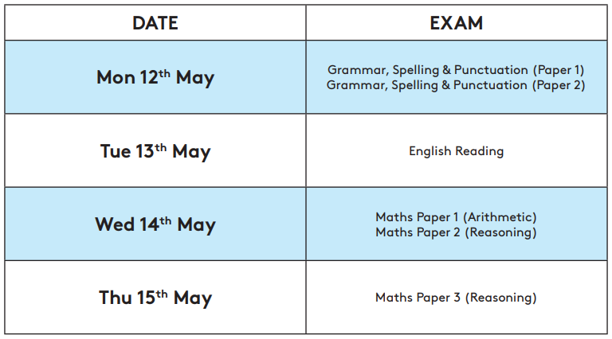
KS2 SATS
Reading: 60 minutes
SPAG: spellings and grammar
Maths: 3 papers (1 arithmetic, 2 reasoning)
Writing: teacher assessed

Slide 22
Activity Week
We are pleased to announce that Activity Week can take place this year. The children will be offsite for 5 days, taking part in teambuilding challenges.
We are hoping this will take place on the week beginning 30th June however we are awaiting confirmation. More information to follow.

Slide 23
Date for your Diaries
INSET day - Monday 5th November
Parent Conferences - Wednesday 23rd and Thursday 24th October
Christmas Performance - Wednesday 18th December
Unicorn Theatre: Pig Heart Boy - Wednesday 29th January

