Slide 1
Year Four Parents’ Curriculum Meeting
Wednesday 11th September 2024
Notes:
Jess

Slide 2
Agenda
Introduce the staff
Daily routines
Behaviour expectations
Homework
Curriculum:
Core subjects
Foundation subjects
MTC
Notes:
Jess

Slide 3
Year 4 Staff
4I - Miss Newson
4J – Miss Williams
Mrs Mullen
Ms Bowden
Mrs Ryan
Notes:
All introduce

Slide 4
Daily Routines
Soft start from 8:15 am
School day begins at 8:30 am
Pupils complete maths activities, handwriting, times tables tasks or 1:1 reading
Emphasis on personal organisation:
Changing reading books independently
Belongings: all to be labelled
Personal responsibility for record books and homework book
Notes:
Jess

Slide 5
PE
Children will have PE twice a week, on a Tuesday and a Thursday
Please come dressed in your PE kits
Please make sure PE uniform is in line with the school uniform guidance- free from sports logos and brands
Notes:
Jess

Slide 6
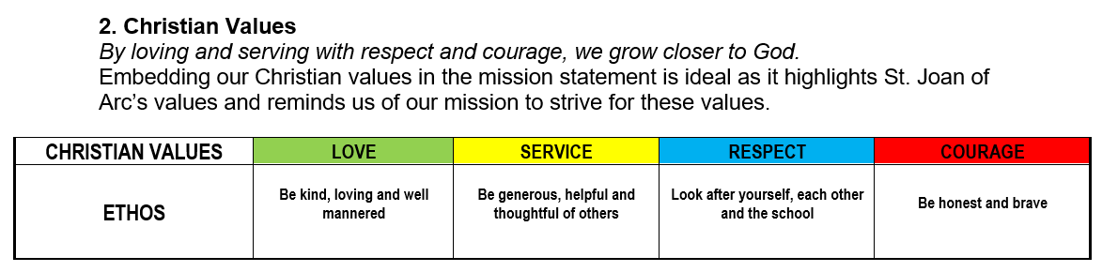
Christian Values
Notes:
Jess

Slide 7
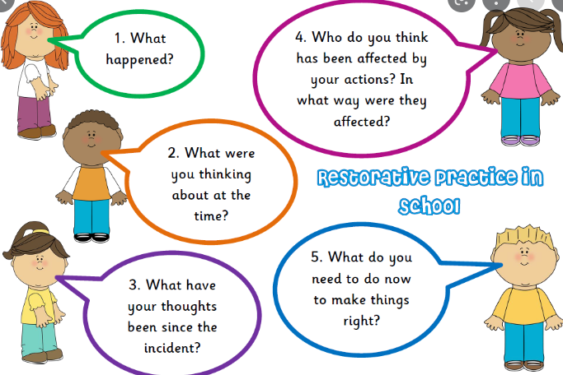
Behaviour Policy – Restorative Justice
Quietly comment
Reminder
Warning
Time out
Calming down
Restore
Detention
Notes:
Jess

Slide 8
Behaviour Expectations
The Standards are:
• For pupils to show a respectful attitude to prayer
• To always try their best
• To respect everyone, their rights, belongings and feelings.
• To listen to teachers and follow their instructions
• To do their homework as well as they can, and on time
• To wear the school uniform appropriately and neatly
In year four:
House points
Arc Awards
Marble jar (whole class reward)
Weekly certificates at phase assembly each Thursday
Values chart for half-termly phase treat/trip (special privilege)
Notes:
Jess

Slide 9
Homework - Reading
At least 15 minutes daily, aloud to an adult or silently
Signed reading record daily, child can write comment and parent can sign off (comments are really helpful)
Discussion about the text
  Sounding out
  Reading around the word
  Checking for understanding
  Predicting
  Inference and deduction
  Intonation and expression
Notes:
Brenda

Slide 10
Reading Records
National Curriculum statements at front
  Signed off by teacher/teaching assistant during guided reading
  When necessary, next steps may be highlighted
Ideas for home reading and spelling are in the middle of the reading record
Notes:
Brenda

Slide 11
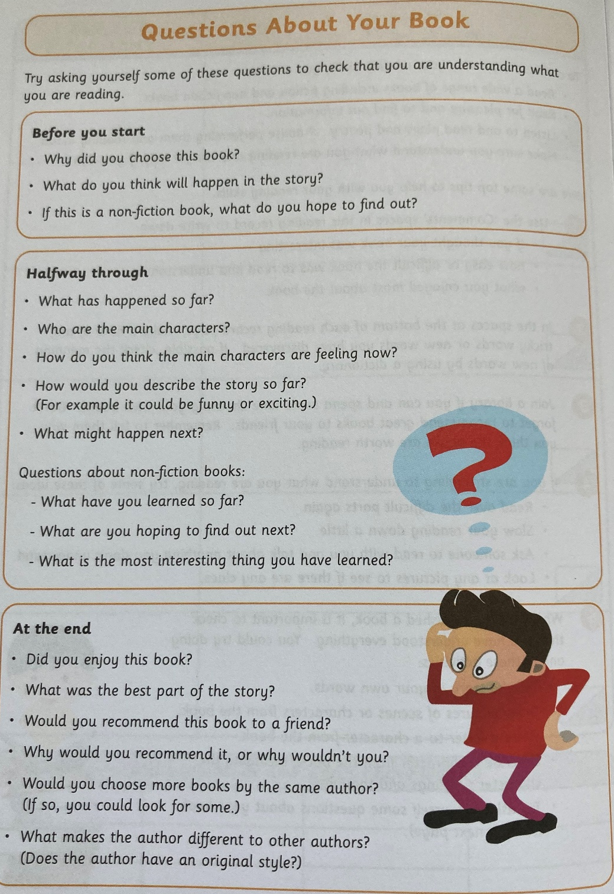
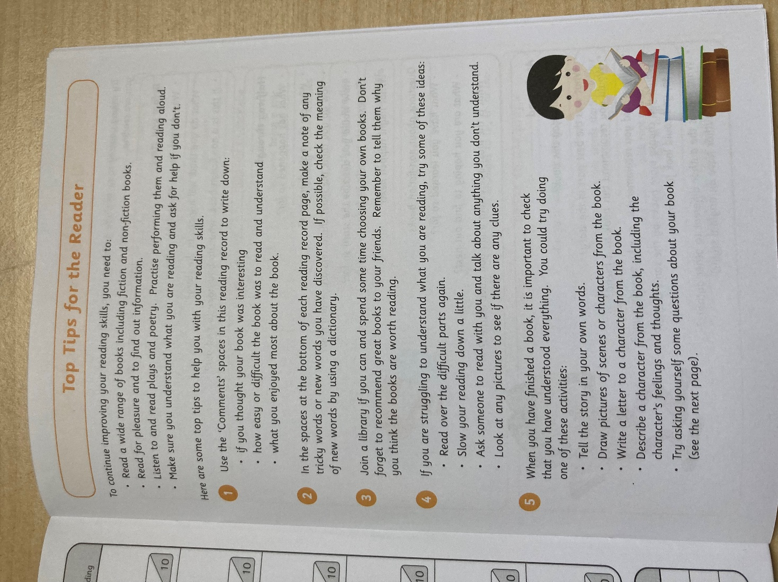
Notes:
Brenda

Slide 12
Homework - Spellings
Common exception rules: everyday words that break the phonic rules
Spelling rules
  Examples given
  Research other words that follow the rule
Monday 18th September 2024
This week, the high frequency words are:
address, appear, arrive
We are focusing on the prefix u-n-, un, i-n-, in, and d-i-s-, dis. They share the same meaning; they mean ‘not’ or the opposite of something. For example: unwell, unknown, inhuman, dislike, disappear,
Notes:
Brenda

Slide 13
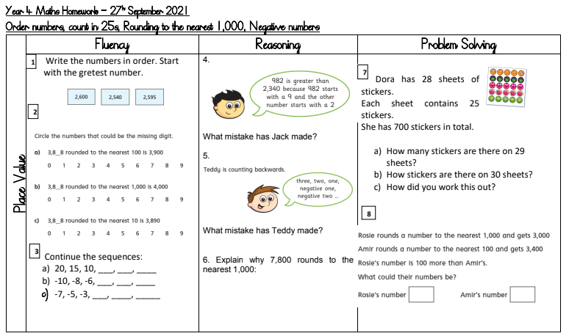
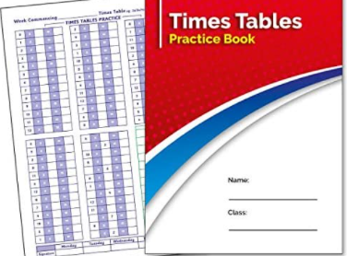
Homework - Maths
Maths homework can be viewed online on GC and answers can be written out in pink books
This will be reviewed in Friday’s lesson. (Not to be submitted on GC)
Times Table Log Book (daily) and Times Table Rockstars
Notes:
Brenda

Slide 14
Year 4 Curriculum
The National Curriculum gives sets out the statutory requirements of the Year 4, 5 and 6 curriculum. Progress across all of Key Stage 2 is assessed in the end of Year 6 tests.
Year 4 pupils will sit an online, timed test of their times table knowledge - 25 questions, 12 x 12. This is a statutory requirement.
Notes:
Brenda

Slide 15
Mathematics
We use the White Rose for Maths
All pupils will participate in additional 15 minute maths fluency sessions in addition to the hour long daily maths lesson.
Children will complete weekly arithmetic practice.
Pupils across all year groups will complete termly reasoning and arithmetic papers from the White Rose scheme (providers of our maths curriculum planning).
Pupils across all year groups will complete termly reasoning and arithmetic papers from the White Rose scheme (providers of our maths curriculum planning).
Notes:
Brenda

Slide 16
Year 4 Maths Objectives
Core skills:
Recall all multiplication facts to 12 x 12, and solve problems involving multiplication.
Round numbers to the nearest 10, 100. 1000 & decimals with 1 decimal place to nearest whole number.
Count backwards through zero
Read Roman numerals to 100.
Add/subtract up to 4-decimal places using formal written methods of addition/Sub.
Divide a 1 or 2-digit number by 10/100 & multiply 2 & 3-digit by a 1-digit number.
Compare and classify geometrical shapes.
Know that angles are measured in degrees and can identify acute and obtuse angles.
Measure/calculate perimeter of reg. shape
Read, write and convert between analogue and digital 12 and 24 hour times.
Notes:
Brenda

Slide 17
English
For English, we draw on a variety of planning resources, we use the CLPE teaching units and Read Write Inc spelling resources.
Children will focus on creating, editing and continually reviewing and improving their writing
Opportunities for digital publishing
Whole class reader sets so that children can participate in whole class together. Children will revisit these at regular intervals across the week
Each child will participate in Guided Reading weekly
Handwriting three times a week in class – big focus on presentation in the curriculum
We will be using teacher judgements and Oxford Reading Buddy assessments to assess the children’s reading, we will no longer be benchmarking the children.
Notes:
Antonella

Slide 18
Year 4 English Objectives
The overarching aim for English in the national curriculum is to promote high standards of language and literacy by equipping pupils with a strong command of the spoken and written word, and to develop their love of literature through widespread reading for enjoyment. The national curriculum for English aims to ensure that all pupils:
read easily, fluently and with good understanding
develop the habit of reading widely and often, for both pleasure and information
acquire a wide vocabulary, an understanding of grammar and knowledge of linguistic conventions for reading, writing and spoken language
appreciate our rich and varied literary heritage
write clearly, accurately and coherently, adapting their language and style in and for a range of contexts, purposes and audiences
use discussion in order to learn; they should be able to elaborate and explain clearly their understanding and ideas
are competent in the arts of speaking and listening, making formal presentations, demonstrating to others and participating in debate.
Notes:
Antonella

Slide 19
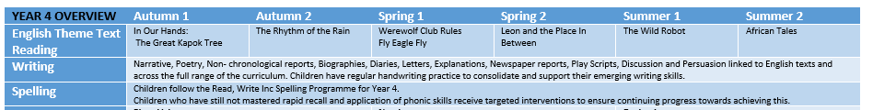
English Curriculum
Notes:
Antonella

Slide 20
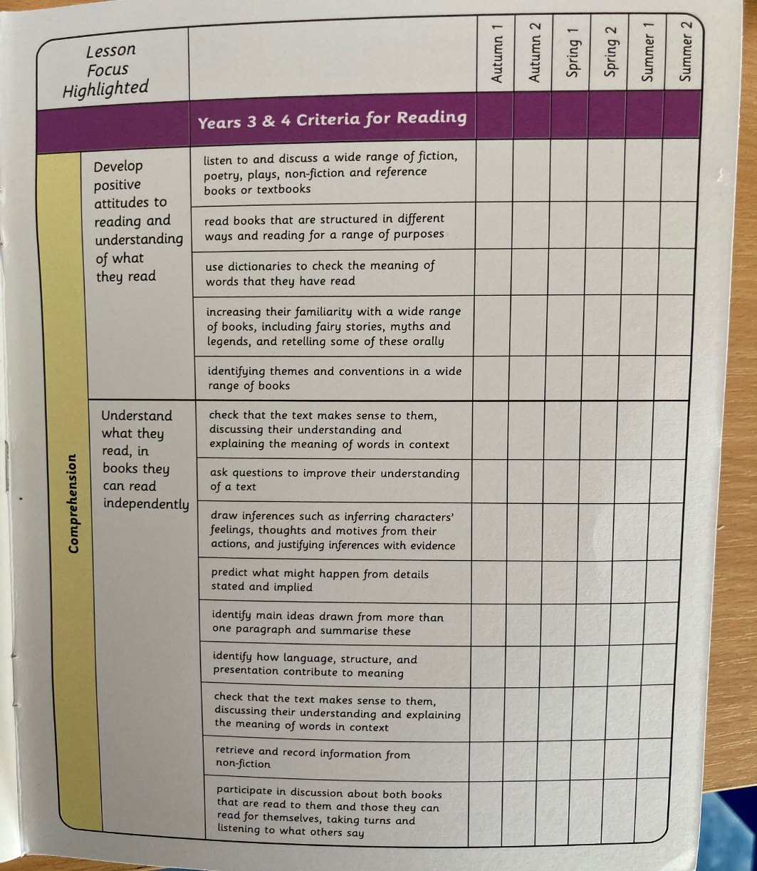
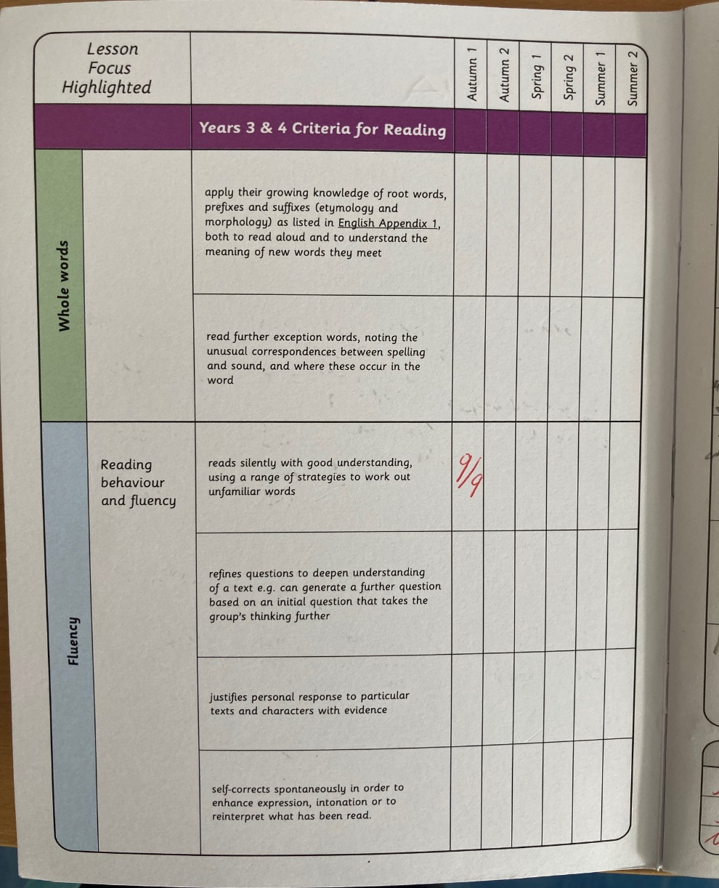
Reading
Notes:
Antonella

Slide 21
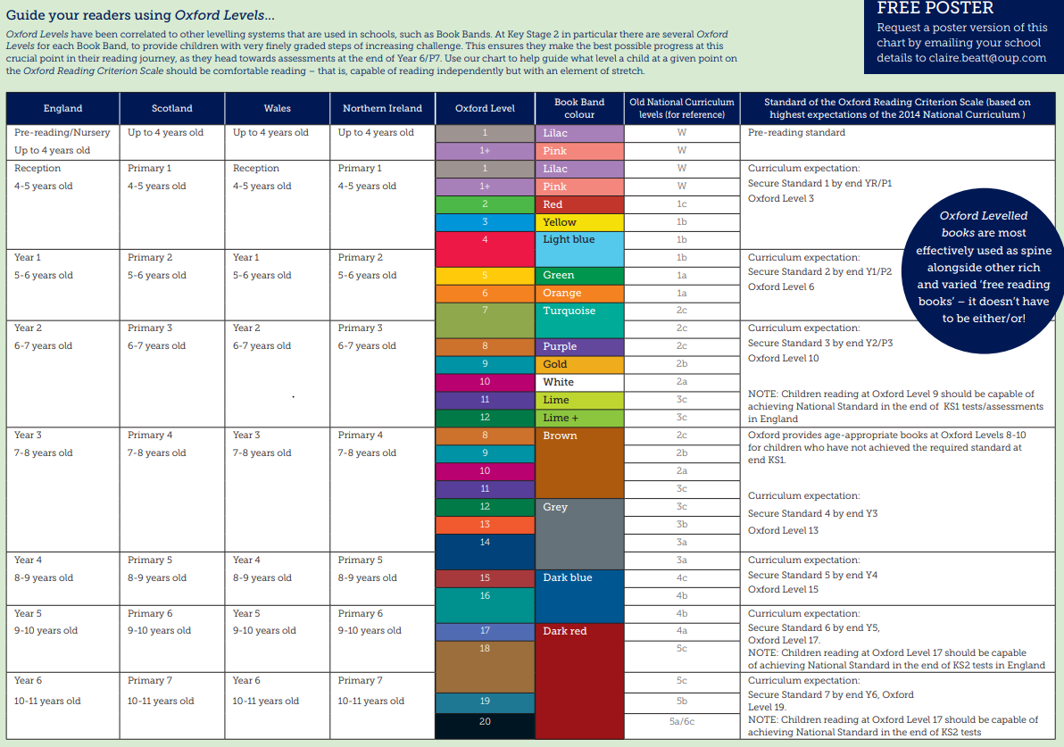
Oxford Reading Levels
Children will now have a numbered level rather than a colour band. This will mean the children will have a very specific text matched to their reading level and will have access to a range of online books and resources on Oxford
Reading Buddy.
Notes:
Antonella

Slide 22
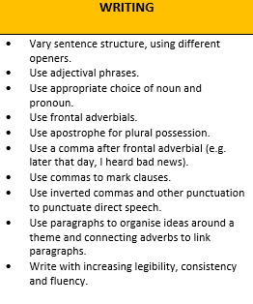
Writing
Notes:
Antonella

Slide 23
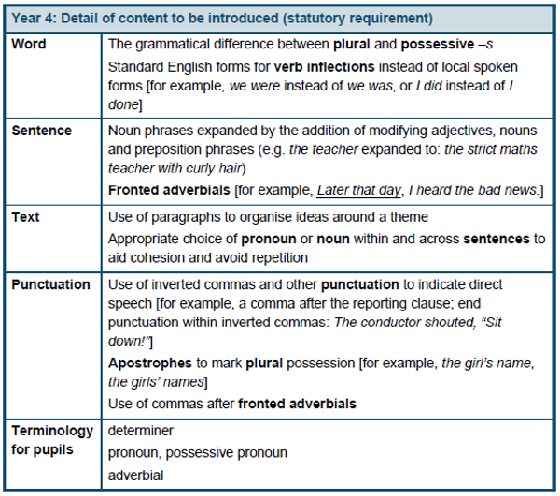
Punctuation and Grammar in Year 4
Notes:
Antonella

Slide 24
Other Subjects
Foundation subjects are taught in half termly blocks
Foundation subjects Music, Spanish, Computing, Art, Geography and History
Singing assembly takes place on a Friday afternoon
All children have a weekly 45 minute music lesson with Mr Owen
A topic related trip will take place offsite and we will provide more details on this at a later date
Notes:
Antonella

Slide 25
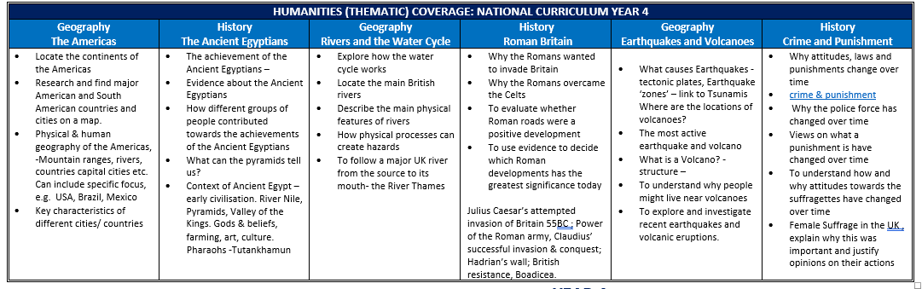
Humanities
Notes:
Antonella

Slide 26
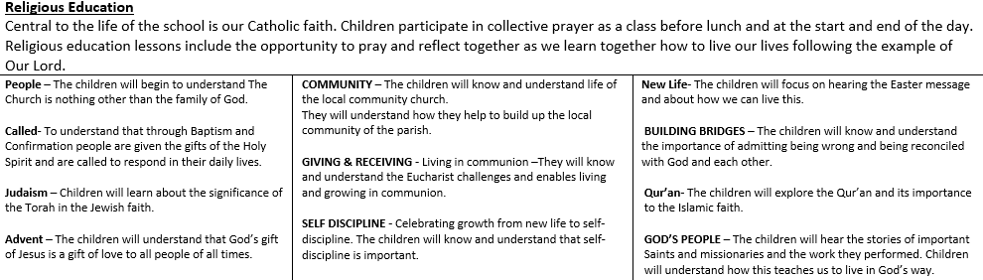
Religious Education
Whole school assembly on Mondays
Year 3/4/5/6 Assembly on Thursdays celebrating achievements
Masses – Check school diary
Notes:
Jess

Slide 27
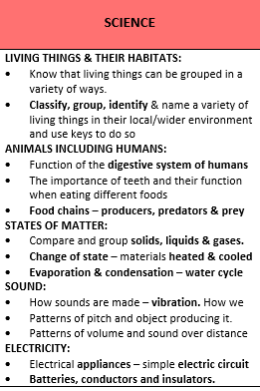
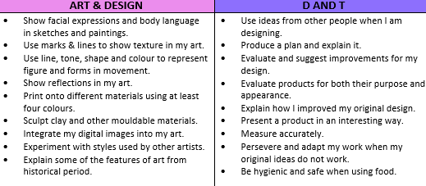
Science, Art and DT
Notes:
Jess

Slide 28
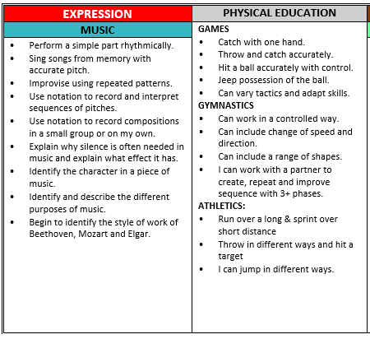
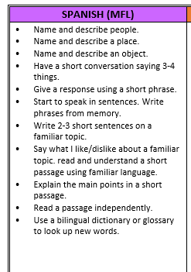
Music, PE and Spanish
Perform a simple part rhythmically. Sing songs from memory with accurate pitch. Improvise using repeated patterns. Use notation to record and interpret sequences of pitches. Use notation to record compositions in a small group or on my own. Explain why silence is often needed in music and explain what effect it has. Identify the character in a piece of music. Identify and describe the different purposes of music.
Notes:
Jess

Slide 29
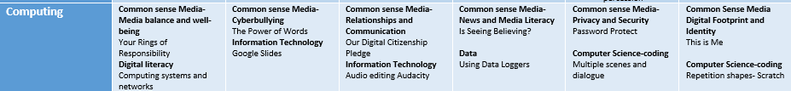
Computing and Online Safety
Notes:
Jess

Slide 30
Relationships and Health Education
Similarities and differences between people as they grow.
Creating community
Self-confidence comes from being loved not status
Respecting our bodies through what we wear, eat and physically do.
How emotions (include hormonal effects) change our feelings but are not always a good guide for actions
Who are our trusted people?
Looking after our emotional well-being- thankfulness builds resilience
How media images do not always reflect reality
Life cycles- handmade by God with the help of their parents- how a baby grows in the womb
Humans experience life on a physical, psychological and spiritual level
Ways to develop good, trusting relationships where friend s what is truly best for each other
Bullying, cyber-bullying, harassment and exploitation. Why these are harmful behaviours and how to respond to them
How to stay safe online and recognise that too much use of technology can affect us negatively
How to report and get help I they encounter inappropriate materials or messages
To know what physical contact is acceptable and unacceptable
Changing Bodies; the changes that take place in the male and female bodies during puberty
The correct names of body parts, including genitalia
To know that medicines are drugs and that alcohol and tobacco are harmful substances
First aid- basic knowledge / remaining calm and taking quick action
Notes:
Jess

Slide 31
Google Classroom
The children’s homework will be posted each week onto the classroom feed (Friday to Friday)
Maths/ Times tables tasks will be posted too
We will also use the GC for computing sessions and interactive Geo/History lessons
Log- ins for GC, Oxford Reading Buddy and Times tables rock stars are all the same
For GC, add @g.st-joanofarc.islington.sch.uk after the 206
Notes:
Brenda

Slide 32
Multiplication Tables Check
The MTC determines if Year 4 children can fluently recall their multiplication tables.
They are designed to help schools identify which children require more support to learn their times tables.
There is no ‘pass’ rate or threshold which means that, unlike the Phonics Screening Check, children will not be expected to re-sit the check.

Slide 33
MTC continued
There will be a 3 week window from June for schools to administer the check.
There is no set day to administer the check and children are not expected to take the check at the same time.
All eligible Year 4 children in England will be required to take the check.
There is a ‘Try it out’ area, provided by the DfE, which will take place in school.

Slide 34
The check will be fully digital.
Answers will be entered using a keyboard, by pressing digits using a mouse or using an on-screen number pad.
Usually, the check will take less than 5 minutes for each child.
The children will have 6 seconds from the time the question appears to input their answer. (6 seconds per answer means that children must be able to read, recall and enter their response within that time. Whatever is written in the answer box at the end of 6 seconds will be counted as the answer.)
There will be a total of 25 questions with a 3 second pause in-between questions.
There will be 3 practice questions before the check begins.

Slide 35
How to help your child/children
Climb the stairs counting in multiples
Play time tables games verbally.
Listen and sing along to times tables songs.
Take it in turns to say times tables in funny voices.
Play maths games online:
Hit the Button- https://www.topmarks.co.uk/maths-games/hit-the-button
Snappy Maths http://www.snappymaths.com/multiplication/multiplication.htm
Time table games: https://www.timestables.co.uk/games/
Maths frame: https://mathsframe.co.uk/en/resources/resource/477/Multiplication-Tables-Check
TT Rockstars: https://ttrockstars.com/

Slide 36
Thank you for joining us this afternoon.
We look forward to working with you!
Notes:
Brenda

