Slide 1
Year Five Curriculum Information for Parents

Slide 2
Aims
Introduce the staff
Give you a better understanding of your child’s learning this term
Share our aims
Help you, parents/carers, to feel empowered to support your children
Give you the opportunity to ask questions- chat function, 5 minutes at the end.

Slide 3
Introductions
Year 5 staff:
5L- Ms. Vasallo
5K – Mr. Gordge
Teaching Assistant across both classes – Ms. Laszcziw

Slide 4
Daily Routines
Soft start from 8:15 am (it really helps to be as close to this time as possible)
School day begins at 8:30 am
Pupils completing Read write Inc spelling books, handwriting and times tables
Independence across their school life.
Emphasis on personal organisation:
Changing numbered reading books independently
Belongings: all to be labelled
Personal responsibility for record books and homework book.

Slide 5
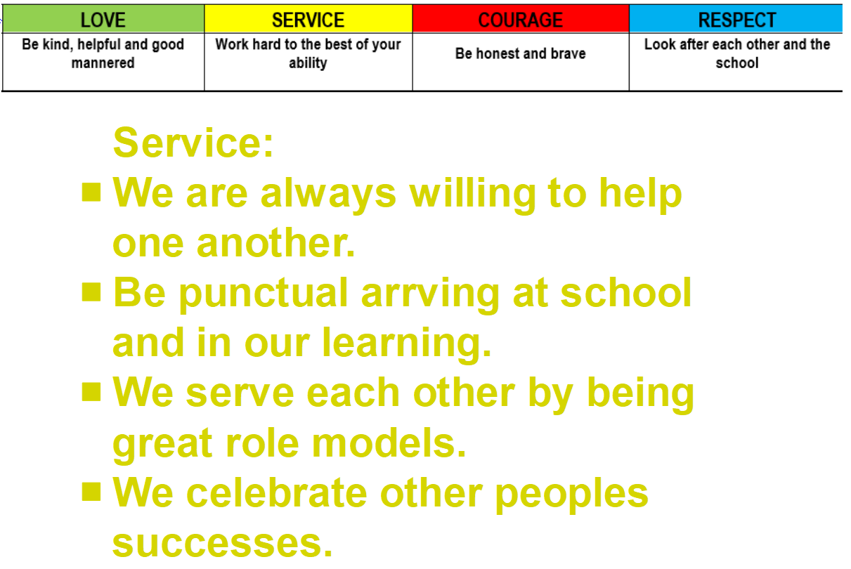
Behaviour Expectations

Slide 6
Behaviour Expectations
In Year 5, we begin preparing students for secondary school by expecting them to show: independence, organisation, time management, strong work ethic, respectful of themselves and others.
In year five:
House points
Arc Awards
Weekly certificates (Linked to LSRC) at phase assembly each Thursday
They now have a LSRC chart for which they can earn a half termly reward.

Slide 7
Homework - Reading
At least 20 minutes daily, aloud
Signed reading record
Discussion about the text
Sounding out
Reading around the word
Checking for understanding
Predicting
Inference and deduction
Intonation and expression
They are asked to take 2 books homes.
Oxford Reading Buddy (computer access)

Slide 8
Reading Records
National Curriculum Statements at front
Year 5/6 spelling list words in the middle
Ideas for home reading and spelling in the middle
Any non urgent contact.

Slide 9
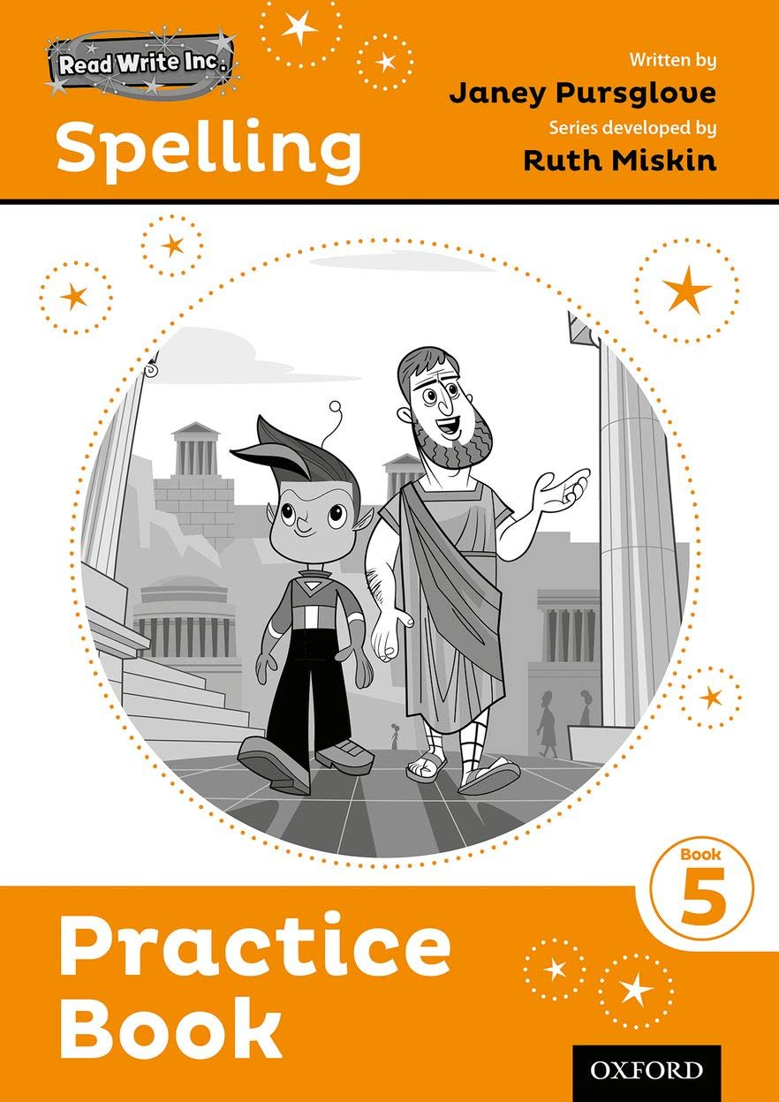
Homework - spellings
5 words from the Year 5/6 spelling list
10 words from their current spelling sound
Spelling rules
Test on Friday
Now set on Friday

Slide 10
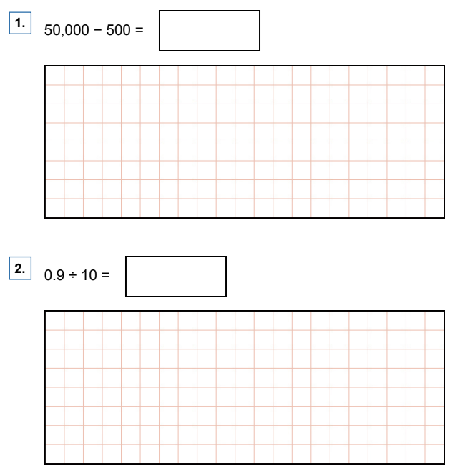
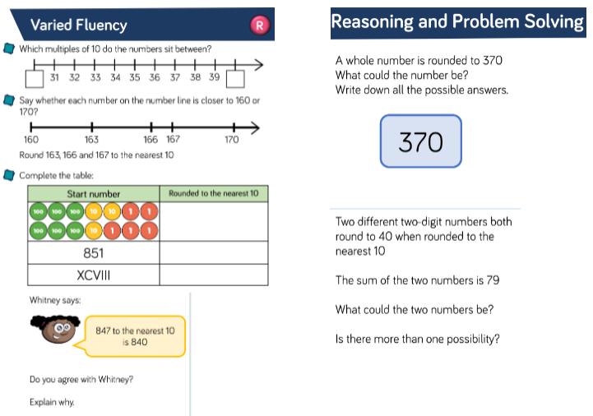
Homework - Maths
Math's questions progressively get harder from fluency to problem solving.
Set on Friday/Reviewed on Friday
Times Table Rockstars ( awards for use)

Slide 11
Year 5 Curriculum
The National Curriculum gives sets out the statutory requirements of the Year 4, 5 and 6 curriculum. Progress across all of Key Stage 2 is assessed in the end of Year 6 tests.

Slide 12
The Core Subjects- Mathematics
Progression shown year-by-year – revisiting key areas.
This term: Place Value, Number Operations, Fractions.
All pupils will participate in additional 15 minute maths fluency throughout the week.
Children will complete weekly arithmetic practise.
Pupils across all year groups will complete end of unit/termly reasoning and arithmetic papers from the White Rose scheme (providers of our maths curriculum planning).
Skills are developed, working towards mastery: fluency – reasoning – problem solving as mirrored with weekly homework.

Slide 13
Year 5 Maths Objectives
Core skills:
Count forward/ backwards in steps of power of 10 for any given number up to 1,000,000.
Recognise/use thousandths & relate then to tenths, hundredths & decimals equivalents.
Recognise mixed numbers and improper fractions & convert from one to the other.
Read and write decimal numbers as fractions, and round decimals with 2dp to nearest whole number.
Recognise % symbol and write percentages as a fraction and as a decimal fraction.
Multiply and divide numbers mentally drawing on known facts up to 12 x 12.
Read Roman numerals to 1000.
Recognise & use square and cube numbers.
Multiply & divide whole numbers and those involving decimals by 10, 100 and 1000.
Estimate/ compare acute, obtuse and reflex angles, draw and measure them in degrees.

Slide 14
Year 5 Maths Objectives

Slide 15
English
For English, we draw on a variety of planning resources including Herts for Learning English and No Nonsense spelling
Children will focus on creating, editing and continually reviewing and improving their writing
Opportunities for digital publishing
Whole class reader sets so that children can participate in whole class together. Children will revisit these at regular intervals across the week
Guided Reading
Handwriting three times a week in class – big focus on presentation in curriculum
Formal reading assessments in 4/5/6 – ensure accurate assessment once children have completed ‘benchmarking’ and good preparation for SATS and secondary schools.

Slide 16
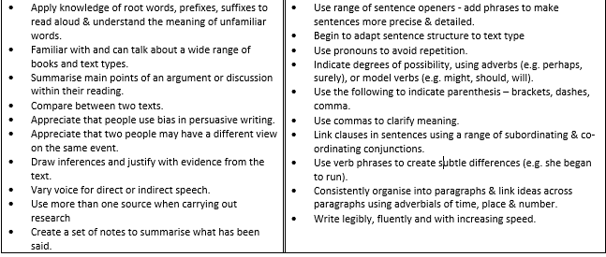
Core Objectives

Slide 17
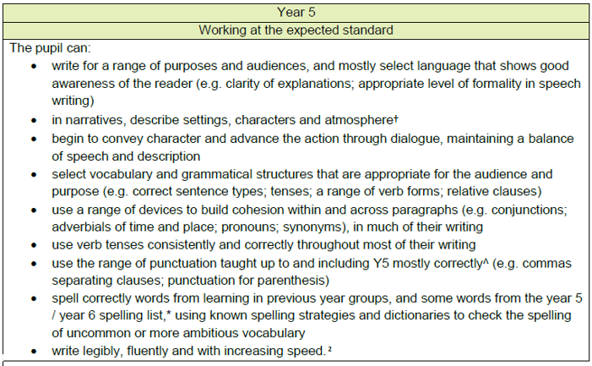
Punctuation and Grammar in Year 5

Slide 18
Other Subjects
Foundation subjects are taught in half termly blocks
Foundation subjects (Music/Spanish, Computing, Art and History) will be taught across Year 5 subject specialist teachers. To be reviewed half-termly
Singing practice takes place on a Friday afternoon

Slide 19
Humanities

Slide 20
Relationships and Health
Physical changes towards adulthood (puberty) are part of God’s plan for us
Similarities and differences between us (being self-confident)
Girls’ bodies and boys’ bodies- learning respect for our bodies and others’. Treating them appropriately and respecting boundaries
Making good choices that impact our health- sleep, exercise, hygiene, discipline around electronic devices etc
Body image- learning that the images in the media do not always reflect reality and thankfulness builds resilience against feelings of inadequacy, envy and pressure from peers or the media
Feelings; recognising that our feelings aren’t always a good guides for action and that some behaviour is wrong, unacceptable, unhealthy or risky
Emotional changes; that hormones affect the intensity of our feelings. Openness with trusted adults can help with our well-being
The difference between harmful and harmless videos online and the ways to deal with viewing harmful videos and images
How a baby grows and develops in its mother’s womb
Menstruation; the nature and role of menstruation in the fertility cycle and help with managing the onset of it
Strategies to resist peer pressure
Understand the meaning of consent and bodily autonomy. Scenarios in which it is right to say no
How thoughts and feelings impact on actions and how this can affect friendships
How to use technology safely and how to get help if you encounter inappropriate materials or messages
Cyberbullying- what it is and how to get help if you experience it
Types of abuse- acceptable and unacceptable forms of physical contact. Knowing who we can talk to for help
Lifestyle impact- the effects of tobacco, alcohol and other substances. Knowing we should be careful about what we consume
The recovery position- how we can help in treating life-threatening conditions
Catholic social teaching- knowing how we live our lives can impact others, locally, nationally or globally
PSHE- Economic education- that money can be borrowed but there are associated risks.

Slide 21
Full document on website

Slide 22
Date for your Diaries
Thursday 17th November – 9:00-9:20 Year 5 class assembly in the hall to showcase all of the learning that has taken place this half term
Tuesday 14th December – 6:00 Christmas concert

Slide 23
Thank you for taking the time to read this information.
We look forward to working with you!

