Slide 1

Year 3 Curriculum Meeting 2024
Miss O’Connor and Miss King

Slide 2
Agenda
Meet the Team
Daily routines
Behaviour expectations and rewards
Reading, Homework and spellings, Times Tables
Curriculum coverage
If you have any questions, please ask them in the chat function. We will respond as we go along and can address any outstanding questions at the end.

Slide 3
The Year 3 Team
Miss O’Connor (3G) with Ms Guy
Miss King (3H) with Mrs Convey
Ms Tibbs
Ms Francis

Slide 4
Daily routines
Soft start from 8:15 am
School day begins at 8:30 am (Gates close at 8:30 - arrivals after this will be recorded as late)
Emphasis on personal organisation:
Changing reading books independently
Belongings: all to be labelled
Personal responsibility for reading record/ times tables, and homework books (Friday)
PE kits on Wednesdays and Fridays
Fruit - Fruit is not provided for KS2 children
PLEASE NO KIWI

Slide 5
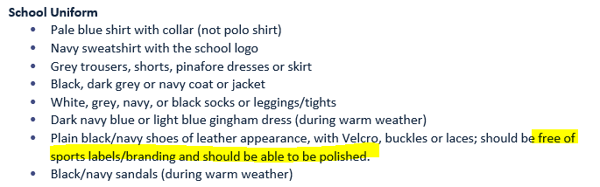
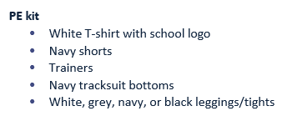
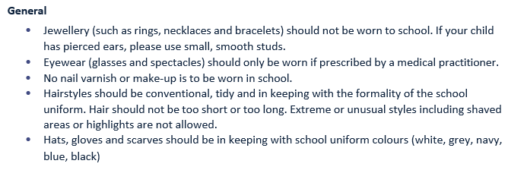
Uniform
Uniform policy
https://www.st-joanofarc.islington.sch.uk/parents/school-uniform/

Slide 6
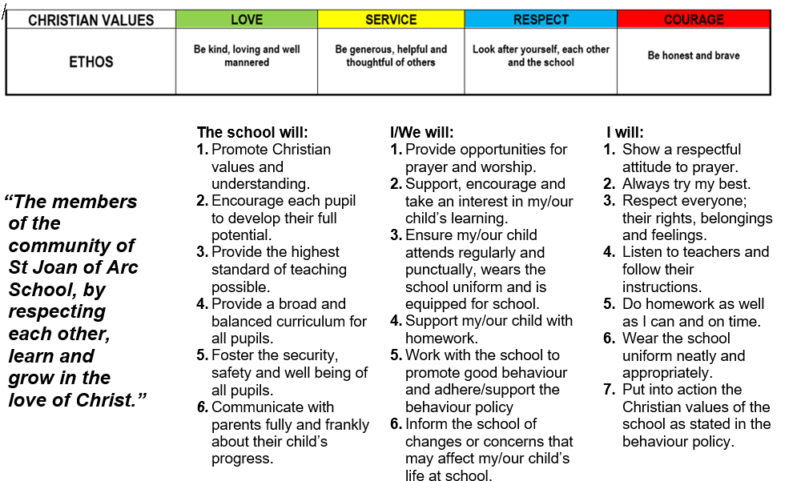
Behaviour policy
School Rules and Values
Home School Agreement

Slide 7
Behaviour policy
Positive Behaviour Rewards:
  House Points
  Arc Awards – a weekly opportunity to win a prize
  Certificates during our weekly Phase Assembly
  Value points to try and win a ‘trip or treat’ at the end of the half term
  Restorative Justice
  A sequence of steps to help pupils get back to demonstrating expected behaviour
  Whole school approach with the following steps :
  a quiet comment 2) a behaviour reminder 3) a warning
  4) Time out 5) Restore using reflective language

Slide 8

Reading records
National Curriculum statements are at the front and back
Each week there will be a comment recorded in the reading record to show the focus of the session, how your child read and what they need to focus on
Ideas for home reading and spelling in the middle

Slide 9

Reading at Home
Banded book linked to their reading level
Reading for Pleasure book to share at home
Reading at home as much as possible - it makes a massive difference
  Recommended 10 - 20 minutes daily to an adult
  Comments in reading records are really helpful for us- how your child read, what they did well/ can improve on or their thoughts on the text
Ask questions as well as listen to them (use Reading Record prompts- on next slide)
Higher order reading skills: when learners are able to retrieve information from a book or text and are able to relate to the text and read between the lines (inference)

Slide 10
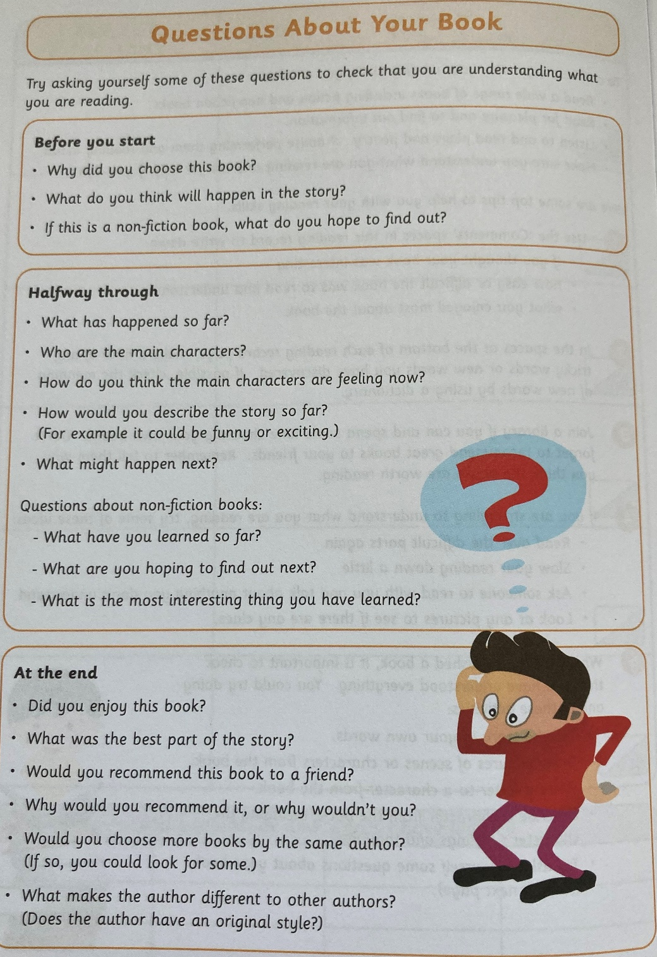
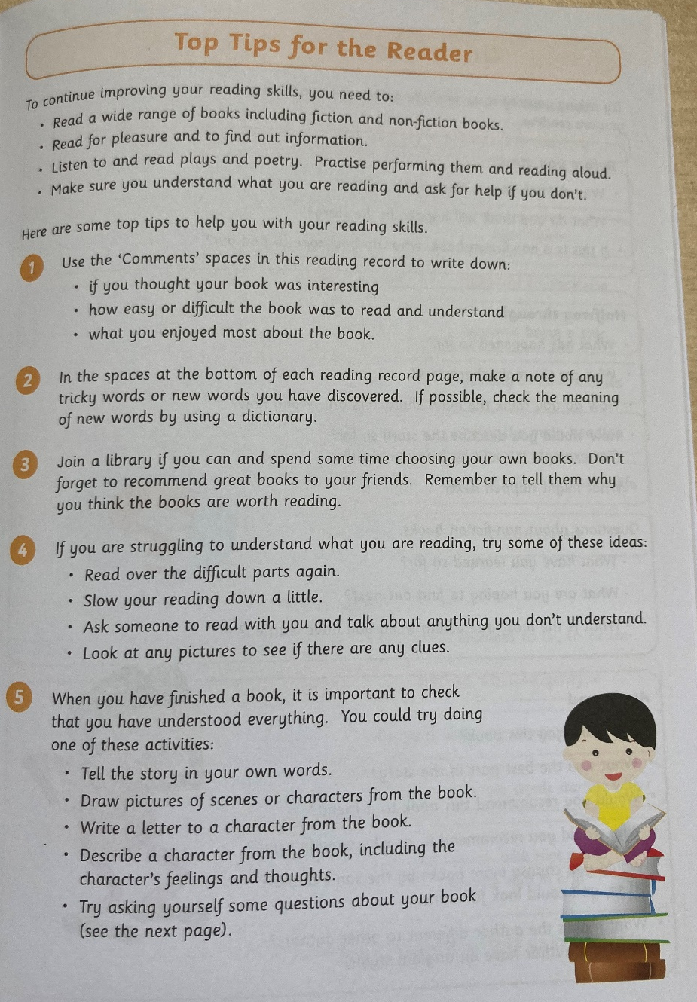
Reading at Home

Slide 11
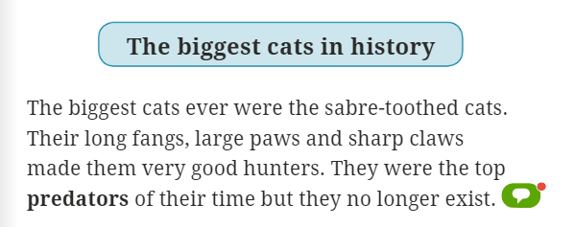
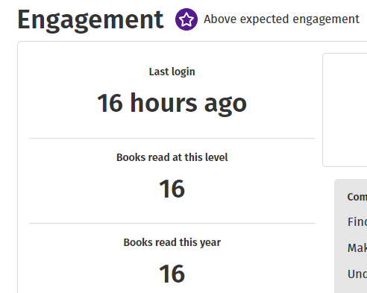
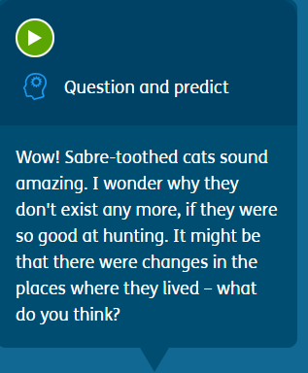
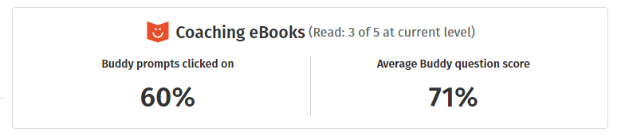
Oxford Reading Buddy

Slide 12
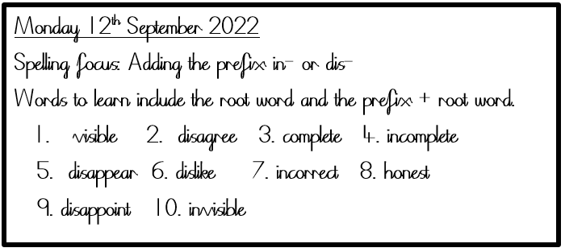
Spelling Homework
Read Write Inc. Spelling lessons
Focus on a spelling pattern, for example a prefix/suffix, over two weeks in school
Spelling homework will links to this
Year 3/4 common Exception Words
Friday 13th September 2024

Slide 13
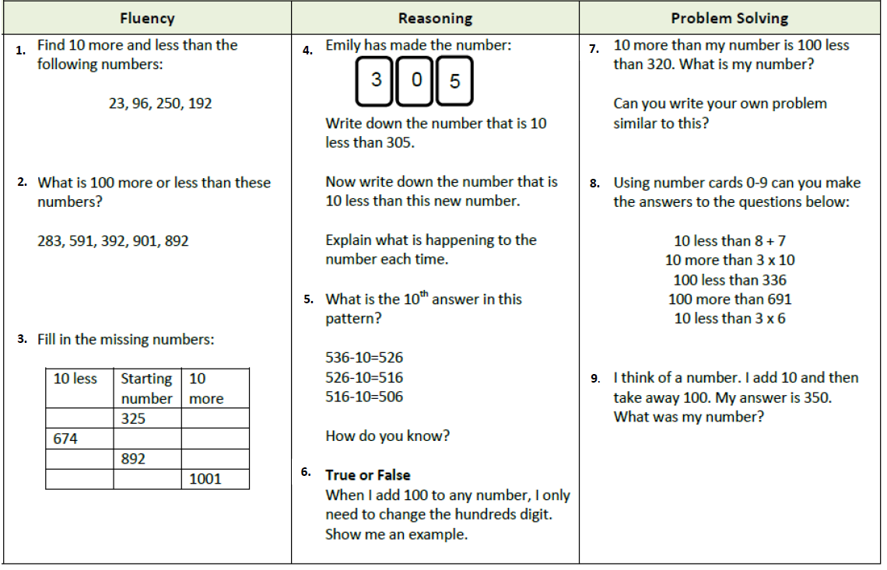
Maths Homework
Homework will be added to Google Classroom every Friday and is to be completed by the following Friday.
Work is to be completed in the blue homework books (not to be submitted on GC). Children should record their written answers in their book.

Slide 14
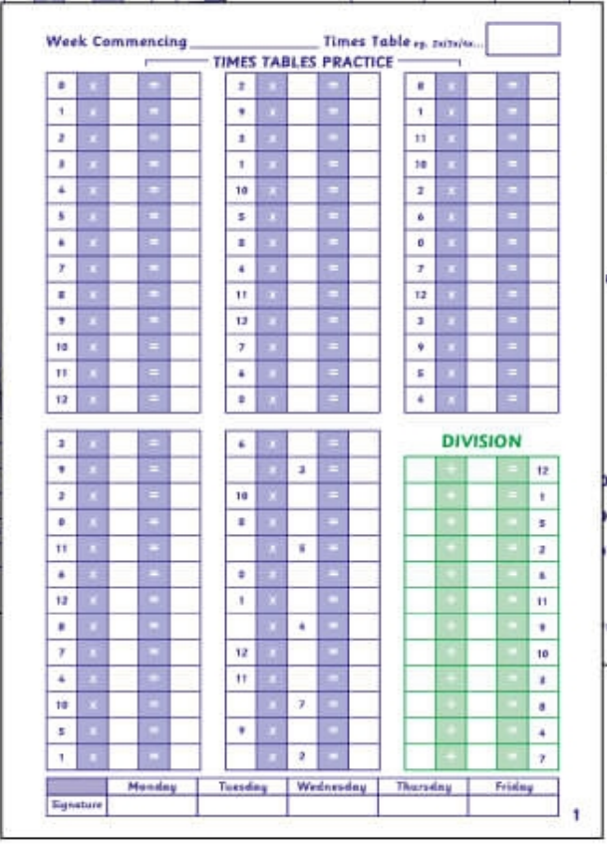

Times Tables
Completed in school on Monday
Monday night
Tuesday night
A vital skill
Preparation for Y4 times tables tests
Daily Times tables book practise
Times Table Log Book
Wed night
Thurs night
Completed as homework
Parents to check and sign daily

Slide 15

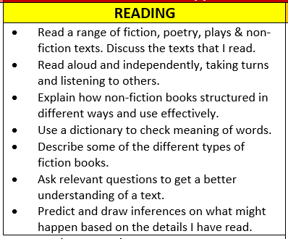
Curriculum
Most important skill the children learn
Foster a love of reading
Reading for pleasure
Read with breath and depth
Guided reading weekly (check front and back covers of Reading Records)
Reading assessments

Slide 16
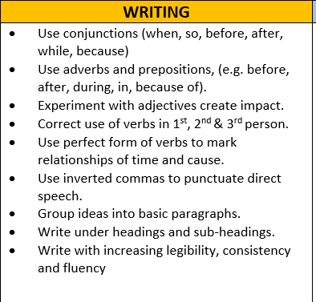
Curriculum
Focus on fundamentals
  Spellings
  Handwriting
  Sentence level learning (grammar)
  Stamina
  Self-editing
Not just in English lessons - across the
Curriculum
Narrative, Poetry, Non- chronological reports, Biographies, Diaries, Letters, Explanations, Newspaper reports, Discussion and Persuasion linked to English texts and across the full range of the curriculum. Children have regular handwriting practice to consolidate and support their emerging writing skills.

Slide 17
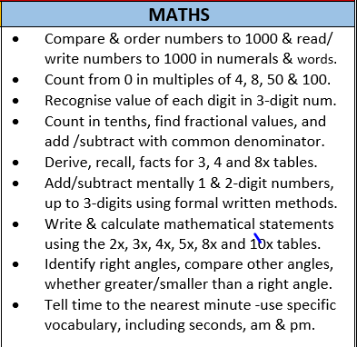
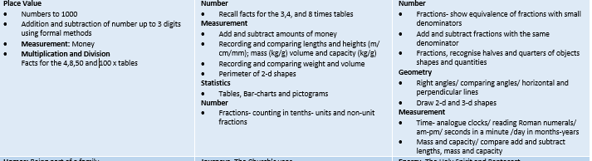
Curriculum
We use the White Rose scheme
Focus on secure understanding of key concepts
Addressing gaps in their understanding (multiplication and division)
Skills will continue to be developed to apply and explain their understanding
Formative assessment: Pupils across all year groups will complete termly reasoning and arithmetic papers from the White Rose scheme
Maths homework

Slide 18
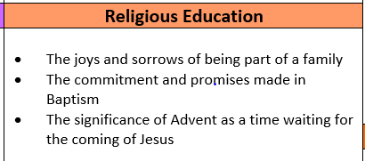

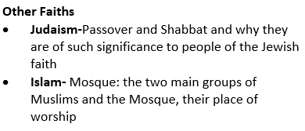
Curriculum

Slide 19
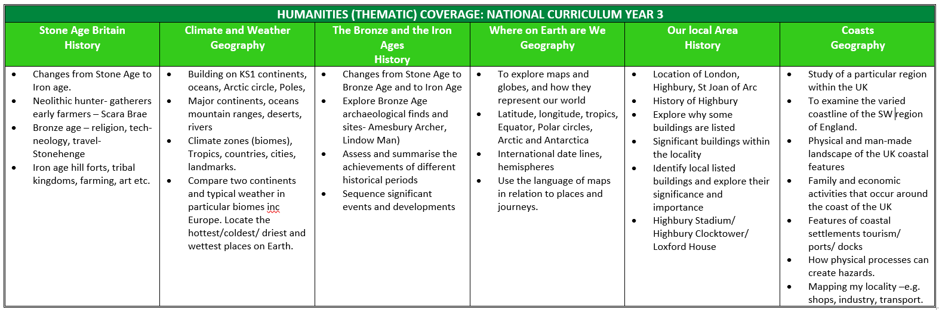
Wider Curriculum
Children receive weekly music sessions led by a music specialist and have singing practice which takes place on a Friday afternoon
Spanish is introduced and taught in Year 3
Geography and History are taught in half termly blocks so will alternate through the year (as below)

Slide 20
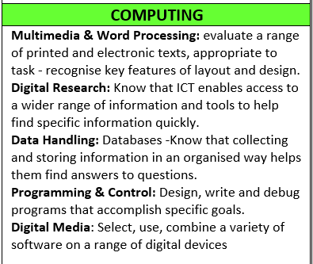
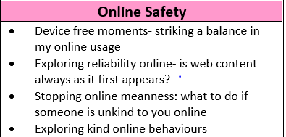
Curriculum
Computing Google Classroom – for Computing lessons in school

Slide 21
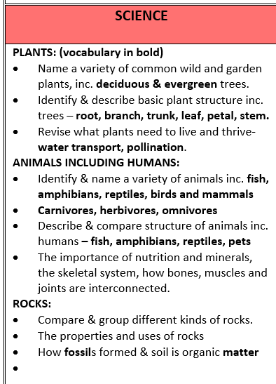

Curriculum

Slide 22
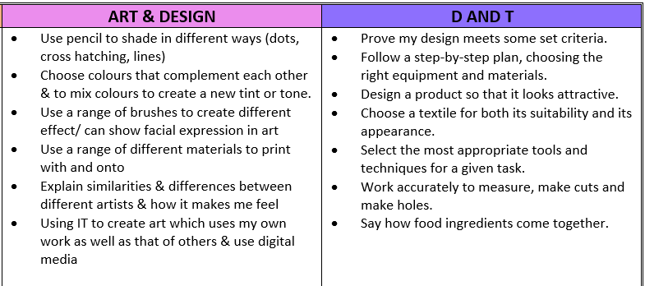
Curriculum
Skills based approach

Slide 23
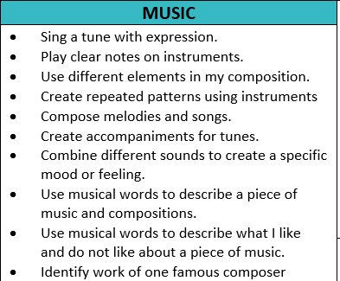
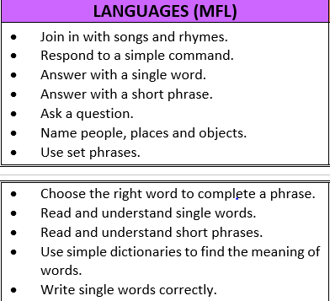
Curriculum

Slide 24
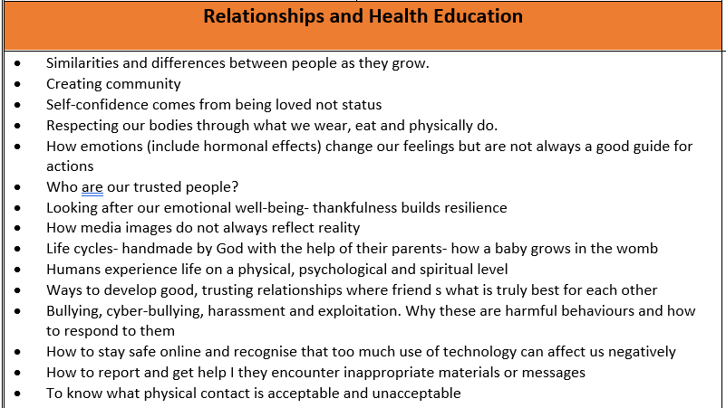

Curriculum

Slide 25
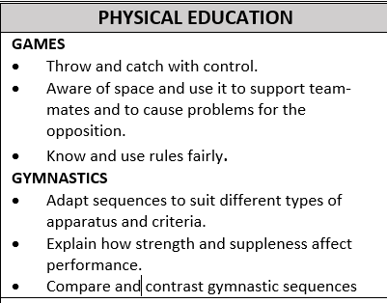
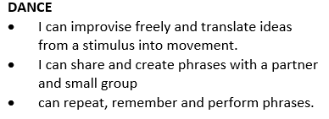
Curriculum

Slide 26

Other Information
Google Classroom
Join our Google Classroom
Notes to parents go on here
It is used in class (learning at school folder) to complete activities during computing
Children can share experiences with each other.

Slide 27

Summary/ Reminders
PE is on a Wednesday and Friday
Homework is set on a Friday and due in the following Friday
Reading records & Times table books should be in school every day
Reading books are changed when they are needed to be changed
Uniform/ coats should be labelled
Children to bring their own fruit, lunch time is much later in the juniors.
Any questions?

