Slide 1
Year 3 Curriculum Information for Parents
Miss Newson and Miss Kelly

Slide 2
Contents
Meet the Team
Daily routines
Behaviour expectations and rewards
Reading, Homework and spellings, Times Tables
Curriculum coverage

Slide 3
The Year 3 Team
Miss Newson (3G)
Miss Kelly (3H)
Mrs Mullen
Mrs Barnett

Slide 4
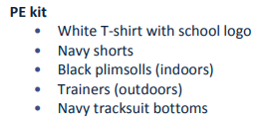
Daily routines
Soft start from 8:15 am
School day begins at 8:30 am (Gates close at 8:30 - arrivals after this will be recorded as late)
Pupils completing arithmetic, handwriting, times tables, writing activities or 1:1 reading
Emphasis on personal organisation:
Changing reading books independently
Belongings: all to be labelled
Personal responsibility for reading record/ times tables and homework books
PE kits on Tuesdays and Thursdays
Fruit - Fruit is not provided for KS2 children

Slide 5
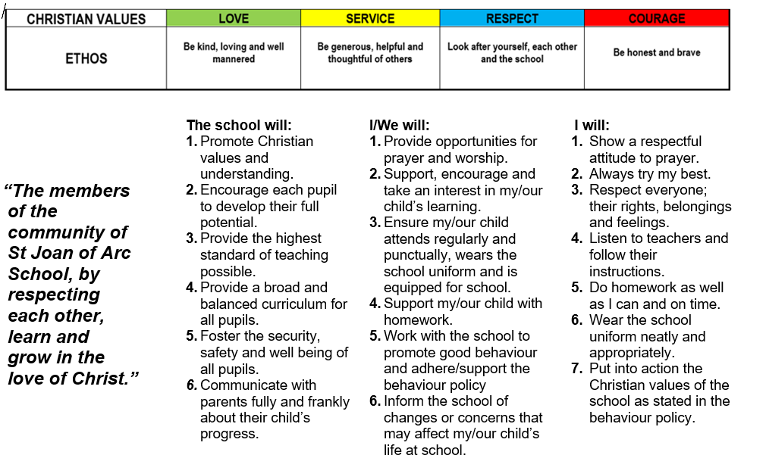
Behaviour policy
School Rules and Values
Home School Agreement

Slide 6
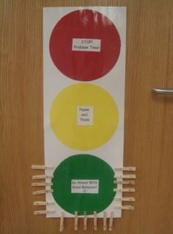
Behaviour policy
Positive Behaviour Rewards:
House Points linked to the class ‘traffic light’ display
Dojos – an interactive way to record good behaviour
Arc Awards – a weekly opportunity to win a prize
Certificates during our weekly Phase Assembly
Restorative Justice
A sequence of steps to help pupils get back to demonstrating expected behaviour
Whole school approach with the following steps :
a quiet comment 2) a behaviour reminder 3) a warning
4) Time out 5) Restore using reflective language

Slide 7
Year 3 Learning
Transition into KS2 - changing expectations
Move towards greater independence and ownership of learning
Evaluative approach to learning – metacognition
Focus on verbal and written reasoning and explaining of understanding
A balance of collaborative and independent learning

Slide 8
Reading records
National Curriculum statements at front and back
Objectives dated by Teacher/ teacher assistant during guided reading session
Comment recorded in reading record to show the focus of the session (dated objective), how your child read and occasionally what they need to focus on
Ideas for home reading and spelling in the middle

Slide 9
Reading at Home
Banded book linked to their reading level
Reading for Pleasure book to share at home
Reading at home as much as possible - it makes a massive difference
Recommended 10 - 20 minutes daily to an adult
Comments in reading records are really helpful for us- how your child read, what they did well/ can improve on or their thoughts on the text
Ask questions as well as listen to them (use Reading Record prompts- on next slide)
Higher order reading skills: when learners are able to retrieve information from a book or text and are able to relate to the text and read between the lines (inference)

Slide 10
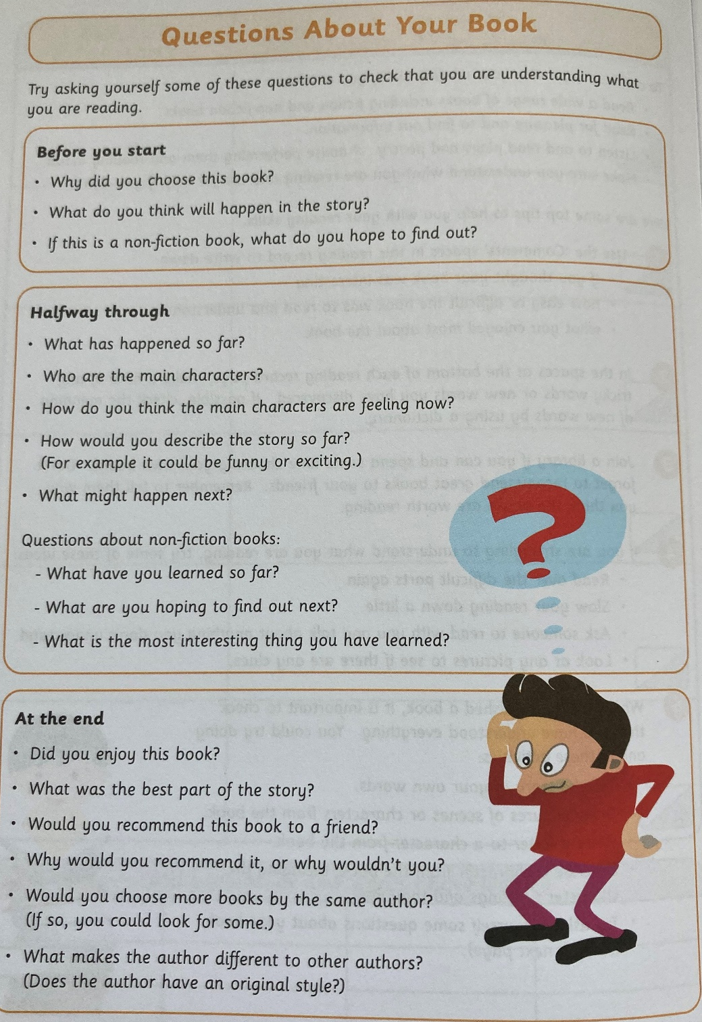
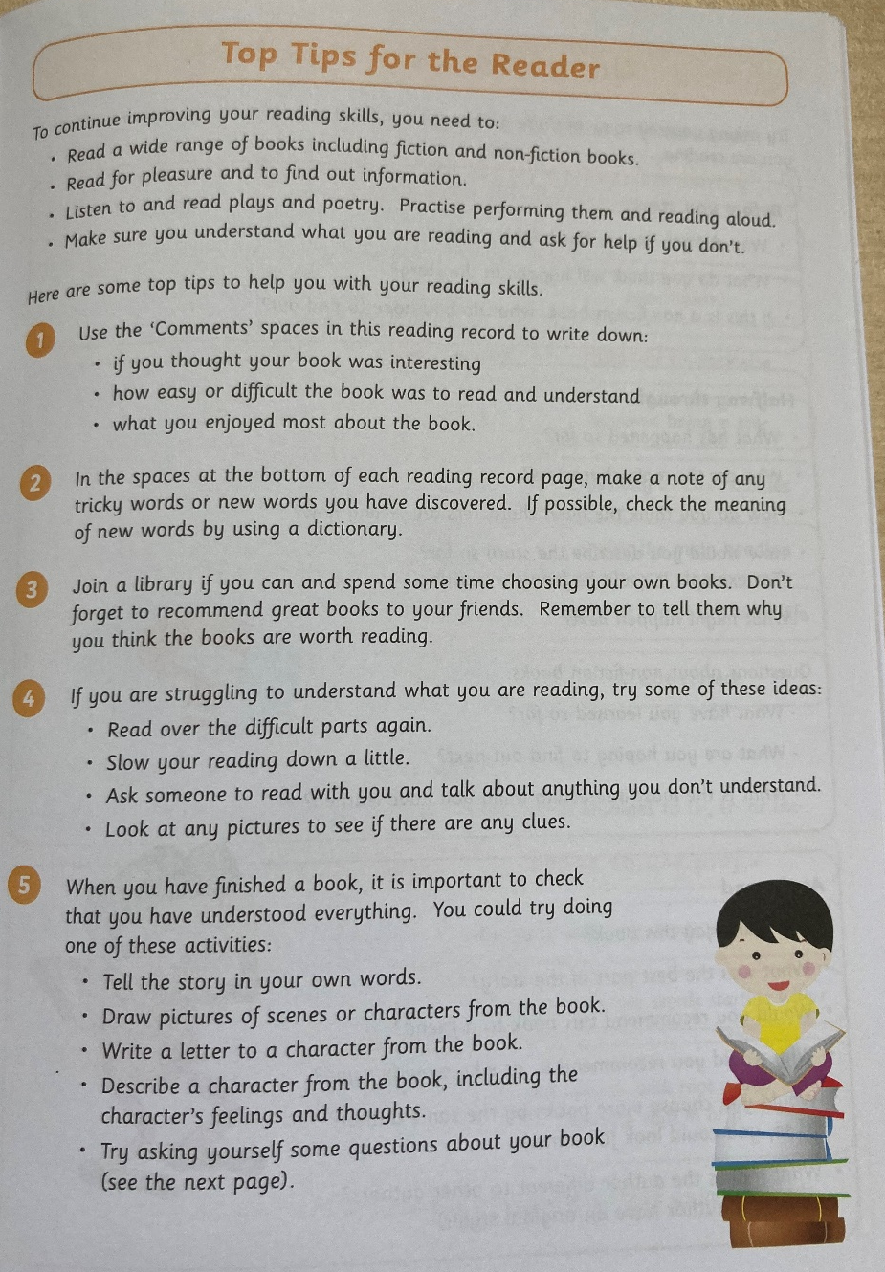
Reading at Home

Slide 11
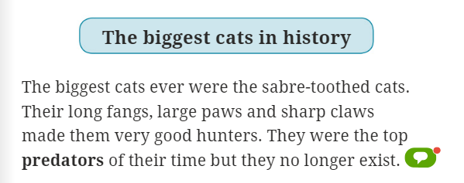
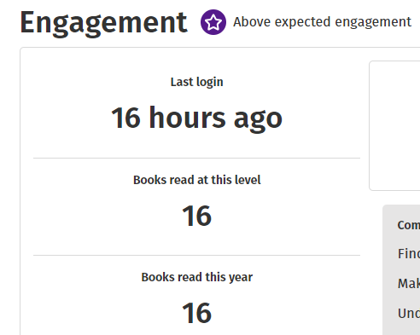
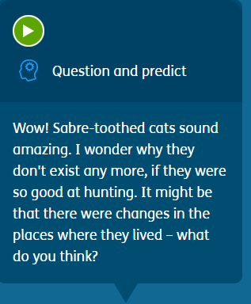
Oxford Reading Buddy

Slide 12
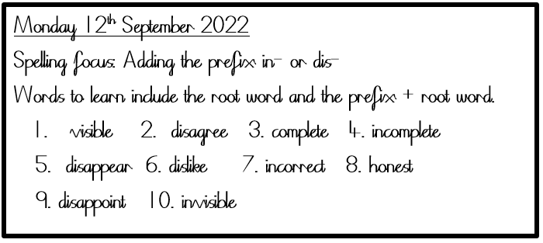
Spelling Homework
Read Write Inc. Spelling lessons
Focus on a spelling pattern, for example a prefix/suffix, over two weeks in school
Spelling homework links to this
Year 3/4 common Exception Words

Slide 13
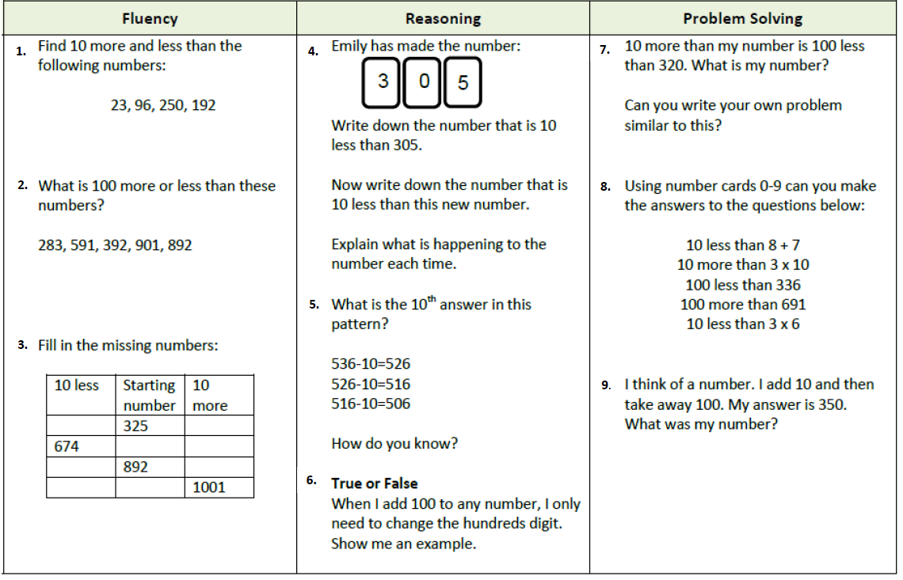
Maths Homework
Homework to be added to Google Classroom every Friday and to be completed by the following Friday.
Work to be completed in the pink homework books (not to be submitted on GC). Maths sheets do not need to be printed, children should record their written answers in their book.

Slide 14
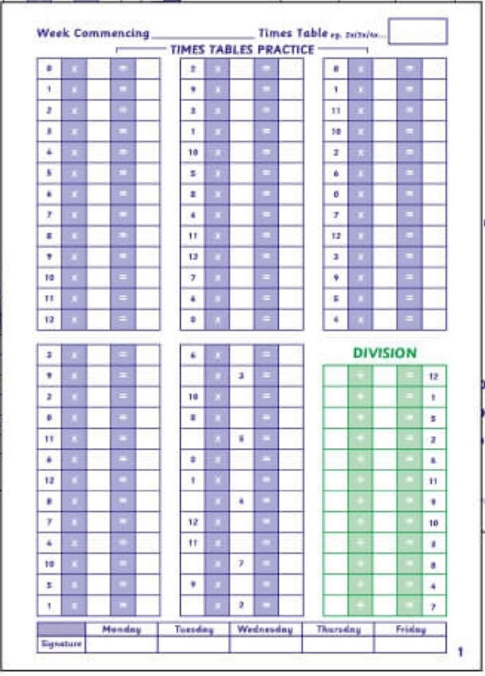
Times Tables
Completed in school on Monday
Monday night
Tuesday night
A vital skill
Preparation for Y4 times tables tests
Daily Times tables book practise
Times Table Log Book and Times Table Rockstars
Times Tables Rock Stars
Wed night
Thurs night
Completed in school on Friday
Parents to check and sign daily

Slide 15
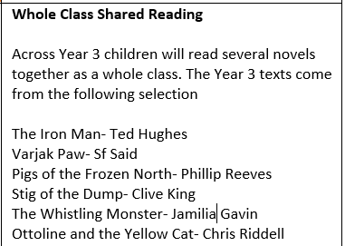
Curriculum
Most important skill the children learn
Foster a love of reading
Reading for pleasure
Read with breath and depth
Guided reading weekly (check front and back covers of Reading Records)
Reading assessments

Slide 16
Curriculum
Focus on fundamentals
Spellings
Handwriting
Sentence level learning (grammar)
Stamina
Self-editing
Not just in English lessons - across the
Curriculum

Slide 17
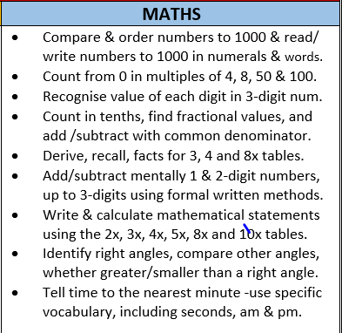
Curriculum
We use the White Rose for Maths scheme
Focus on secure understanding of key concepts
Addressing gaps in their understanding (multiplication and division)
Giving skills to apply and explain their understanding
Formative assessment: Pupils across all year groups will complete termly reasoning and arithmetic papers from the White Rose scheme
Maths homework

Slide 18
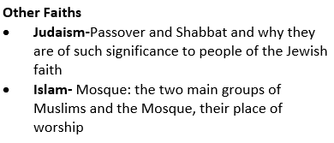
Curriculum

Slide 19
Wider Curriculum
Children receive weekly music sessions led by a music specialist and have singing practice which takes place on a Friday afternoon
Spanish is introduced and taught in Year 3
Foundation subjects will be taught across Year 3/4 subject specialist teachers (Computing, Geography/ History, Science and Art/ DT. To be reviewed half-termly
Geography and History are taught in half termly blocks so will alternate through the year (as below)

Slide 20
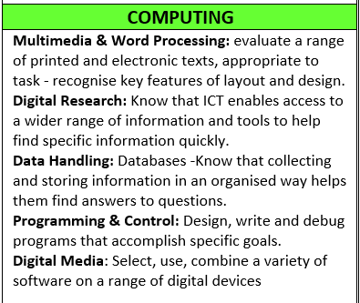
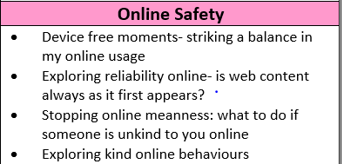
Curriculum
Computing Google Classroom – for Computing lessons in school

Slide 21
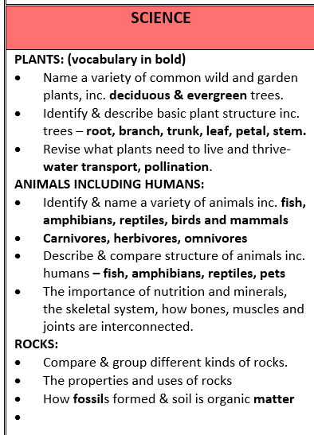
Curriculum

Slide 22
Curriculum

Slide 23
Curriculum
Skills based approach

Slide 24
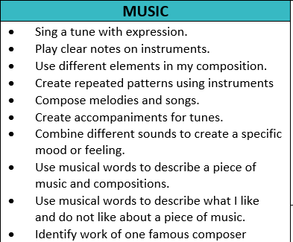
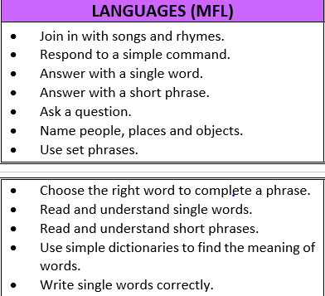
Curriculum

Slide 25
Curriculum

Slide 26
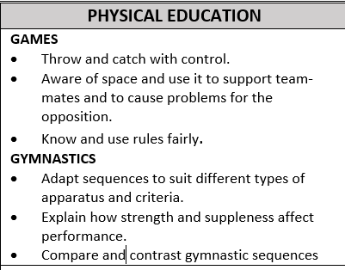
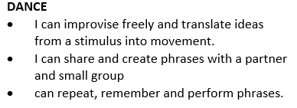
Curriculum

