Slide 1
Year 2 Curriculum Information for Parents
Mrs Farrell and Mr Shreeves

Slide 2
Contents
Staff in Year 2
Behaviour policy
Curriculum coverage
The school day and classroom routines
Reading, Homework and spellings
Expectations

Slide 4
Behaviour

Slide 5
Behaviour

Slide 6
CORE SKILLS Essential skills to be used, applied, and consolidated across the wider curriculum, including speaking and listening skills.
READING | WRITING | MATHS
· Secure with year group phonic expectations. · Recognise simple recurring literacy language. · Read ahead to help with fluency and expression. · Comment on plot, setting and characters in familiar and unfamiliar stories. · Recount main themes and events · Comment on structure of the text. · Use commas, question marks and exclamation marks to vary expression. · Read aloud with expression and intonation. · Identify past/present tense and why the writer has used a tense. · Use content and index to locate information. | · Write different kinds of sentence -statement, question, exclamation, command, · Use expanded noun phrases to add description and specification. · Write using subordination (when, if, that, because) and co-ordination (or, and, but). · Correct, consistent use of present, past tense · Correct use of verb tenses. · Write with correct and consistent use of - capital letters, full stops, question marks, exclamation marks. Use commas in a list · Use apostrophe to mark omission and singular possession in nouns. · Write under headings. · Write lower case letters correct size relative to one another – join with correct strokes | · Read and write all numbers to at least 100 in numerals & words. Odd/even numbers to100 · Order numbers using the < > and = signs. · Count in steps of 2, 3 and 5 from 0. · Recognise and can define the place value of each digit in a 2 digit number. · Name fractions 1/3, 1/4, 1/2 and 3/4 & find fractional values of shapes, lengths/numbers · Recall and use multiplication and division facts for the 2, 5 and 10x tables. · Add and subtract two 2-digit numbers, and three 1-digit numbers. · Tell and write the time to 5 minute intervals. · Recognise and use symbols £ and p solving money addition and subtraction problems. · Describe the properties of 2D and 3D shapes to include edges, vertices and faces.

Slide 7
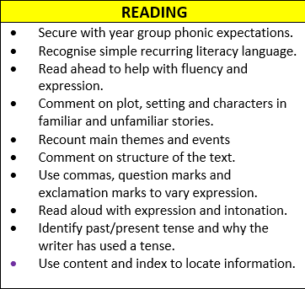
Curriculum
Most important skill the children learn
Foster a love of reading - New book corners
Read with breadth and depth
Black History Month
Daily phonic session - reading
Reading records
Book bag books / phonics reading books / library books - change ind
Cost of the books

Slide 8
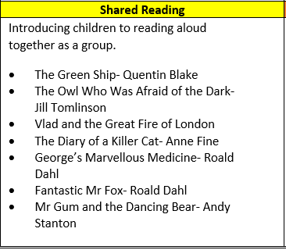
Class readers

Slide 9
Curriculum
Focus on fundamentals
Spellings
Handwriting
Sentence level learning
Stamina
Not just in English lessons
Vocabulary
Phonics daily
CLPE - Writing based on high quality texts

Slide 10
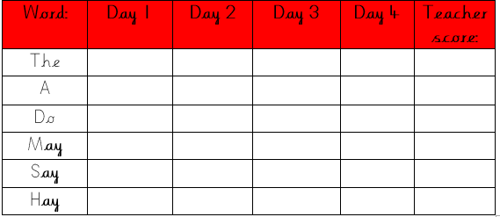
Spelling

Slide 11
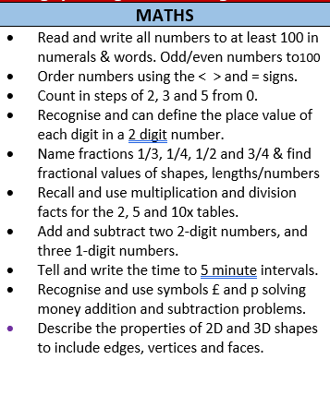
Curriculum
Focus on secure understanding of key concepts
Maths fluency - focus on number bonds / number composition / place value
Time / Fractions - Kitchen maths
Addressing gaps in their understanding (multiplication and division)
Giving skills to apply and explain their understanding
2, 3, 5 and 10 times tables

Slide 13
Curriculum
Black History Month
RHE/ PSHE
Music
P.E
Art / Computing / D.T

Slide 14
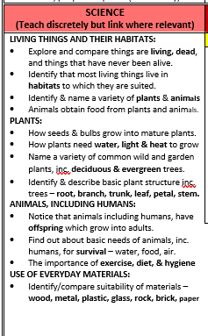
Collaboratively
Working scientifically

Slide 15
School Day/Week
Soft Start - 8:15-8:30 (Gates close at 8:30 - arrivals after this recorded as late)
Early Morning learning is really important - teaching of fundamentals
Times tables / Handwriting/ Sentence work / Revisiting previous lessons / Spelling and grammar and also time for 1:1 conferencing
PE kits on Monday and Thursday
Footwear - laces

Slide 16
Reading at Home
Reading at home as much as possible - it makes such a massive difference.
Recommended 10 - 20 minutes
Comments in reading records are really helpful for us.
3 books - Phonics / Book Bag (Reading aloud) / Free reader - library book
Transition to KS2 introduce Oxford Reading Buddy in Summer Term / Book bands.

Slide 17
Maths Homework and Spellings
Maths
Given out on a Friday - Due in the following Friday
All paper copies - Transition to Google Classroom in Summer Term
Discussion on Google Classroom
Maths is application of skills worked on in class that or the previous week.
20 - 30 minutes
Spellings
Home Handwriting (specific children)

Slide 18
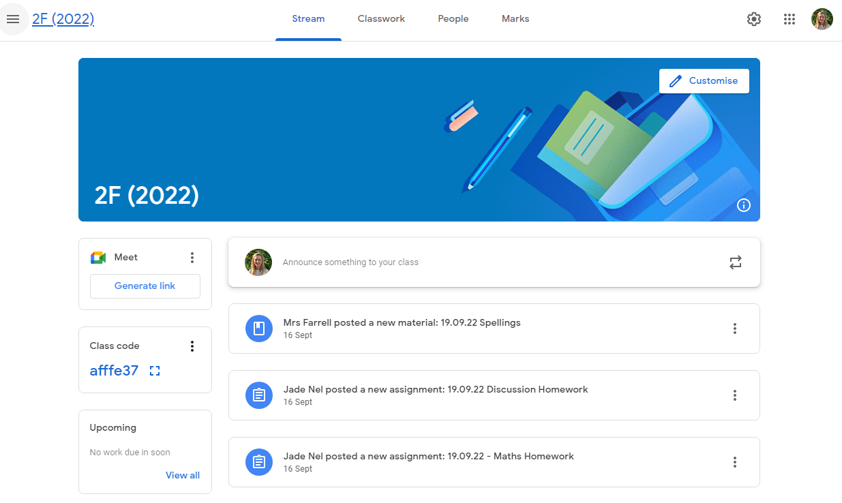
Other Information
Google Classroom
Discussion homework on Google Classroom
Show and tell online

