Slide 1

Year 2 Curriculum Information for Parents
Staff:
Class E: Ms Rowley and Ms Laszsciw
Class F: Ms Kelly and Ms Long

Slide 2
Contents
The school day and classroom routines
Behaviour policy
Curriculum coverage
Reading, Homework and spellings
Expectations

Slide 3
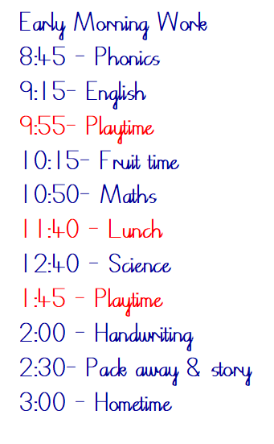
School Day/Week
This is an example of a typical school day in Year 2. The afternoon sessions change between different foundation subjects but the morning roughly remains the same.
On Monday children change their book independently
On Friday children will be required to bring in their homework books (more information later regarding homework)
Soft Start - 8:15-8:30 (Gates close at 8:30 - arrivals after this recorded as late)
PE days: Tuesday and Friday

Slide 4
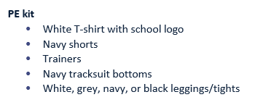
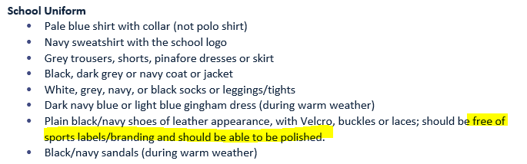
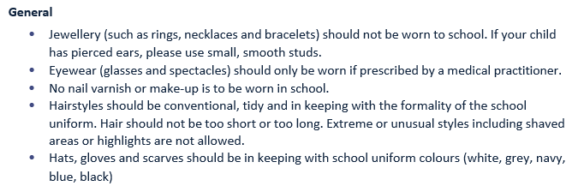
Uniform

Slide 5
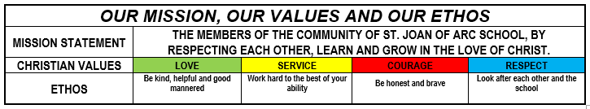
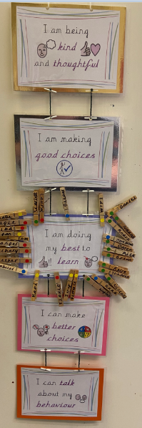

Behaviour
We follow the school values: Love, Service, Respect and Courage
In class, we have our own behaviour chart
As a whole school we follow the restorative justice approach where children are given opportunities to reflect on their choices.
We also use house points that are a collective around the school and the winning house is announced weekly in assembly.

Slide 6
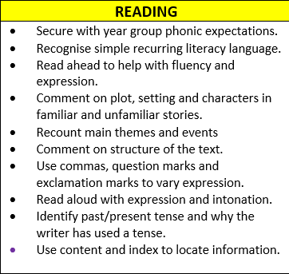
Curriculum
Most important skill the children learn
Foster a love of reading – Last year we had new book corners and we have had a recent top up of new books
Books: Children take home 3 books a week. 1 book corner book, 1 ‘book bag’ book and 1 phoncis book that is used in phonics sessions. Children change their books independently on a Monday
Phonics: The children take part in a daily phonic session using the Read Write Inc scheme. Curently we are continuing with the phonics groups from Year 1 until we build a relationship with the children.
Reading records: These need to be in school daily. Please sign every night and write a short comment on how your child read at home. Please also use the reading records if you need to let us know anything i.e. pick up changes.
Focus for reading: Consolidation and application of sounds and shifting focus onto fluency and comprehension skills

Slide 7
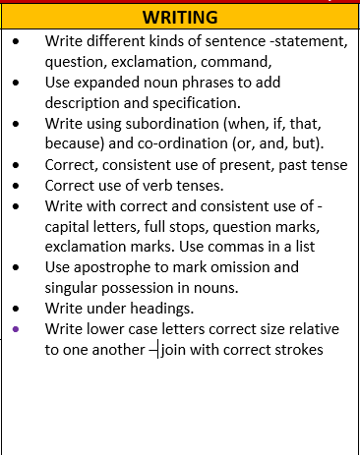
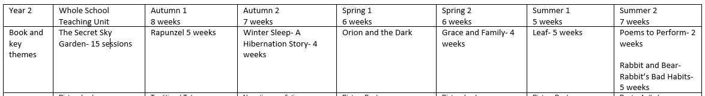
Curriculum
Writing is not just taught in English lessons but across the whole curriculum
  Focus on fundamentals:
  Spellings through weekly spelling homework, daily phonics and explicit spelling teaching (shown on next slide)
  Phonics
  Handwriting taught daily and some children may receive a home handwriting book to continue practicing
  Sentence level learning/ grammar focuses/ punctuation/ vocabulary
  Stamina
CLPE scheme of work - Writing based on high quality texts

Slide 8
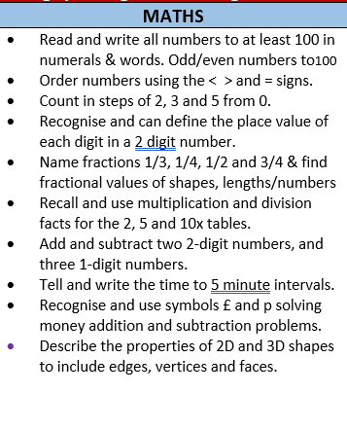
Curriculum
Initially a lot of the maths in class is fluency based, to try and encourage independendence. We will then move on to more reasoning and problem solving based questions (similar with maths homework).
Focus on secure understanding of key concepts (addition and subtraction, odd/ even numbers)
Maths fluency - focus on number bonds/ place value
Time / Fractions - Kitchen maths
2, 3, 5 and 10 times tables

Slide 9
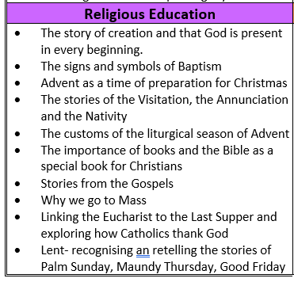
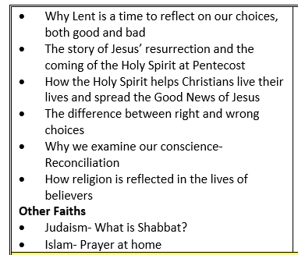













Curriculum
The children pray together at the beginning of the day, lunch time and at the end of the day.
We attend church and celebrate mass at the beginning of each term and on Feast days that fall during the school week.

Slide 10
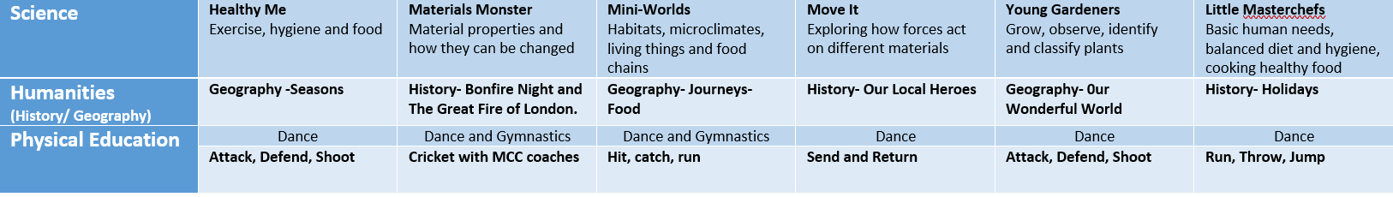
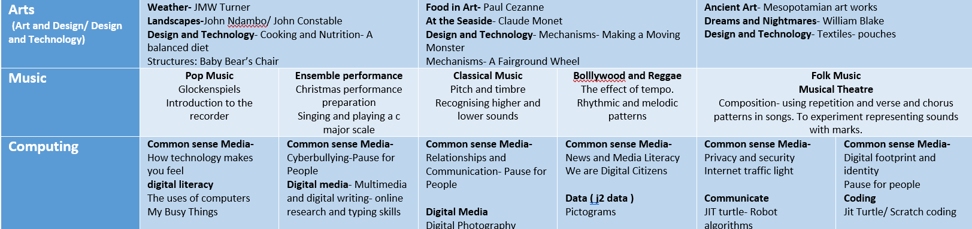
Curriculum

Slide 11
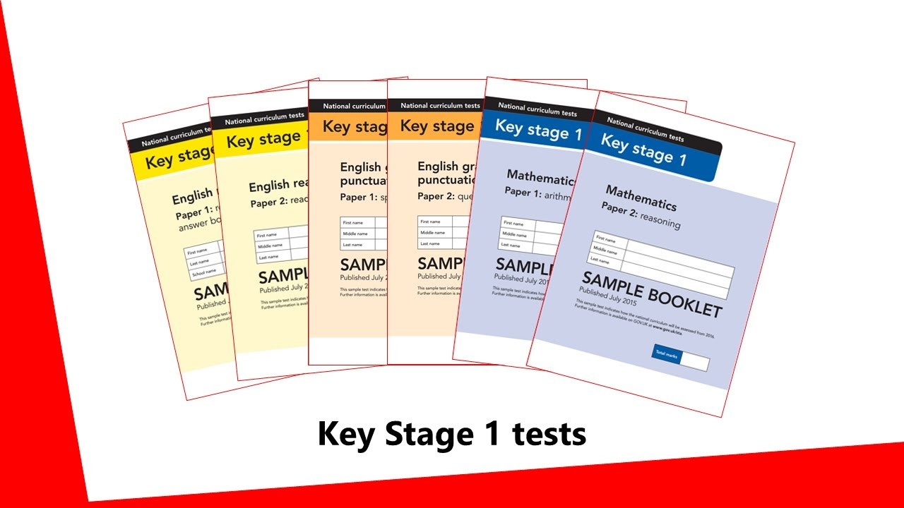
End of year assessments
We will submit teacher assessments to the local authority in June 2025
The levels submitted will be either WTS, EXS or GD
Reading, writing and maths
No formal SATS
Past papers will still be used to inform our teacher judgements
We never use the term SATS and the pressure is not on the children

Slide 12

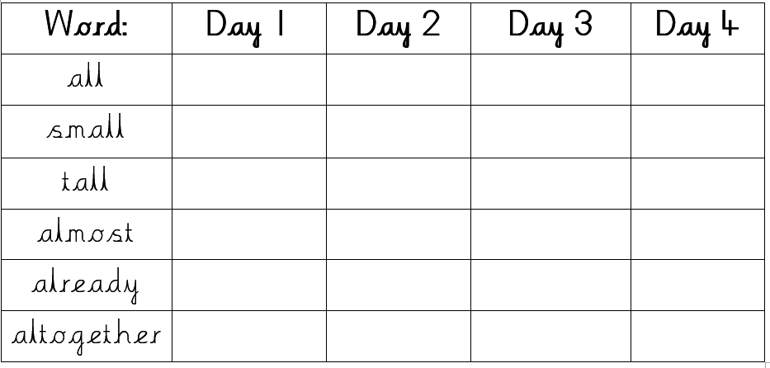
Maths Homework and Spellings
Maths
  Given out on a Friday - Due in the following Friday
  All paper copies - Transition to Google Classroom in Summer Term
  Maths is application of skills worked on in class that or the previous week
  Children should attempt the homework on their own before going through it with an adult
Spellings
  Given out on a Friday – Spelling test the following Friday
  The spelling test will initially take place in order they are sent home. However, later in the term we will mix the order so please ensure children practice this way at home
Home Handwriting (specific children)

Slide 13
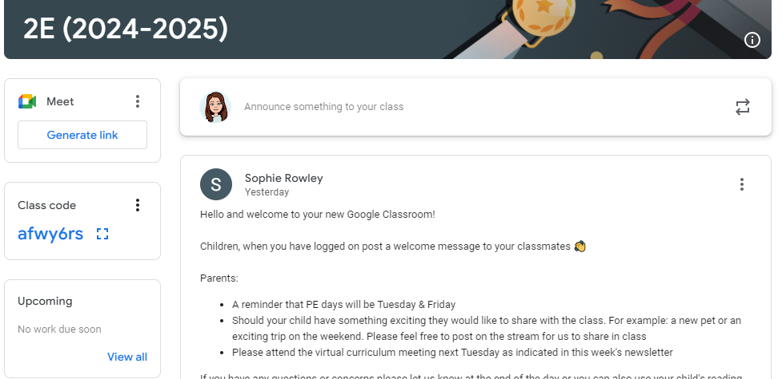
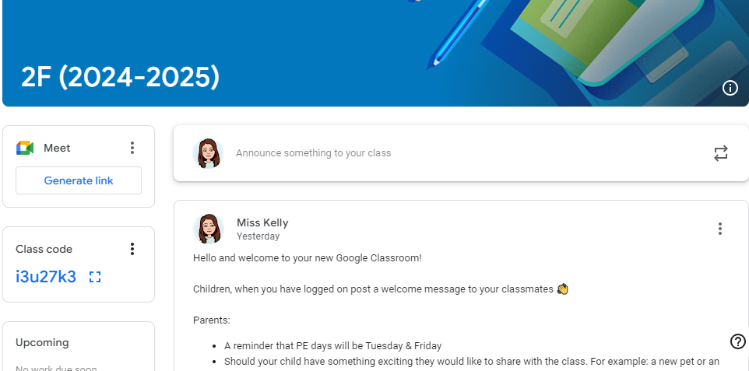
Other Information
Google Classroom
Join our Google Classroom
Show and tell online
It is used in class (learning at school folder) to complete activities
Used for computing

Slide 14
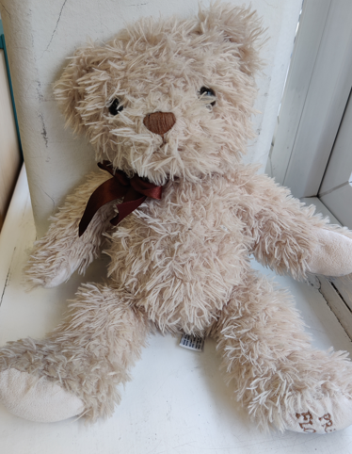
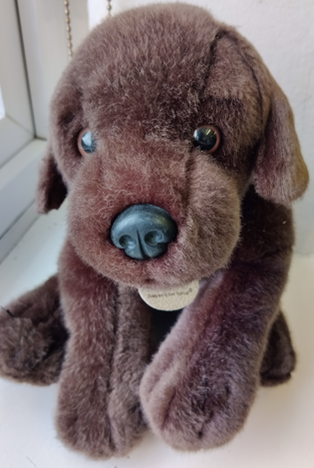
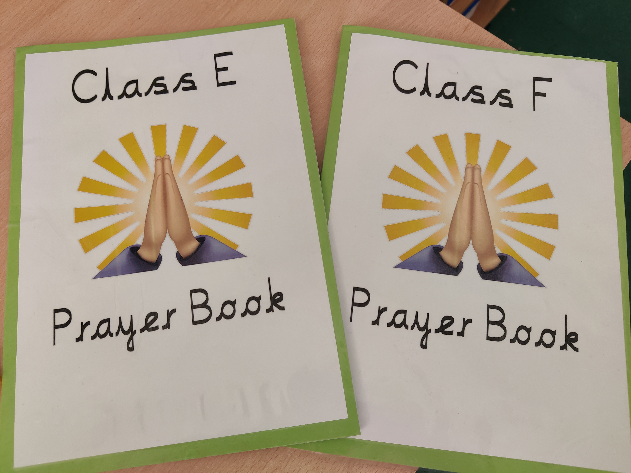
Class mascots and prayer book
Class mascots and prayer books will go home a child every Friday and should be brought back in to school on Monday. Please ensure they are looked after and returned promptly.
We ask children to upload pictures on Google Classroom of their adventures with the mascot that they can share in class.
Class E mascot-
Class F mascot- Basil

Slide 15
Summary/ Reminders
PE is on a Tuesday and Friday
Homework is set on a Friday and due in the following Friday
Reading records should be in school every day
Reading books are changed on a Monday- children's responsibility but please write a note in the RR if this has not been done
Uniform/ coats should be labelled
Encourage independence at home getting dressed etc. and encourage children to check their own bag for their school belongings
Any questions?

