Slide 1

Year 1
Parent Curriculum Meeting
Tuesday 10th
Welcome
Class C:
Miss Nicou
Mrs Barnett
Class D:
Miss Thomas/Miss O’Brien
Mrs O’Neale

Slide 2
Aims of the Session
Give you a better understanding of your child’s learning this year
The school day and classroom routines
Curriculum coverage
Help parents/carers to feel empowered to support their children at home
Give you the opportunity to ask questions
If you do have any questions, please add them to the chat function and we will answer at the end of the session
C

Slide 3
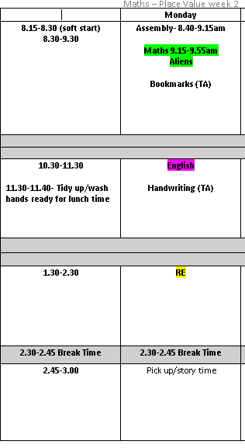
The school day
Here is an example of what a day looks like as a year 1 child.
On a Monday, the children come in and independently change their guided reading books, book bag books and book corner books.
On a Friday, the children will bring back their math's homework, we go through it as a class and then they are given the next week’s homework.
C

Slide 4
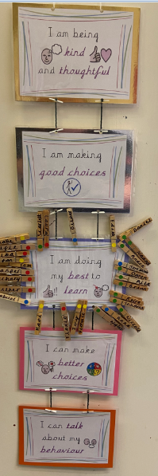
Behaviour
As a whole school we are focusing on a restorative justice approach for behaviour -children are given an opportunity to reflect on their choices and the impact their choices have on themselves and others
In class we also made our own class rules, these go alongside our four school rules; Love, Service, Respect and Courage.
A

Slide 5




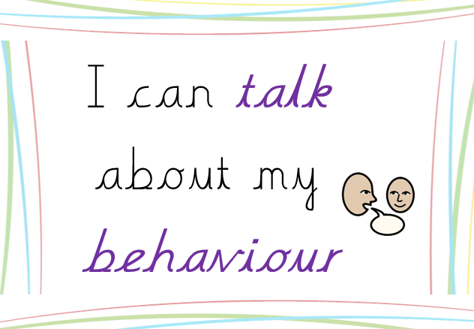
Behaviour
C

Slide 6

Behaviour
Certificates are also awarded for demonstrating the school ethos and/or fantastic work during our Phase assembly (years Reception, year 1 and year 2) on Friday morning.
A

Slide 7
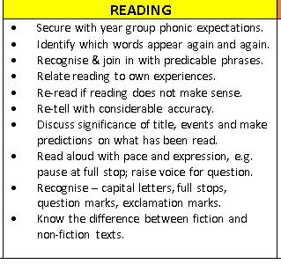
Curriculum
For English we follow a scheme that promotes the power of reading CLPE. We will look at a number of lovely picture books in lots of detail throughout the year
Daily phonics sessions RWI
Within our phonics sessions we also do group guided reading with teacher or teaching assistant leading the group.
Story time – promote a love for reading
A

Slide 8

Phonics: what is RWI?
A reading and writing programme, which is based on the teaching of synthetic phonics
Aims to get children reading fast, by having a secure phonic knowledge and being able to read and spell words
Links phonics, reading, spelling, handwriting and writing
The children are securing their phonics knowledge of speed sound set 1 and 2 learnt in reception before we move onto set 3.
In Year 1: we have 5 sessions a week which are led by either a teacher or teaching assistant, which rotates fortnightly.
Phonics screen check will take place the
second week of June A

Slide 9
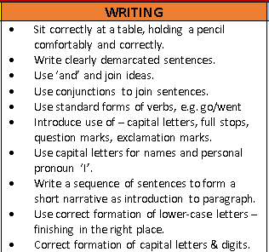
Curriculum
Shared writing
Adult directed writing tasks
Chances to write independently through their play
Phonic sessions
Encouraging phonetic sounding out of words
Letter formation
High frequency words - bookmarks
Handwriting
A

Slide 10
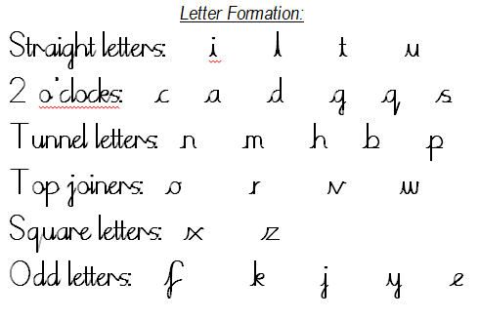
Handwriting formation
Form lower-case letters correctly
Know and form capital letters
  SJA website: handwriting, school script and rhymes
  A

Slide 11
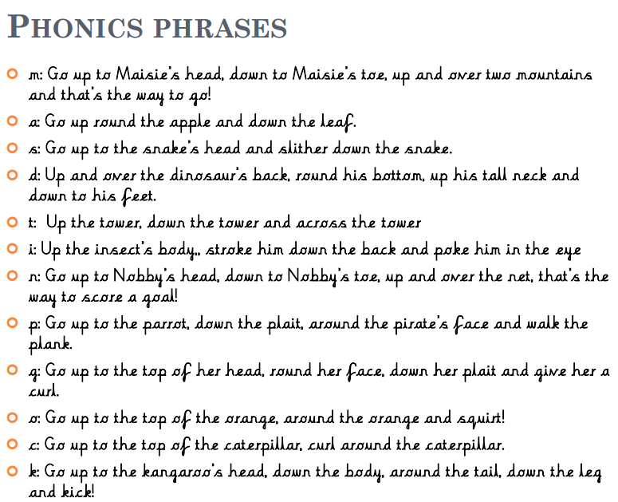
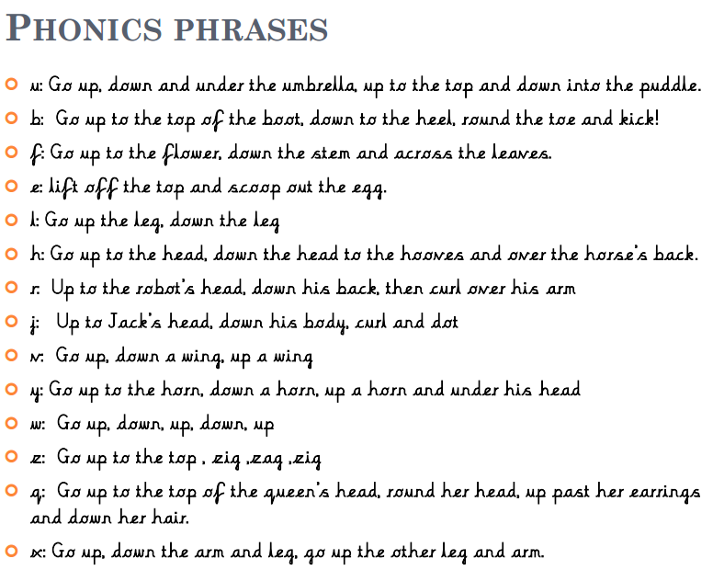
Handwriting formation
A

Slide 12



Curriculum
Whole-School Mastery approach – Focusing on secure understanding of key concepts
Adult led investigations moving towards more independent
Everyday fluency
Using a wide-range of manipulatives (Numicon, bead strings…)
Develop reasoning: “How do you know that? Prove it”
Modelling vocabulary
Maths working wall.
C

Slide 13


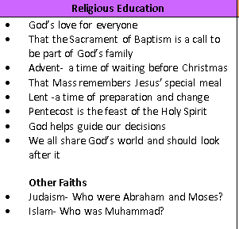
Curriculum
The children pray together at the beginning of the day, lunch time and at the end of the day.
We attend church and celebrate mass at the beginning of each term and on Feast days that fall during the school week.
C

Slide 14
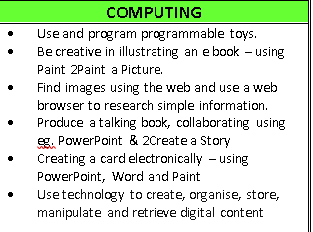

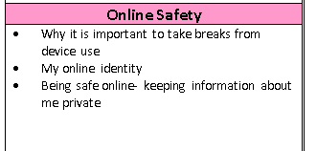
Curriculum
Organised into four Threshold Concepts
Code: This concept involves developing an understanding of instructions, logic and sequences
Connect: developing an understanding of how to safely connect with others
Communicate: involves using apps to communicate one’s ideas
Collect: developing an understanding of databases and their uses
A

Slide 15
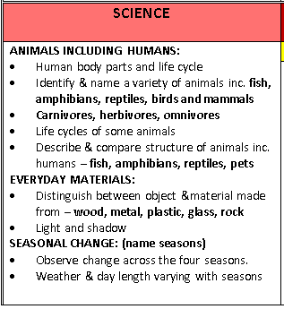
Curriculum
We cover these objectives throughout the year through the following topics-
Who am I – The human body.
Celebrations – light, shadows and materials
Polar adventures – classifying materials
Treasure Island – plants
On Safari – invertebrate animals
Holiday – classify animals C

Slide 16
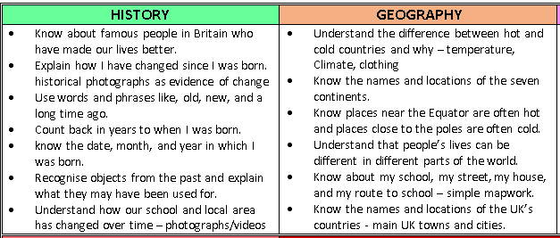

Curriculum
A

Slide 17


Curriculum
Geography topics:
Our local area
People and their communities
Animals and their habitats
History Topics:
My family history
The greatest explorers
Great inventions
Building on skills and knowledge learnt in reception and forms the foundations of learning to come. A

Slide 18
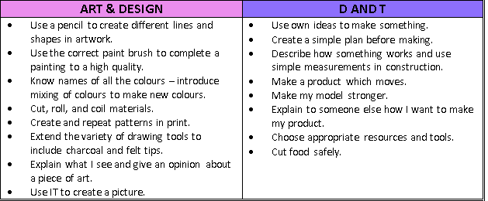
Curriculum
C

Slide 19
Curriculum
We have weekly singing assembly, led by Mr. Owen. The children learn songs for Mass and non-religious ones
The children have weekly 45 minute music lessons with Mr Owen too. The children are also introduced to playing musical instruments such as the xylophone.
A

Slide 20
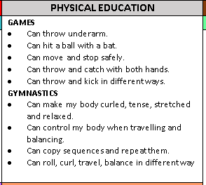
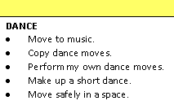
Curriculum
A

Slide 21

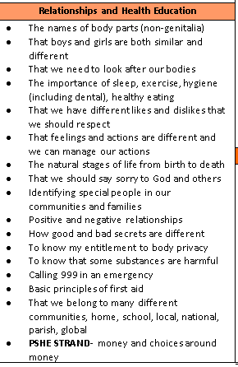

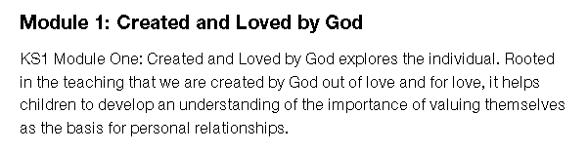


Curriculum
A

Slide 22
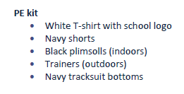
PE days
Please remember to send your child into school in their PE kits on a Monday and Friday so they can take part in the lesson
A

Slide 23
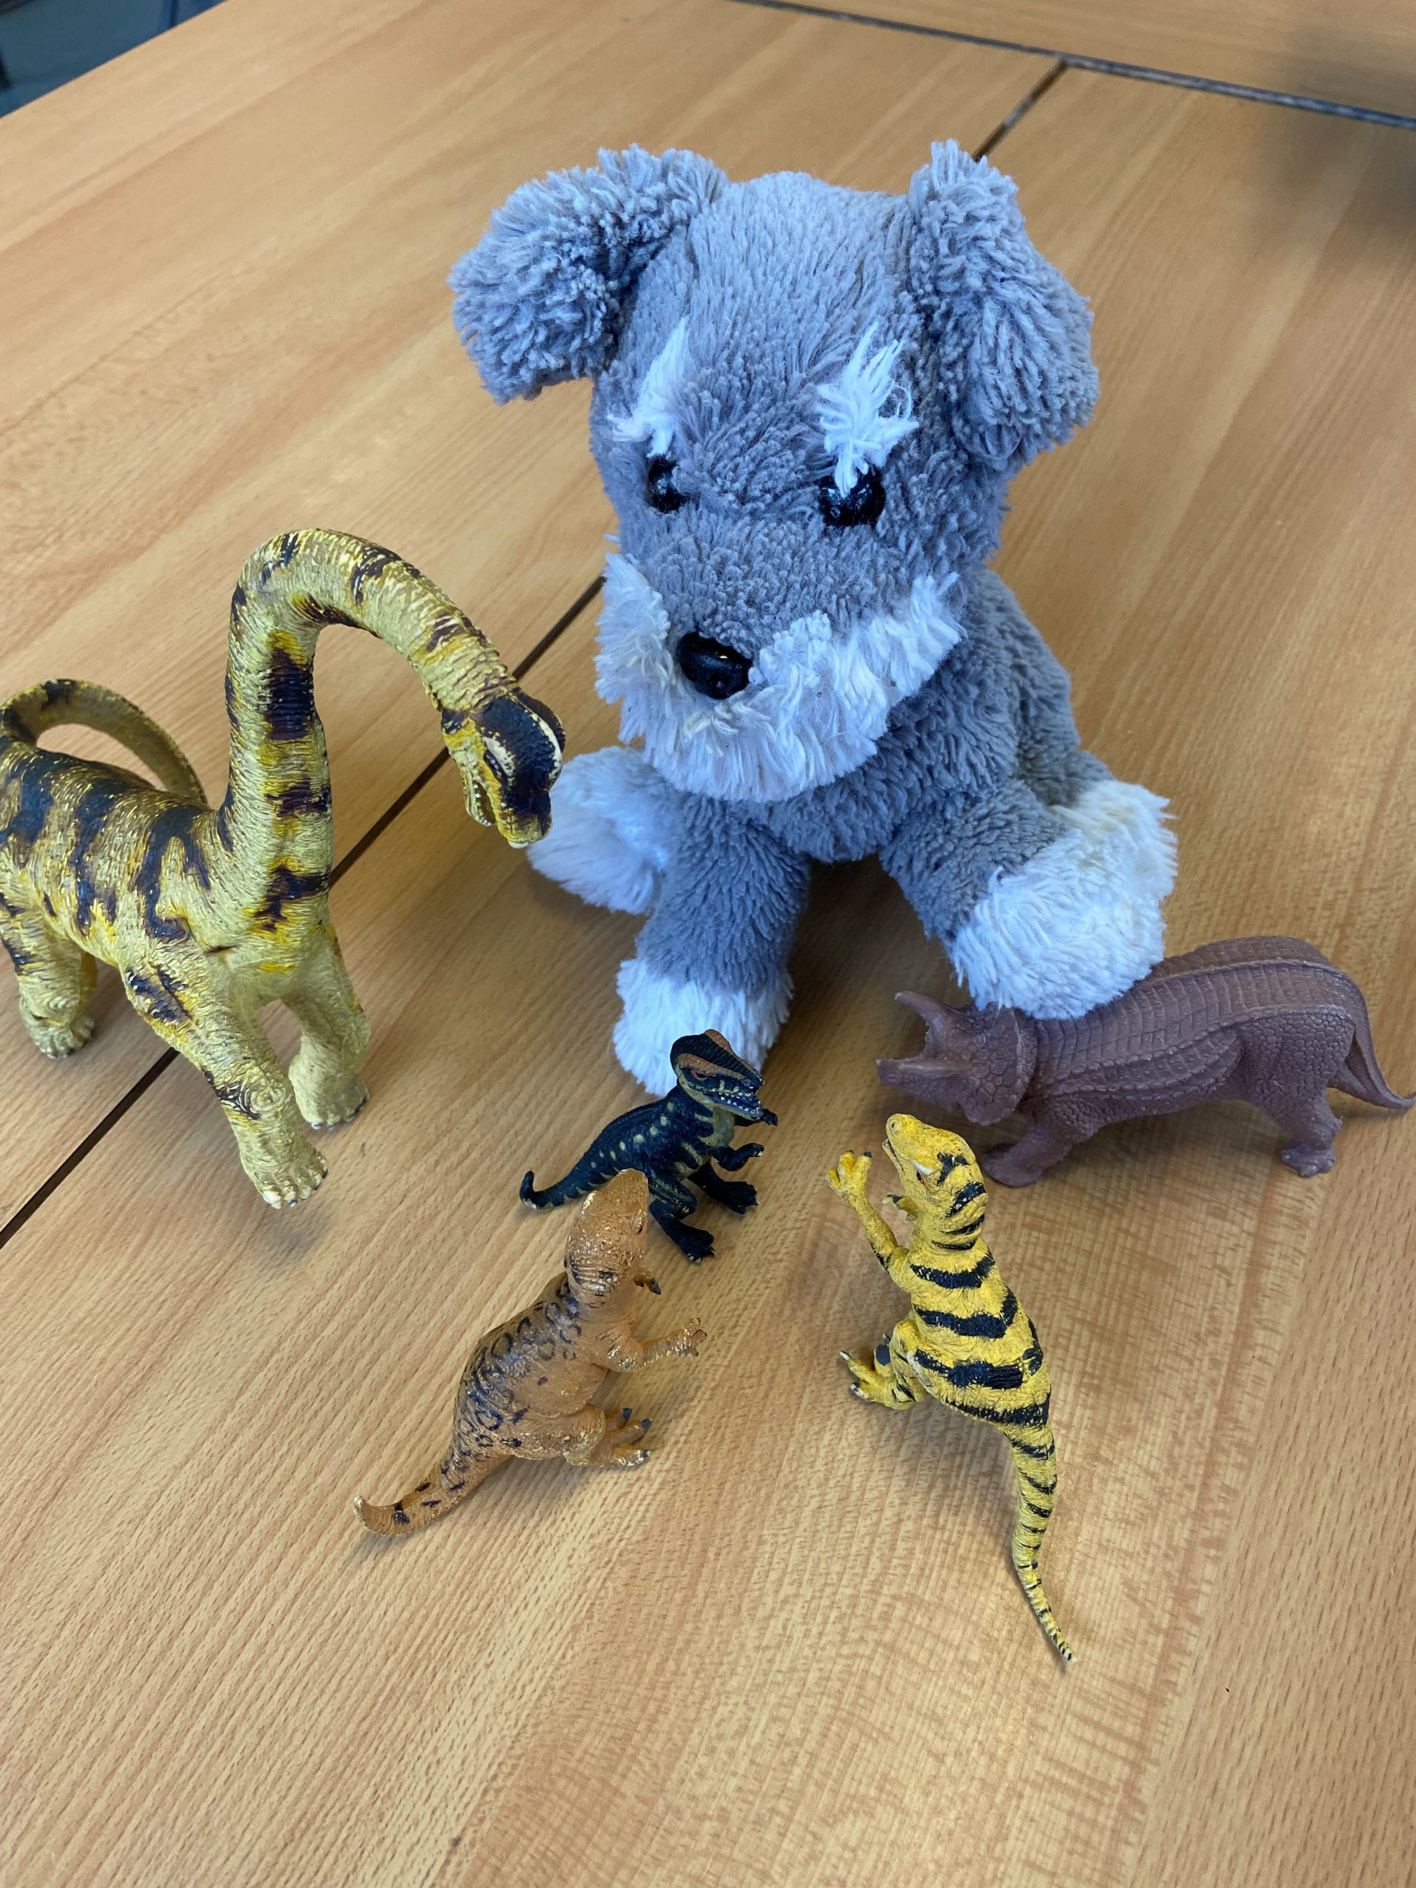

Maths homework
Maths homework will be handed out on a Friday in your child’s blue homework folder and the class we go through the homework the following Friday.
The homework is based on the learning done that week or the previous week in class.
Class pet
Please upload photos and a little caption onto your child’s Google Classroom page by the following Friday so they can enjoy showing their peers. C
Danny Dog

Slide 24

Supporting your child at home
Reading at home makes such a difference
Please read for ten to fifteen minutes reading with your child daily– their guided reading book / book bag book / book corner book
Ask questions as well as listening to your child read
Comment in the Reading Record and ensure you sign it daily
A

Slide 25
Reading & spelling bookmarks
Year 1 pupil’s have a bookmark with high frequency words to learn to read and spell. This will have continued on from Reception. They will work through these at their own pace, please practise these regularly with your child
Children should work through their current bookmark but also review previous bookmarks
They will be given new words once they have progressed to the next phonics group. Bookmarks will remain the same until then. We encourage children to write sentences containing the words on their current bookmark C

Slide 26



Learning resources at home
Your child’s LGfL log-in and Google Classroom log in are the same and are stuck in the back of your child’s reading record.
Access interactive resources across all areas of learning via free LGfL website
C

Slide 27
Other matters…
Children should attend school everyday, there is an expectation that children have a minimum of 96% attendance
Please ensure all clothing and water bottles are labelled
Also ensure your child is wearing the correct school uniform (including jackets/coats – navy blue, grey or black and shoes not trainers)
Please help your child at home by encouraging them to dress and undress themselves, put on their own coats and zip them up
A
Notes:
Letter with highlighted missing/incorrect items

Slide 28
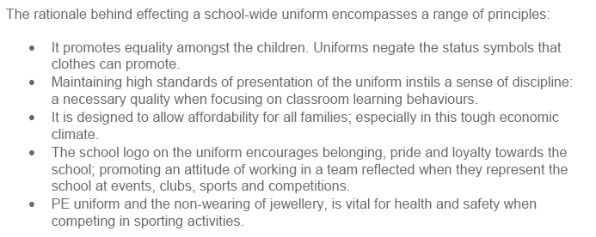
School Uniform
Mr Fuiava has been so impressed by the standards of presentation in our uniform, just a quick note from him:
A

Slide 29

Questions
C

