Slide 1
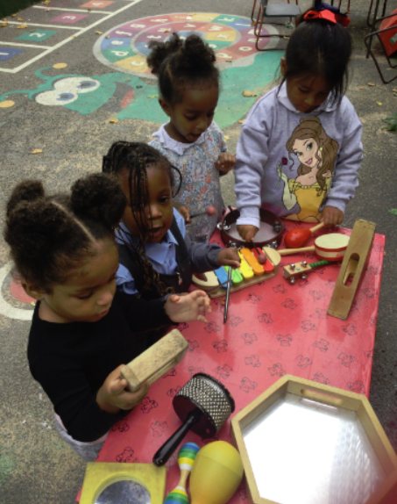
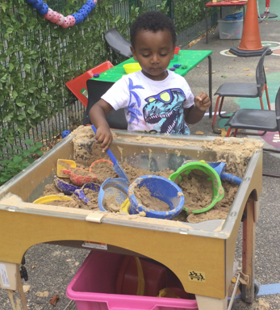
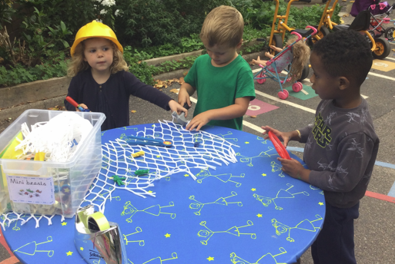
EYFS Nursery Curriculum Information for Parents

Slide 2
Aims
To give you a better understanding of your child’s learning this year
To share our aims
To help parents/carers to feel empowered to support their children
To give you the opportunity to ask questions

Slide 3
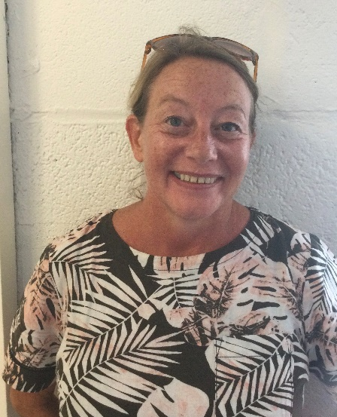
Introductions
Aims of the Session
Miss Tibbs– EYFS Lead and Reception teacher
Ms Kelly– Nursery teacher
Ms Desci – Lead Early Years Practitioner
Ms Carty – Nursery Nurse

Slide 4
What is the Early Years Foundation stage (EYFS)?
The EYFS is the stage of education for children from birth to the end of the Reception year
It is based on the recognition that children learn best through play and active learning
It is developed around 4 themes that underpin the EYFS:
1. A Unique Child - Observe what a child is learning
2. Positive Relationships - What adults can do to support learners
Enabling Environments - What adults could provide to enhance learning
Learning and Developing - Children’s achievements through the above
Notes:
Unique child - Looking at the development of each individual child
Positive relationships – how adults can support the children
Enabling environment – following children’s interests, providing a stimulating environment
Learning and development – monitoring and tracking children’s development through the above.

Slide 5
Characteristics of Effective Learning
Playing and Exploring
Active Learning
Creating and thinking critically
Notes:
Playing and exploring – engagement, finding out and exploring, playing with what they know, being willing to ‘have a go’
Talk about how you and the children get better at things through effort and practice, and what we all can learn when things go wrong.
Encourage children to try new activities and to judge risks for themselves. Be sure to support children’s confidence with words and body language
Active learning (motivation): Being involved and concentrating, keeping trying, enjoying achieving what they set out to do
Help children to become aware of their own goals, make plans, and to review their own progress and successes. Describe what you see them trying to do, and encourage children to talk about their own processes and successes.
Encourage children to learn together and from each other
Be specific when you praise, especially noting effort such as how the child concentrates, tries different approaches, persists, solves problems, and has new ideas.
Creating and thinking critically – thinking, having their own ideas, making links, choosing ways to do thing
Model being a thinker, showing that you don’t always know, are curious and sometimes puzzled, and can think and find out.
Encourage children to describe problems they encounter, and to suggest ways to solve the problem.
Give children time to talk and think.

Slide 6
EYFS – Key changes from 2021
Some key changes:
1. Less focus on recording and paperwork.
This means staff do not need to keep a large amount of written evidence that proves children are able to do lots of things.
Staff still know the abilities and skills of each child, and know how to support them to develop. However, now they do not need to write this down unnecessarily.
This frees up more time for staff to spend directly with the children.
By taking away the need for constant recording, it helps to develop more natural play, conversations and interaction between adults and children.

Slide 7
Communication and Language
2. There is more of an emphasis on the importance of developing communication and language skills.
Children should be supported in building up vocabulary by increasing the amount of words they know and can use.
Encourage more conversations between adults and children, but also children and their peers.
Good language skills are the basis for all other learning and social interaction, so this is vital to focus on.
Asking and answering questions
Vocabulary
Listening and attention
Retelling events

Slide 8
Reading
There is a focus on how reading stories is important to help children develop in all of Areas of Learning.
Daily reading of stories encourages an enjoyment of reading from a young age.
Lots of other learning opportunities happen when looking at books, for example comparisons of culture or the past.
Listening to stories develops imagination, ideas and language.
Reading is an essential skill and so should be shown to children, as well as practised by them regularly.
Children are also encouraged to use story ideas in their play.

Slide 9
Healthy Living
There is a focus on encouraging healthy choices overall and an understanding of oral health.
Required to teach children the importance of brushing teeth.
Supervised toothbrushing is not expected in settings and schools.
Focus on helping children to understand which choices to make that will help them to be healthy, for example which foods to eat and why.
Getting into good routines from a young age is important as these often continue into adult life.

Slide 10
Areas of Learning…
The EYFS Framework is broken down into:
3 Prime areas -
Communication and language
Personal, Social and Emotional Development
Physical Development
And then 4 specific areas -
Literacy
Mathematics
Understanding of the World
Expressive Arts and Design
Notes:
The prime areas are instrumental in igniting children’s curiosity enthusiasm and capacity for learning forming relationships and thriving in life. The prime areas begin to develop quickly in response to relationships and experiences, and run through and support learning in all other areas. The prime areas continue to be fundamental throughout the EYFS

Slide 11
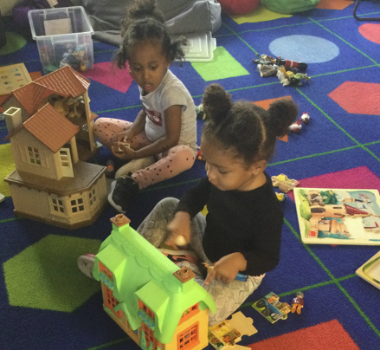
Personal, Social and Emotional Development
Greater emphasis on self-regulation
Making and building relationships
Know what their own needs are
Dress and undress independently
Develop independence
Manage feelings and behaviour - telling the difference between right and wrong
Health and Self-Care – identifying dangers, washing hands

Slide 12
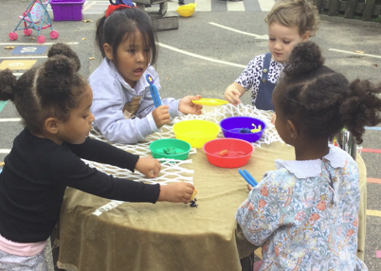
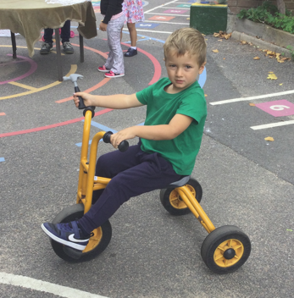
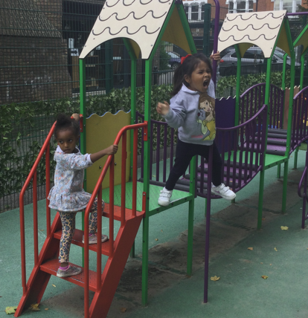
Physical Development
Provides opportunities for using a range of large and small equipment
Helps them to develop a sense of space around themselves and others
Encourages balance
Develops practical skills such as dressing, undressing etc.
Handling equipment and tools effectively including pencils for writing
Focus on developing
both fine and gross motor skills

Slide 13
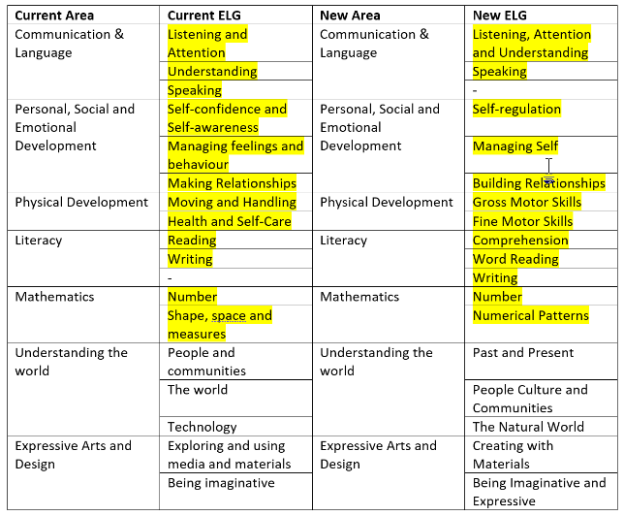
Areas of Learning…
Notes:
The specific areas are more specific skills which need to be learnt and practised over time through a range of experiences, through which the prime areas will also be strengthened and applied. The specific areas include essential skills and knowledge. They grow out of the prime areas, and provide important contexts for learning.

Slide 14
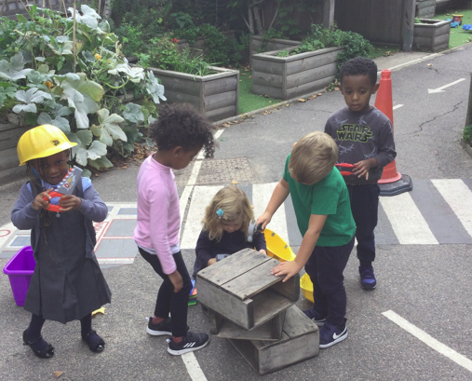
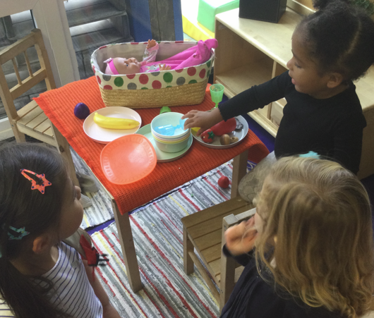
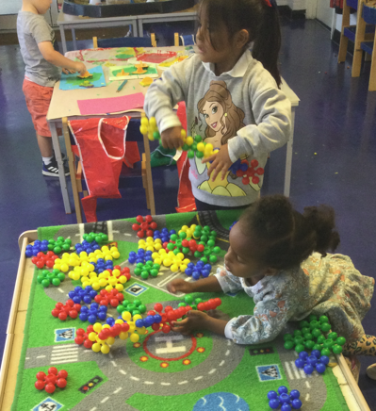
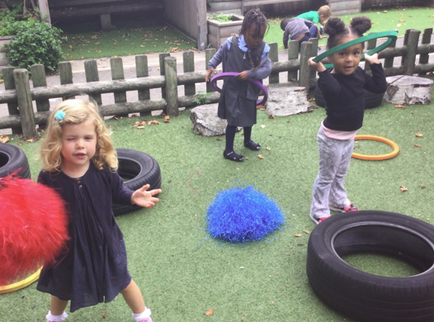
Children’s independent learning through play
Through careful observation we put things in place to develop children’s learning in the context of their interests.

Slide 15
Adult directed tasks
Based on child’s individual needs
Adult support and questioning extends learning
Planned using Topics
Incorporate children’s interests
Indoors and outdoors

Slide 16
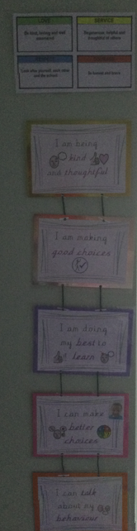
Behaviour chart
We have our own behaviour chart in EYFS and speak about the expectations in the classroom.

Slide 17
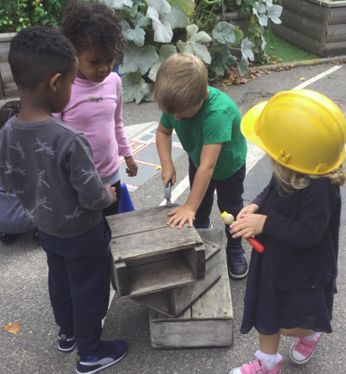
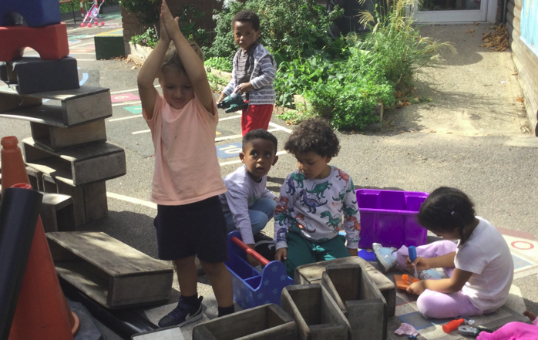
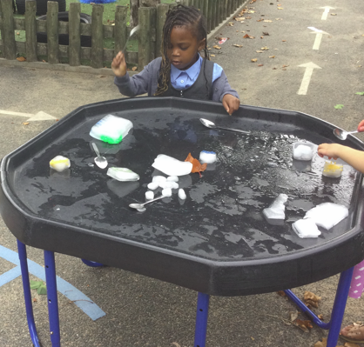
Outdoor learning
Has a positive impact on children’s sense of wellbeing and development
Provides opportunities for doing things in different ways and on a larger scale than indoors
Gives children first-hand contact with the weather, changing seasons and the natural world
Notes:
Outdoor environments offer children freedom to explore, use their senses, take risks and be physically active and exuberant. Outdoor learning is fun! Coats, warm weather gear, sunhats in the summer

Slide 18
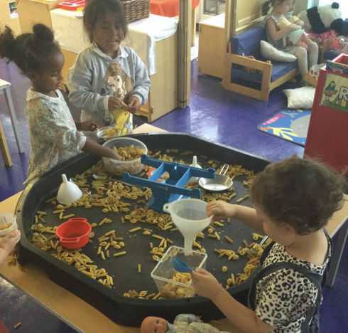
Nursery: Mathematical Development
Number
To count up to ten
Beginning to represent numbers using fingers, marks on paper or pictures
Numbers around the environment
Shape, space and measure
Use of mathematical language such as greater, smaller, heavier, lighter, more, less etc.
to develop skills in comparing and sorting objects
To develop understanding of shape and size including 2D and 3D shapes
Positional language- behind, next to, in front, on top, inside etc.
Notes:
Number:
Provide games and equipment that offer opportunities for counting, such as skittles
Support children’s developing understanding of abstraction by counting things that are not objects, such as hops, jumps, clicks or claps.
Encourage chn to show an interest in representing numbers
Plan to incorporate a mathematical component in areas such as the sand, water or other play areas
Shape, space and Measure:
Provide opportunities for children to measure time (sand timer), weight (balances) and length (standard and non-standard units
Measure for a purpose, such as finding out whether a teddy will fit in a bed.
Encourage children to talk about the shapes they see and use and how they are arranged and used in constructions
Play games involving children positioning themselves inside, behind, on top and so on.

Slide 19
Maths: Key strategies
Concept of counting relies on 1:1 correspondence
Develop reasoning: “How do you know that?”
Modelling vocabulary
Practical situations
Addition and subtraction development
Recording and representation in forms other than numerals

Slide 20
Nursery: Literacy expectations
Reading:
Has some favourite stories, rhymes, songs, poems or jingles
Joins in with repeated refrains and anticipates key events and phrases in rhymes and stories
Recognises familiar words and signs such as own name
Writing:
Mark making: sometimes gives meaning to marks as they draw and paint
Ascribes meaning to marks that they see in different places
Notes:
Nursery rhymes!!!!
Repeated refrains – going on a bear hunt, hungry caterpillar, brown bear brown bear what do you see etc
Mark making- paintbrushes, chalk, crayons, pencils

Slide 21
Reading in the EYFS
Story time
Puppet/role play
Environmental print
Shared reading using big books/online resources
Library time
1:1 Reading
Phonic sessions
Guided Reading
High Frequency Words (Word Wallet)
Reading Buddy

Slide 22
Writing in the EYFS
Independent writing for a range of purposes
Encouraging emergent writing and mark making
Shared writing
Adult directed writing tasks
Phonic sessions
Encouraging phonetic sounding out of words
☺ Letter formation
☺ High frequency words
☺ Support at home e.g. homework books in Reception

Slide 23
Nursery: What can you do to help your child’s learning?
Reading Books: 1 book to share every day – please record and comment in Reading Record (after half term)
Bedtime stories, sharing books, talking about the pictures
Encourage mark making, shopping lists, postcards etc.
Encourage children to talk
Practise counting at any time-climbing the stairs, shopping etc.
Play simple board games
Sing number rhymes and songs together

Slide 24
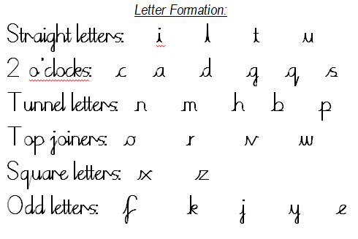
Handwriting – EYFS
Form lower-case letters correctly
Know and form capital letters
SJA website: handwriting, school script and rhymes

Slide 25
Handwriting Formation

Slide 26
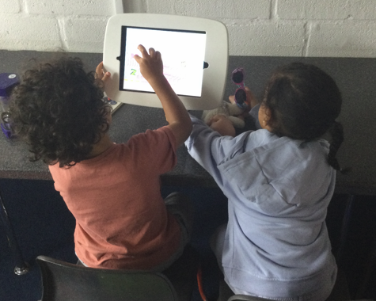
Learning Resources at home
Your child’s LGfL log-in will be send home
Access interactive resources across all areas of learning via free LGfL website

Slide 27
Other matters…
Please let us know if someone different is collecting your child or call the office!
Please ensure all clothing and water bottles are named
Please ensure you bring a spare set of clothes into nursery
Please assist your child in using cutlery independently to encourage them to eat during lunchtime
Please wear closed toe shoes to nursery and if you want you can bring a spare pair of wellies to leave in school
Notes:
Letter with highlighted missing/incorrect items

